Slide 1
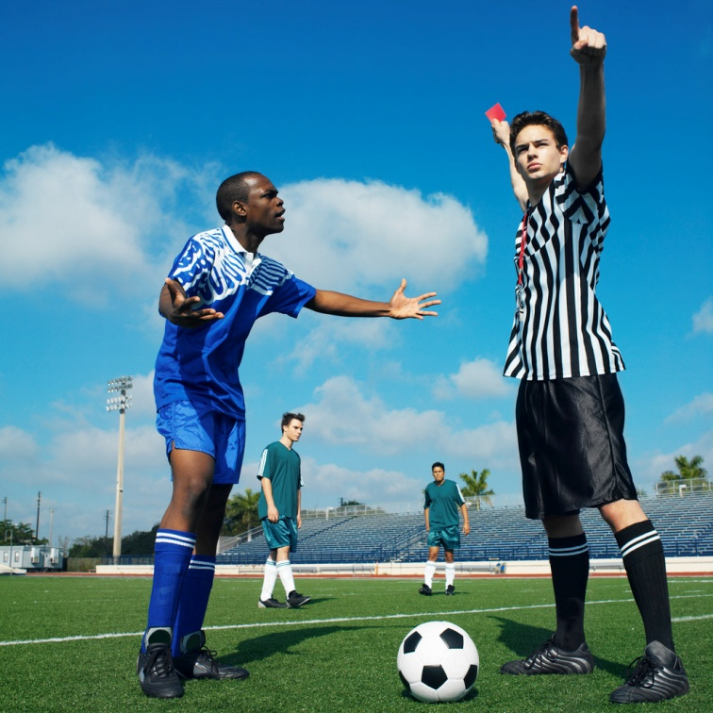
The CIVA FairPlay System
and ACRO contest software
F a i r P l a y
Why do we have it?
What does it do?
Pilots FP Score Sheets
Judges Ranking Index
Judge Analysis reports
Notes:
<number>

Slide 2
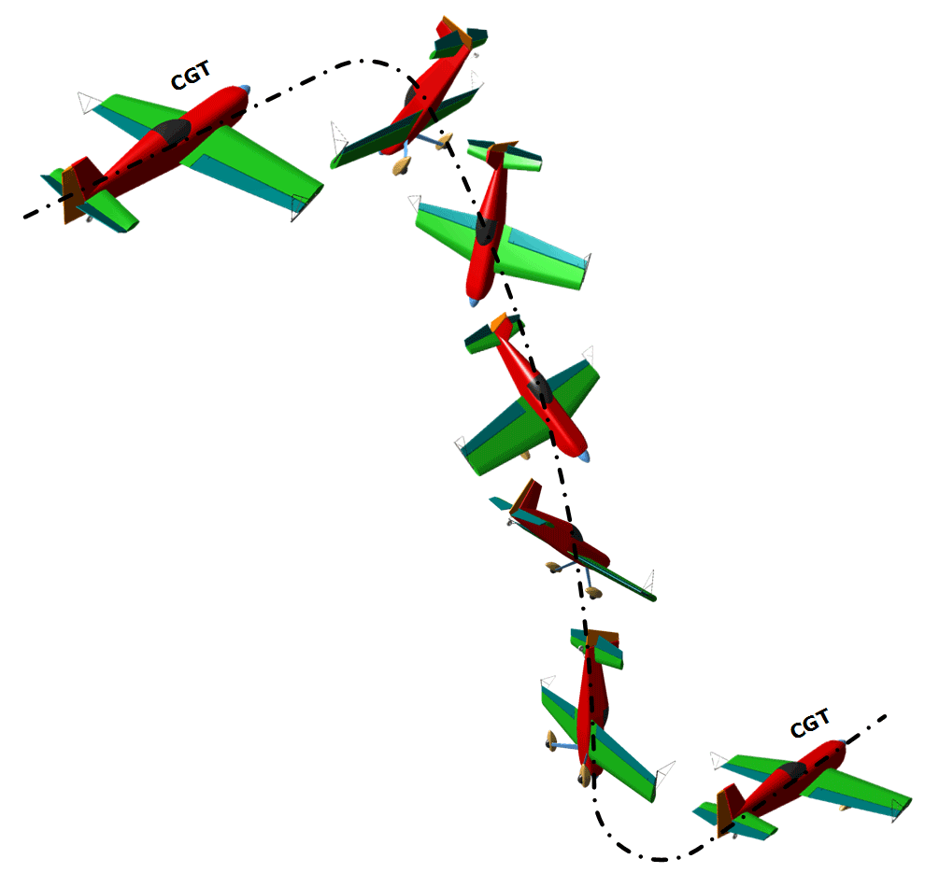

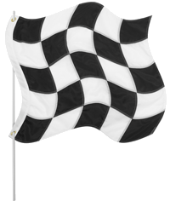
The
Basics
In most sports it is pretty easy to see who is the winner – it’s the person who gets to the finishing line before anyone else ….
However, in
some sports the
“performance”
of each athlete
must be expertly
Judged
Good examples are ice skating,
gymnastics, high-board diving, dressage, and …..
COMPETITION AEROBATIC FLYING

Slide 3

Practical marking of aerobatic figures
Figure geometry errors:
Normal marks. Judges add-up the downgrades they see and subtract the total from ten. This mark can be between 10.0 (perfect!) and 0.0 (the numeric zero)
Major errors:
The Hard Zero. If the figure flown is not the one specified on the judges Form-B or Form-C paperwork, then he should award an “HZ”
The Average:
If a judge can’t reach an appropriate mark for any reason, then he should ask for an average or “AV”

Slide 4
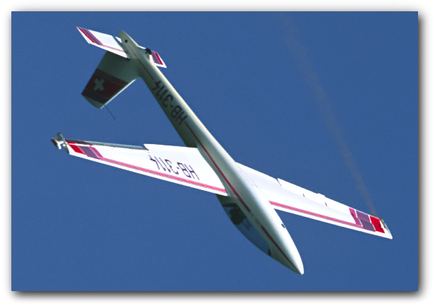
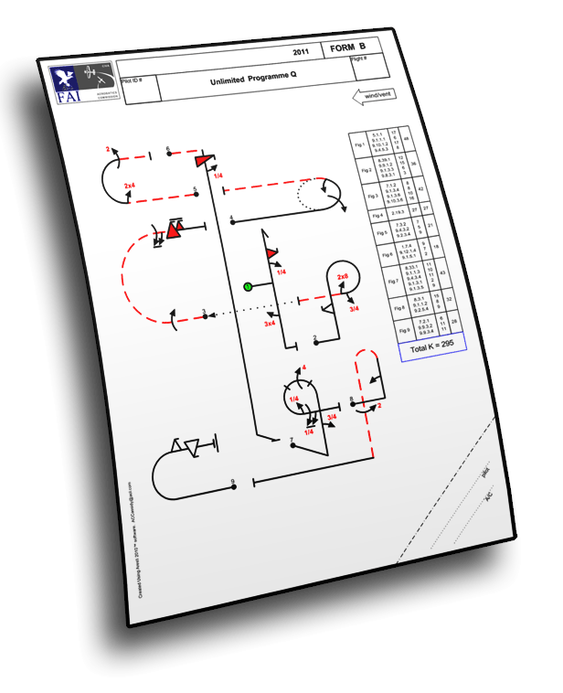
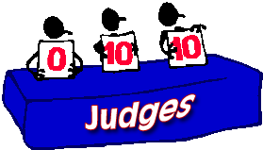
Opinions
In aerobatic sequences, judges use a complicated set of Rules to give their OPINIONS about key elements in each pilots flight
Even though we have strict
rules about how to judge,
because we are human all
judges can have slightly
different opinions about
exactly the same things
Most judges mark in a very similar way
However …..

We completely miss some little things …


We can concentrate on the detail and miss some big things …


And occasionally we make plain old mistakes …


Slide 5


Managing different opinions
Judges don’t all see the same things all the time
Style and unconscious bias are always present
Small differences between judges marks are OK
Major differences are problems that must be resolved in a sensitive and appropriate manner
Judging errors arise from:
Poor team work – Judge / Caller / Scribe
Failure to see critical details
Poor understanding or application of the rules
Pilots must get the benefit of any doubt!
If a judge gives a mark that is significantly different to the marks from the other judges, then it may simply be “wrong” and we should investigate it
7.5 7.0
8.0 4.5
9.0 8.5
Notes:
<number>

Slide 6

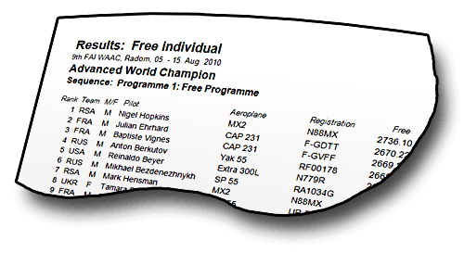
Influences on the Results
Every raw mark from every judge has the same power to influence the result, whether it is similar to or very different from the other judges marks
An experienced judge will see most of the pilots “errors” and
downgrade the marks more, with a consistent spread of grades
On the other hand, some judges do not see all the “errors” and
so they give less downgrades and are usually not as consistent
The simple way to calculate the final result is to add up all the marks and average them to remove the differences between the judges
Unfortunately ….
The sharper judges
who “see” more
errors and give the
pilots lower marks
will have less influence
Other judges who “miss”
downgrades and give
out higher marks will
normally have more influence in the Results

Slide 7



Can we test marks for “confidence”?
To be completely FAIR we need a way to check every mark so that we can identify judgements that are unusually different from other judges opinions
For each ‘unusual’ mark that we find we must:
Test to see whether it is acceptable or not, using a practical confidence check to compare it to the other judges marks
And - if it is proven to be unacceptable then:
We must remove the unacceptable mark and make a careful substitution that is in the style of that judge
The computer DOES NOT KNOW HOW TO JUDGE !
But it can compare each judge to the other judges, and the
FairPlay system can remove all anomalies from the final results

Slide 8


The CIVA FairPlay process
The FairPlay System is actually very simple
It follows the same set of simple steps that YOU would …. if only you could do the work fast enough with such a lot of information
Computers can do millions of sums very quickly and run statistical programmes that closely mimic the way humans think
So: Let the computer do all the hard work …
The key to FairPlay is . . .
It works on a figure by figure basis so that it only ever compares LIKE with LIKE. This is a major difference from the old TBLP process

Slide 9
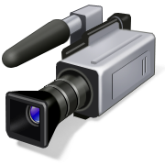

Before FairPlay starts:
Confirm or deny the Hard Zero’s – the “CHZ”
After each flight the judges decide whether any figures should be given a Hard Zero. This must be by majority agreement, and video may be used to help make the decision
On the Pilots Score Sheet:
Where a Hard Zero is agreed the Chief Judge confirms it :
► On the Flight Summary Sheet the figure is annotated “CHZ”.
► Other marks will be and are then called “Missing”
Where the majority of judges do not support the Hard Zero then:
► On the Flight Summary Sheet the figure is annotated “OK”.
► Judges HZ marks are and are then called “Missing”
boxed
boxed

Slide 10
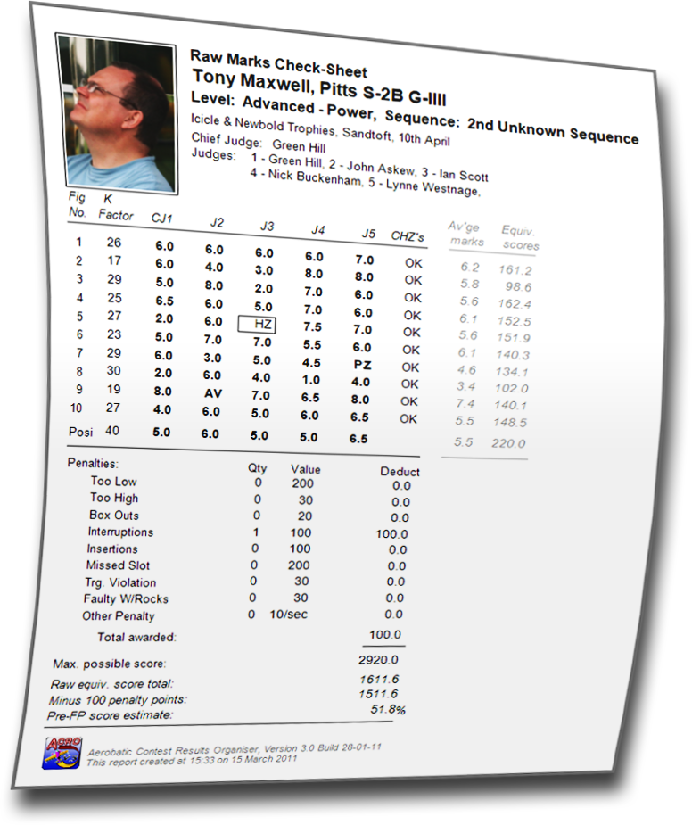
The Pilots Raw Marks Check Sheet
This sheet allows the pilot to check that the marks have been correctly entered into the scoring computer, and talk to his Team Manager if he wishes to consider a protest about any aspect of the data.
The “Equivalent scores” that are given here are simple calculations based on the Raw Marks. The FairPlay system has not yet been used.
These sheets are published on the web until the sequence is completed – they are then replaced by the Pilots FairPlay sheets and all scores are final

Slide 11
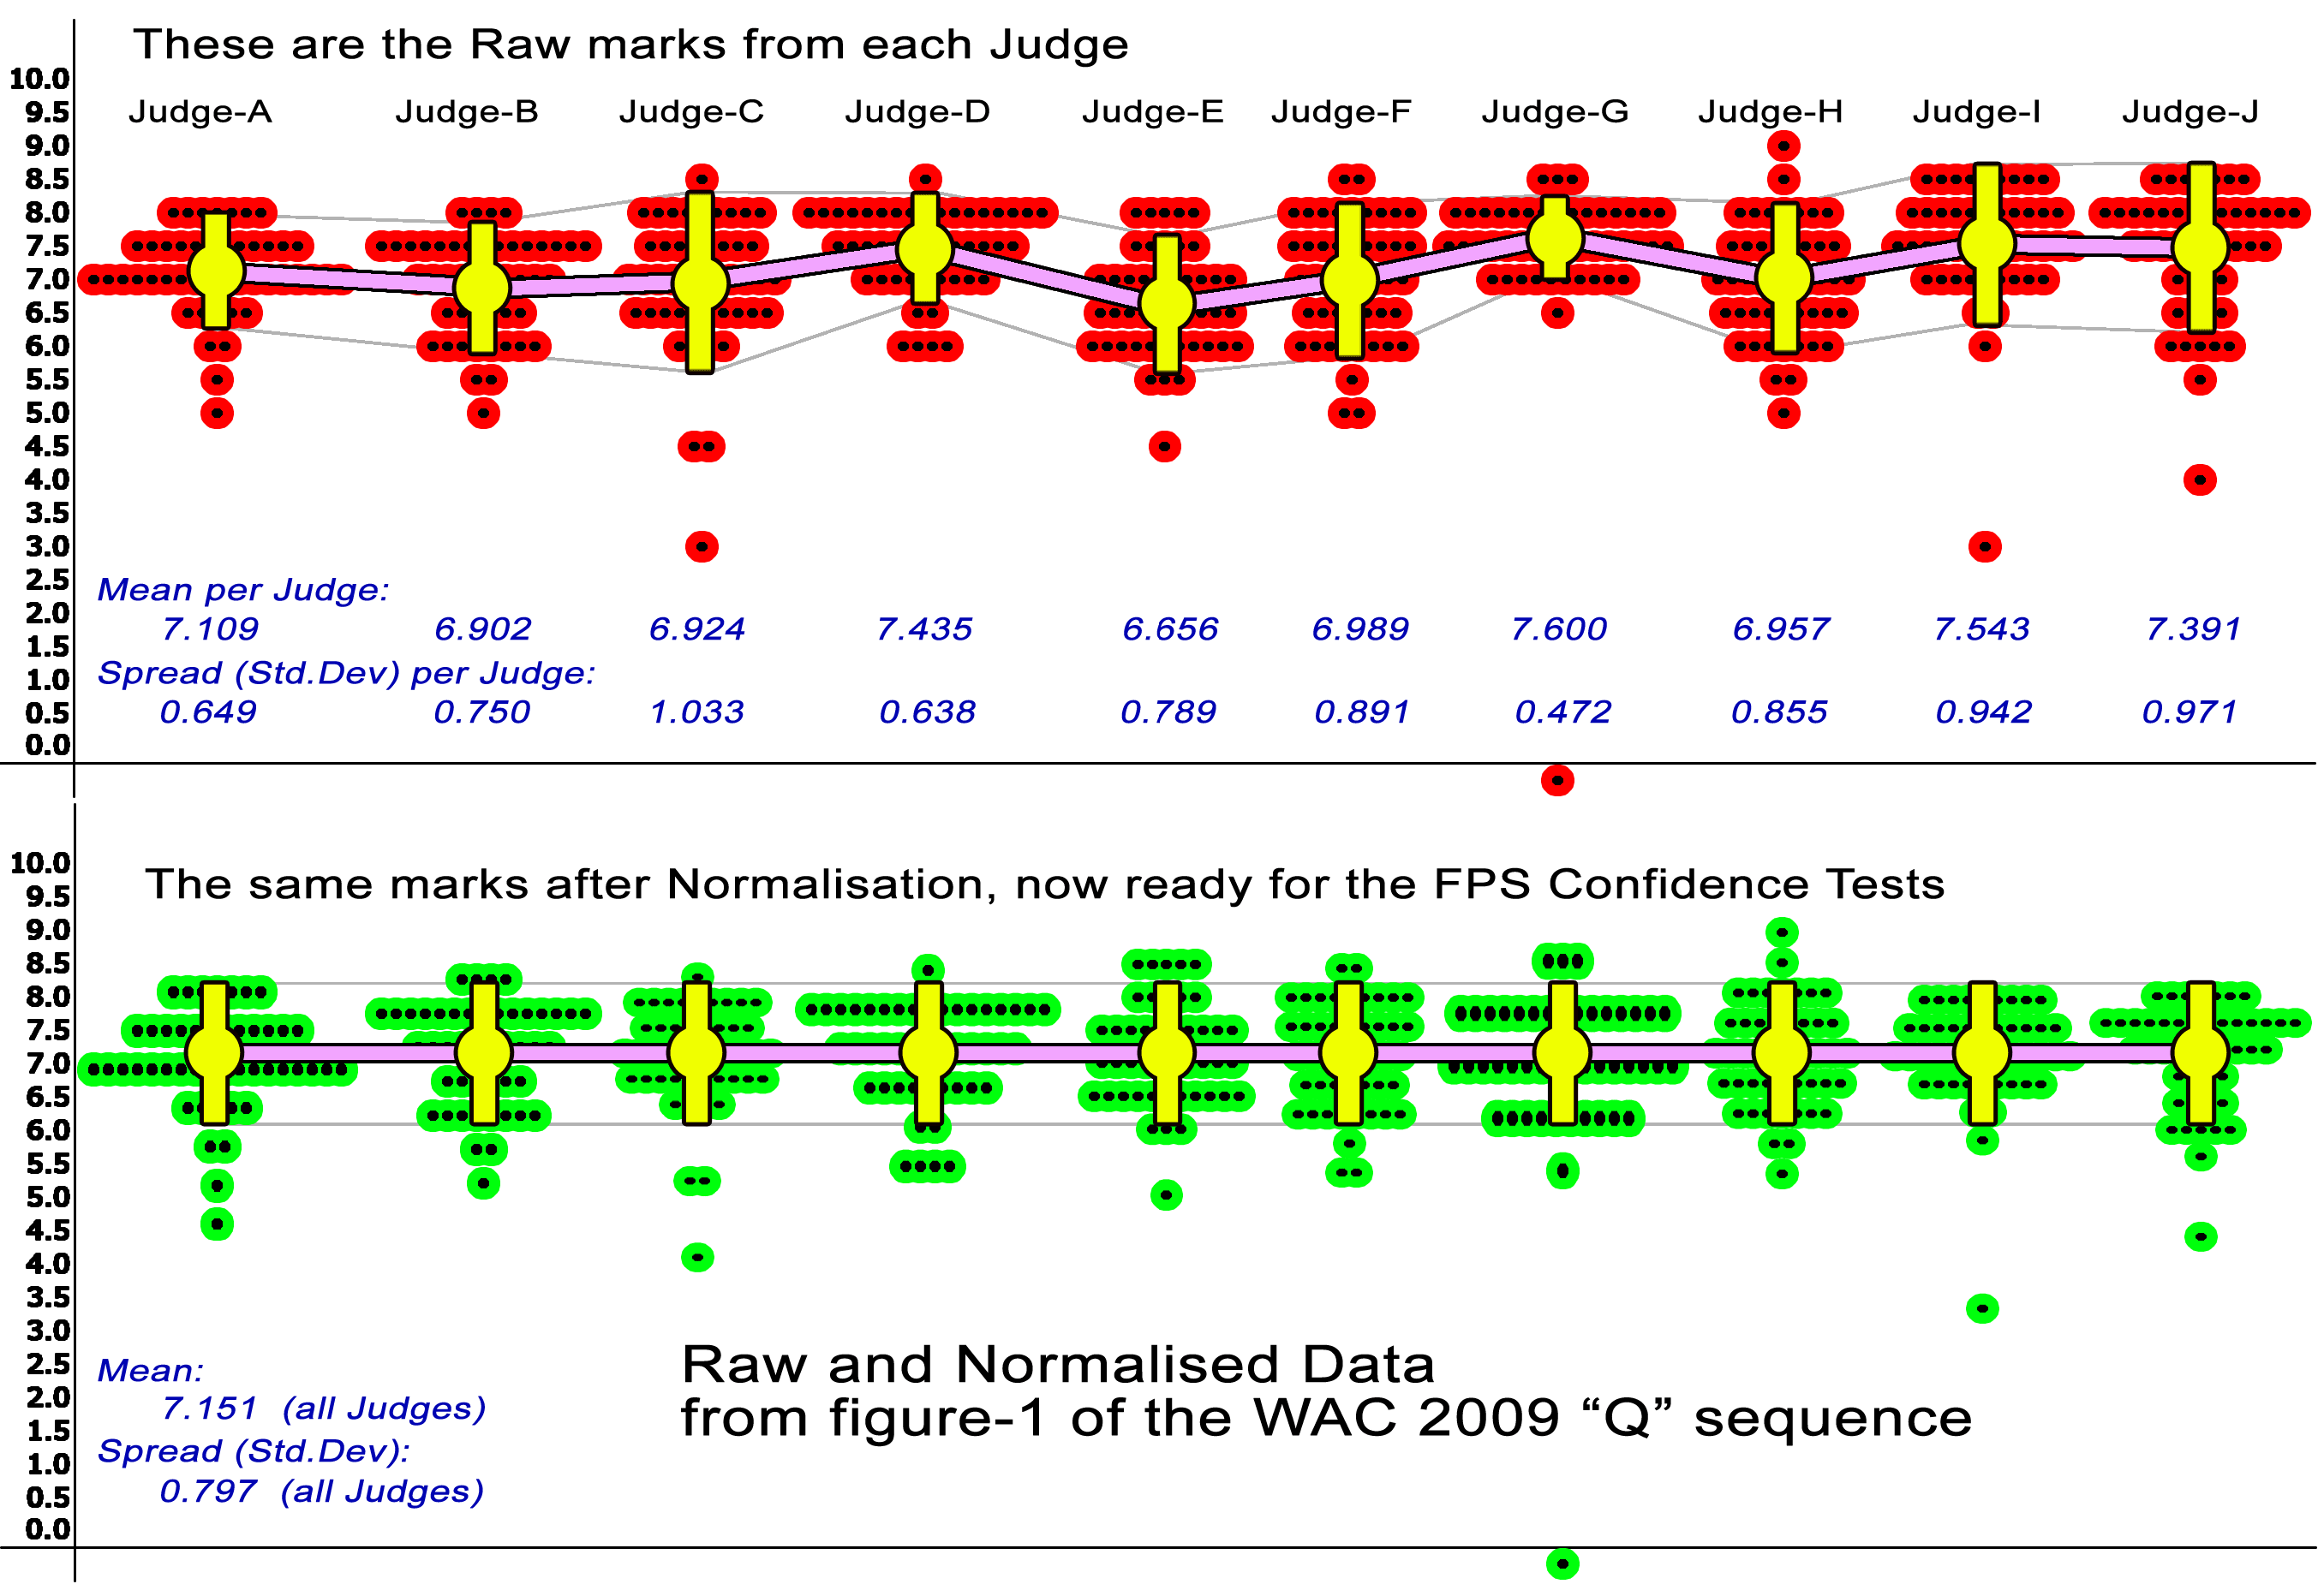
FP Step 1: Normalisation …. balance the judges output
We must adjust each judges set of figure marks so that they all have the same AVERAGE and SPREAD. This does not affect the pilot rankings
Only non-zero marks are normalised - HZ’s and Av’s are ignored

Slide 12
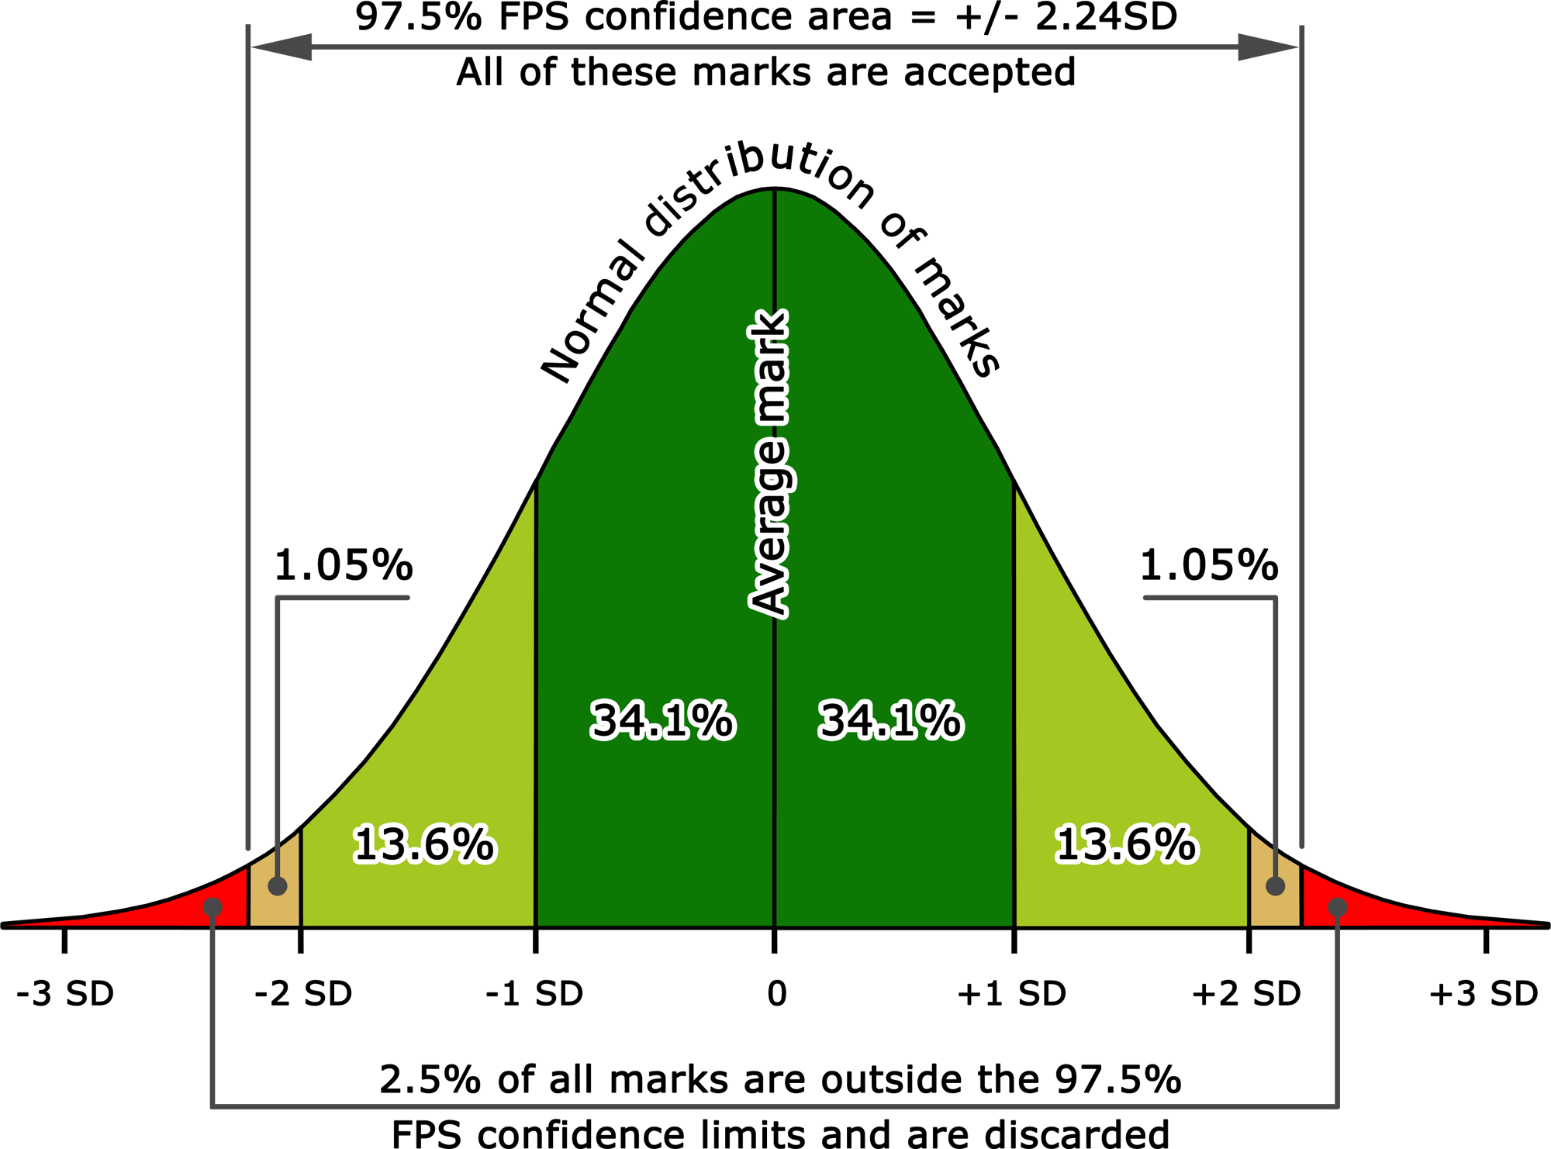
Information! The “normal” spread of figure marks
If we make a graph to show how the normalised marks for all pilots flying one figure compare, the distribution we should expect will look something like this:
Approximately 68% of the marks would be in the dark green area within one Standard Deviation (SD) of the average, a further 27% in the lighter green area would be within two SD’s, and so on to 100%
In FairPlay we accept all normalised marks within the central 97.5% confidence area. These marks are all within 2.24 SD’s from the overall average mark

Slide 13
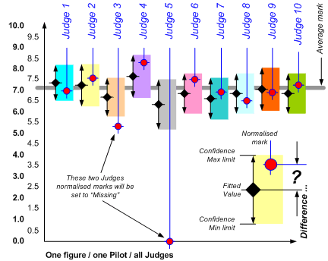
FP Step 2: The Confidence Test
Here we take each figure separately so that all comparisons are valid
For each Judge an ideal set of “Fitted Values” is calculated to match the Judge’s style, based on the spread of the judges normalised marks data
Every pilots normalised mark for this figure must now pass a Confidence Test, to see if it is close enough to the corresponding Fitted Value
Normalised marks that
fall within the confidence
limits remain unchanged
Normalised marks that
fail the test are rejected by
setting them to “Missing”
After this step we can be
confident that ALL of the
remaining marks are free
of detectable anomalies

Slide 14
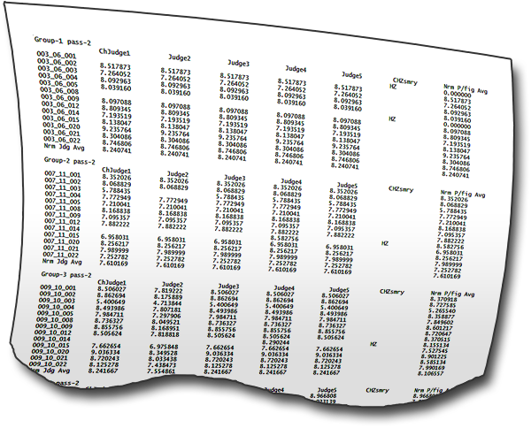
FP Step 3: Replace “Missing” marks that were rejected
Now that all the anomalies have been removed, FPS can make a new table of Fitted Values that is built from all of the remaining “good” data
In each “Missing” slot where an unacceptable mark was identified, FairPlay now substitutes a new
error-free Fitted Value in it’s place
On the Pilots FairPlay Check Sheet the rejected mark will be shown in red and the Fitted Value that replaces it will be below it in black
Lo 6.261
7.724
At the conclusion of this step we can be confident
that in every figure no mark is unusually different
from the other judges marks, and that the majority
view of the Judging Panel has been carefully used to
give every Pilot a fair and balanced result

Slide 15
FP Step 4: Calculate the preliminary FPS scores
Here the final FPS marks for each judge are multiplied by the figure
K-factors, and a preliminary set of scores is calculated for each pilot
For example:
Judge 1 Judge 2 Judge 3 Judge 4
Pilot 1 1692.98369 16529.4723 1593.56274 1785.28452
Pilot 2 1681.48956 16486.9437 1628.40021 1709.03743
Pilot 3 1704.42793 17109.3749 1680.28642 1599.28754
etc …..
Of course … all the scores from each judge will be slightly different for each pilot, and now we must check between all the judges for undue
“BIAS”

Slide 16
FP Step 5: Testing for BIAS ….
Blonde …
Bias is a human characteristic that is impossible to avoid. It affects every aspect of our lives, and it makes us all different
Redhead …
Brunette …
Silver …
It is not possible for judges to avoid some degree of bias in their marks, regardless of whether this is conscious or totally unconscious
In aerobatic judging we test for undue bias, and any that is above a pre-set confidence level is removed
The final step in FairPlay is to normalise the judges scores, and
run another Confidence Test (this time at 90.0% = 1.65 SD limits)
Any undue bias that is found is resolved by setting the score to Missing and subsequently replacing it as usual with a Fitted Value
These final scores are now free of all anomalies and, after deduction of penalties, are used to create the final contest results

Slide 17
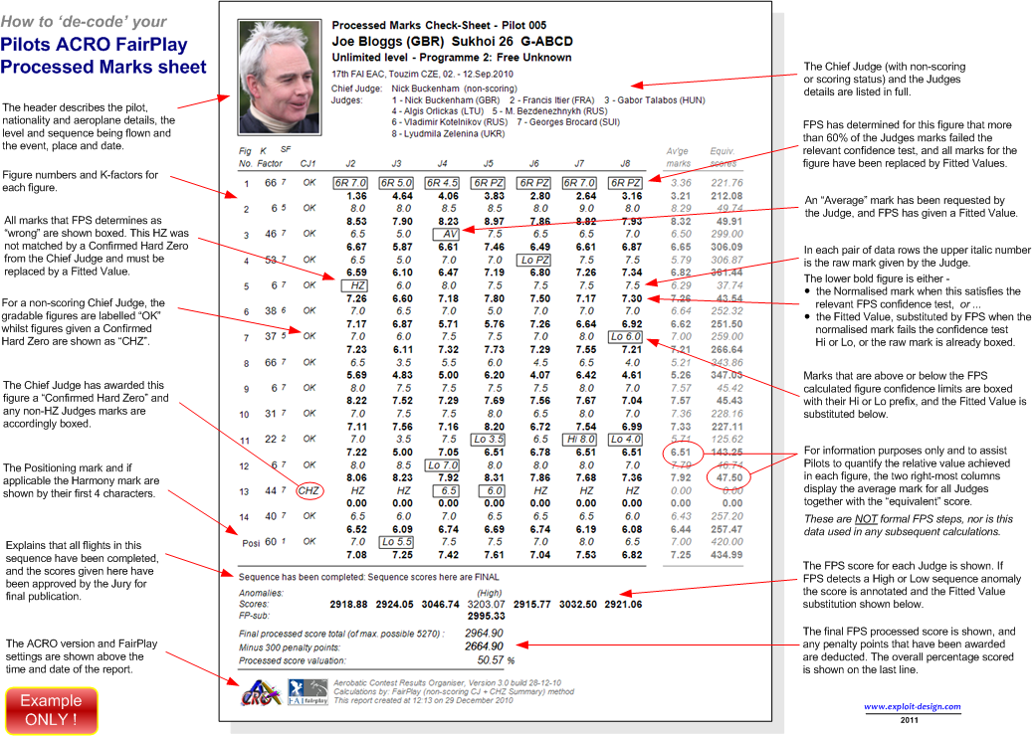
Notes:
<number>

Slide 18
FairPlay and the RI: The Judges Ranking Index
After FairPlay has run we can compare how each judges Raw Marks would have ranked the pilots, as though the judge was working alone.
The Judges Ranking Index is calculated by comparing each judges “Raw” rank order of pilots with the final FairPlay results. The RI is zero if the judge puts the pilots in exactly the same order as FPS, but gets bigger as the judges ranking of pilots becomes increasingly different to the FPS results. The RI is also increased where the judges score varies more from the FPS score ….
An RI less than 15 is quite good, between 15 and 25 indicates that the judge is more different from the other judges, and over 25 then the judge should seek advice from the Chief Judge to see if some further help may be required
To achieve a good RI you must simply get your scores for
each pilot reasonably close to the overall final FPS results
AND FINALLY: CIVA sorts the judges RI’s LOW to HIGH to create a list of average Judge Rank Positions – the JRP.
These provide a useful ranking that shows how well each judge has matched the final results at every championship. The JRP list is used by the CIVA Judging Committee as a helpful guide during the next year’s judge selections.
JRP = 3.67

Slide 19

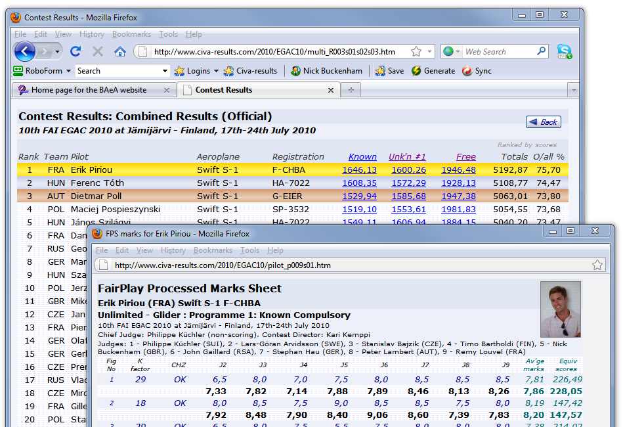
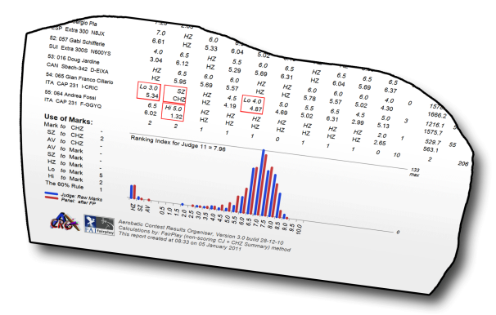
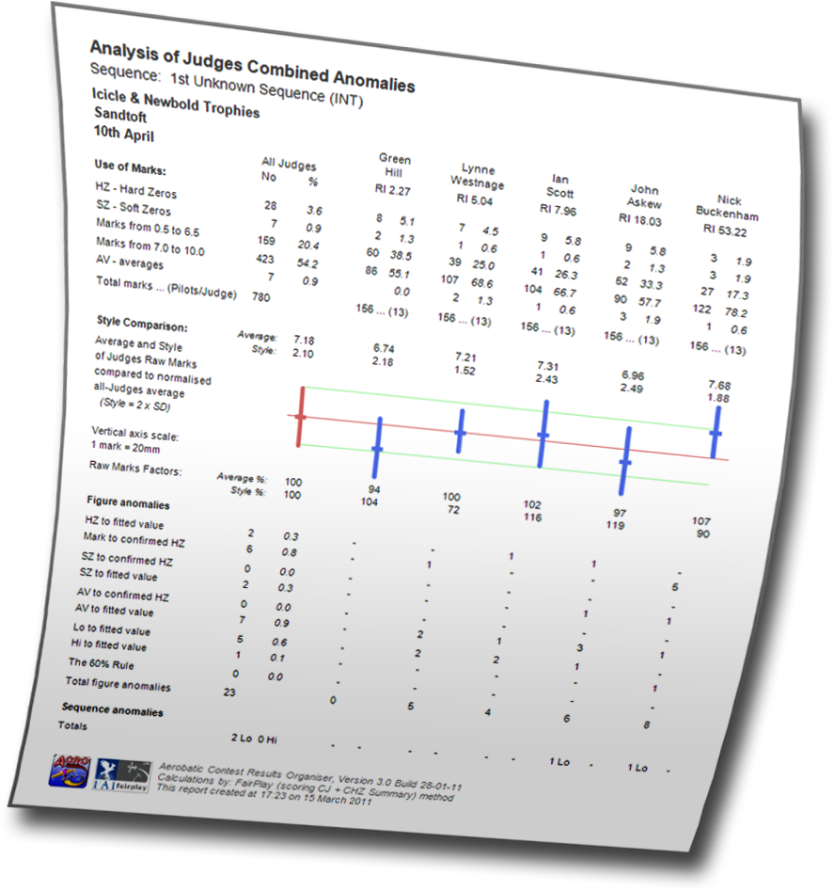
ACRO
also provides . . .
For Pilots:
A completely open web-based review of all Raw and FairPlay sequence marks and scores for everyone to see, compare, discuss, analyse . . .
For each Judge:
A fully detailed comparative analysis for every sequence that shows where the judge differs from his colleagues
For the Chief Judge:
An overall analysis that summarises and compares each member of the Judging Panel, and shows national influences
Notes:
<number>

Slide 20
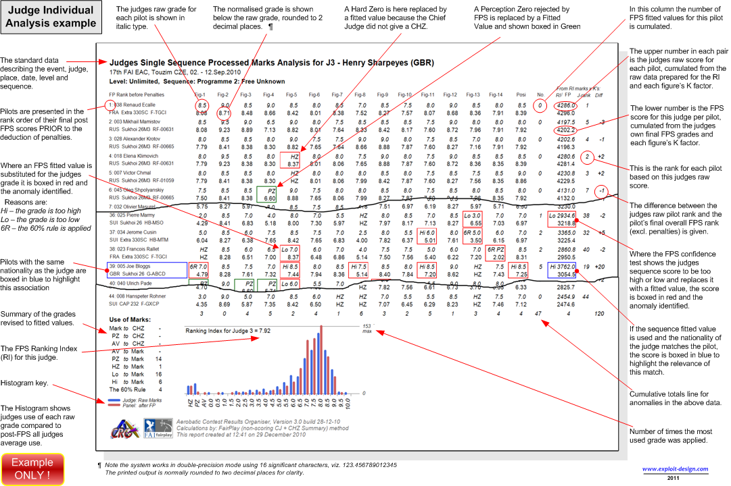
Notes:
<number>

Slide 21
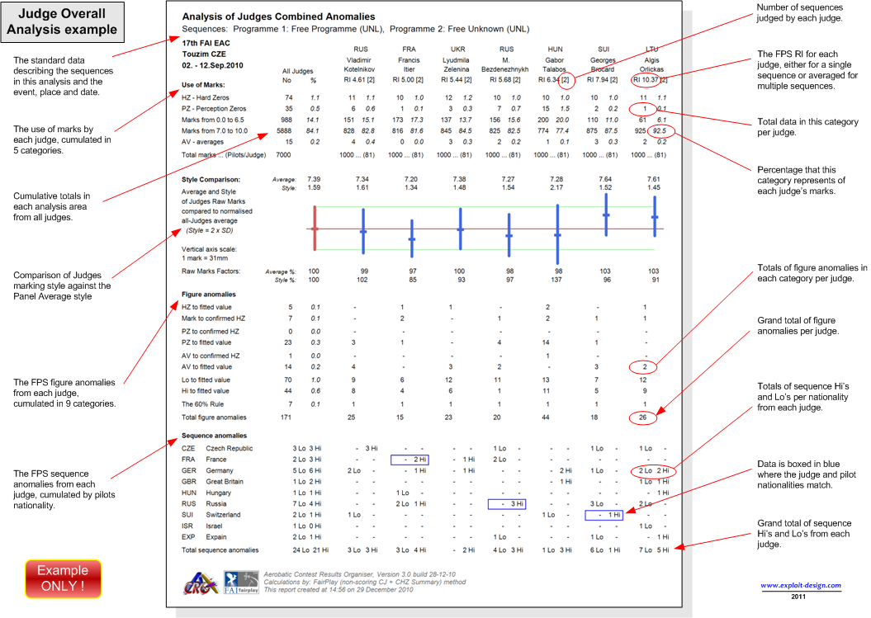
Notes:
<number>

Slide 22
The CIVA FairPlay System is used
in the ‘ACRO’ contest software
On the internet go to:
https://www.acro-online.net/
You can download the ACRO software, and run it on your own Windows computer. You also have full access to an extensive archive of past national and international contest files.
The website includes copies of all the Pilot and Judge Analysis explanations, together with a detailed description of the complete FairPlay Statistical Analysis system.
To see ACRO’s results output in action at CIVA events go to:
www.civa-results.com
NHB
January 2026
Notes:
<number>

