Slide 1
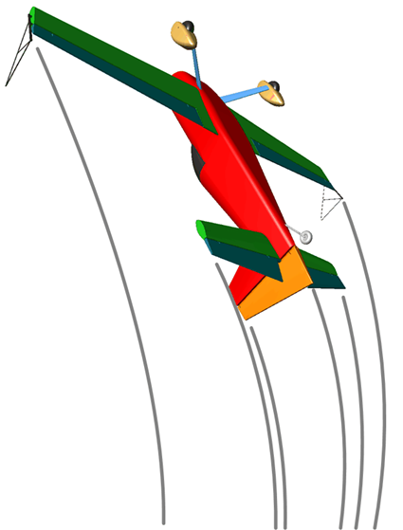

A Quick Zoom through the Rules
● Centre of Gravity Track
● Zero Lift Axis
● When to use each one ?
● The “Box”
● Wing Rocks
● Steep / Shallow, Neg & Pos
● Basics Rules of Judging
● Turns
● Slow Rolls
● Flick Rolls
● Spins
● Loops and Eights
● Stall Turns
● Humpty Bumps
● Tail Slides
● Rolling Circles
● Positioning mark
● Handling the major errors

Slide 2
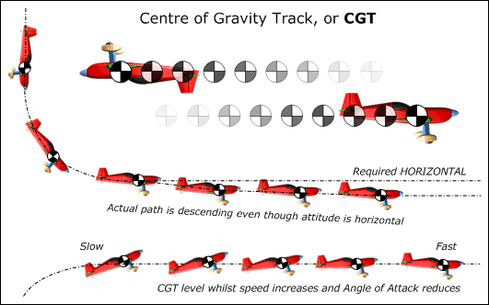
Centre of Gravity Track (CGT)
The Centre of Gravity Track (also called the Flight Path) is the imaginary line that the aircraft centre of gravity draws as it flies along.
Imagine the aeroplane condensed into a dot, and watch the path that the dot takes through the sky. This is the CGT or if you prefer the Flight Path, the Track of the aeroplanes' Centre of Gravity.
To judge the flight path, compare the CGT against the horizon or the box 'A' or 'B' axes.
Example 1
The aeroplane is required to transit from a vertical down-line to horizontal flight. Although the ZLA (the Zero Lift Axis, explained in the next slide) remains horizontal after the 90° corner has been completed, the CGT will in reality continue to descend a little below the required horizontal line.
Example 2
Here the transit is from a vertical up-line to normal horizontal flight. The CGT must remain in a level horizontal line, whilst the aircraft speed will increase from very slow and the angle of attack reduces accordingly.
CGT and Angle of Attack
Judges must always look at the CGT or Flight Path and not be "fooled" by a high angle of attack at low speed – this can be particularly noticeable when the aeroplane is inverted, as with most aircraft the nose will appear unnaturally high with the ZLA pointing upwards.

Slide 3
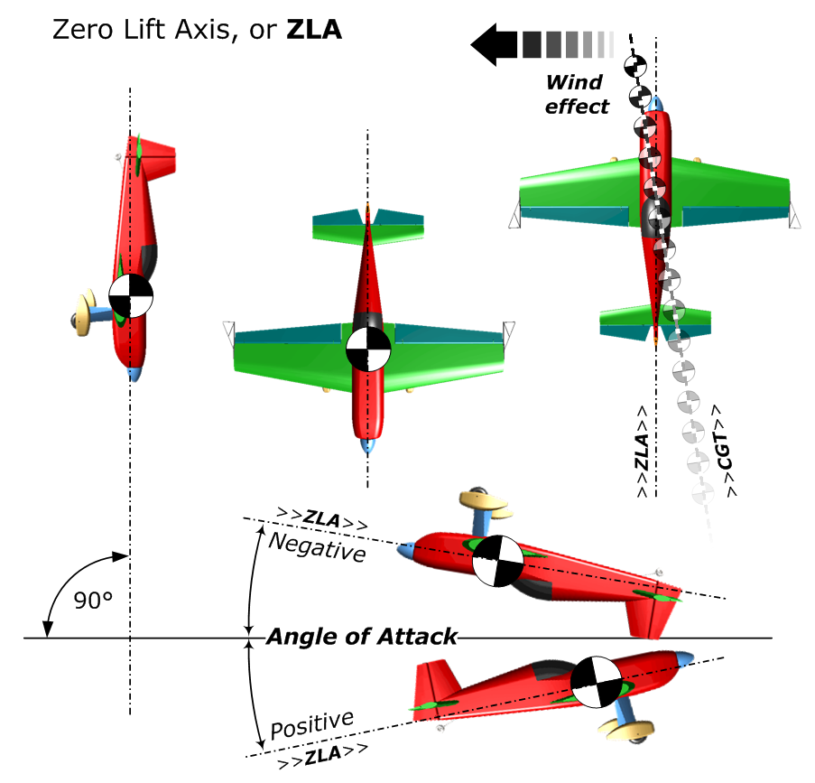
Zero Lift Axis (ZLA)
The "Zero Lift Axis" of an aircraft is purely a function of its shape and aerodynamic qualities.
When flying a true vertical line in still air, the ZLA will be exactly perpendicular to the ground.
In the left and centre sketches the aeroplane is flying vertically downwards with its ZLA through the main axis.
The sketch on the far right shows that the CGT can be different to the ZLA because of the wind.
On all 45° and vertical lines we use the ZLA to tell us how accurately the aircraft is flying the figure.
Note again that in level CGT flight the wing must have a positive or negative Angle of Attack relative to the airflow to keep the aircraft flying. Don’t be fooled into thinking that the Flight Path is incorrect.

Slide 4
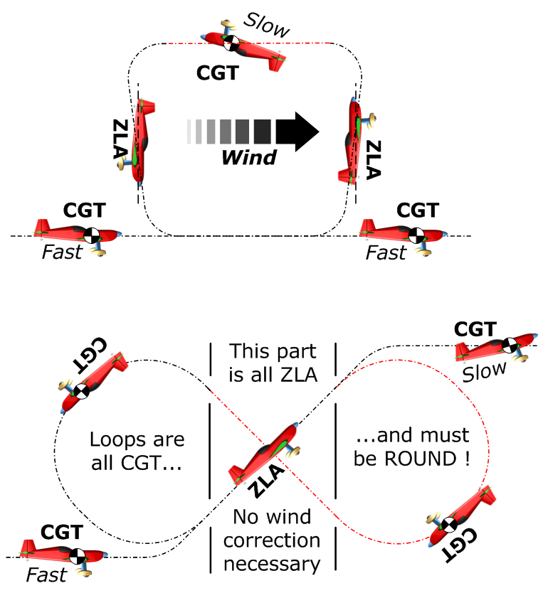
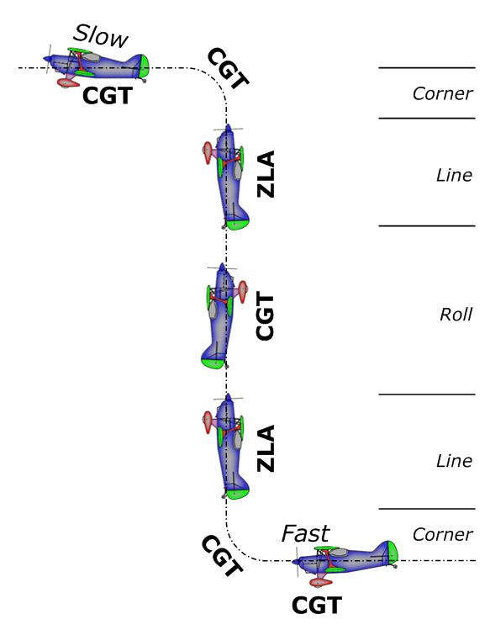
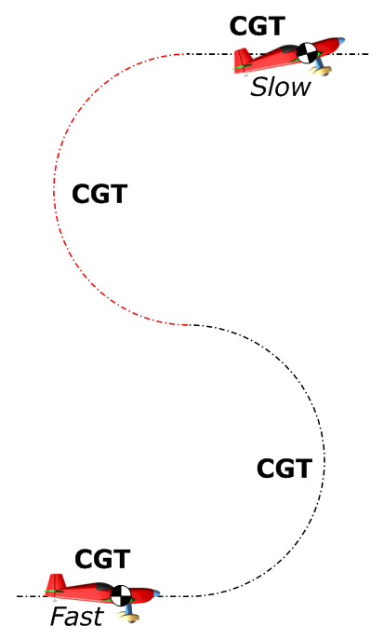
When should we use CGT
and when should we use ZLA?
In horizontal lines or curving, rotating or rolling manoeuvres –
use CENTRE OF GRAVITY TRACK (CGT). This is the Flight Path of the aeroplane.
When we are judging vertical or 45° lines up or down –
use the ZERO LIFT AXIS (ZLA). This is the neutral centre line through the plane.

Slide 5
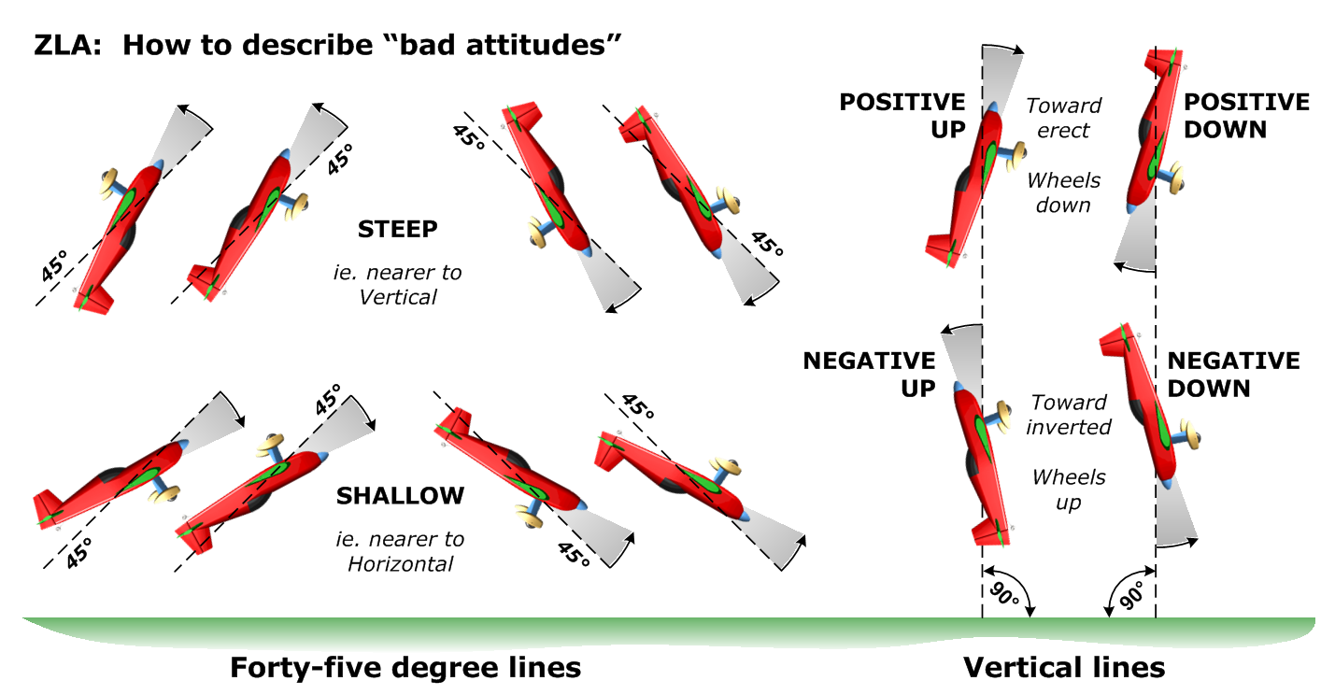
Steep or Shallow ….
Negative or Positive

Slide 6
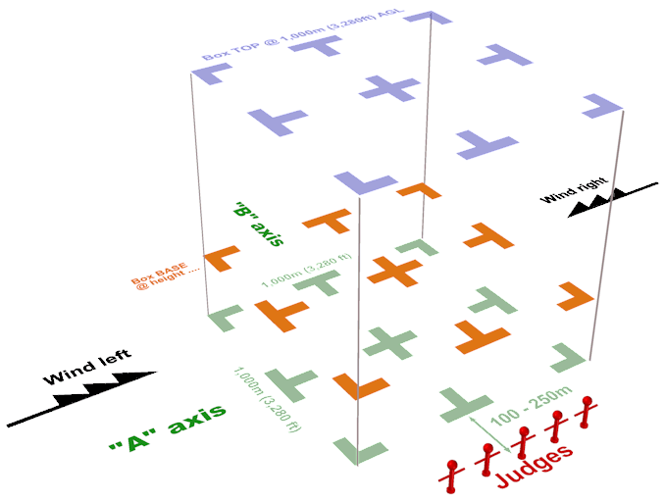
The Aerobatic Performance Zone
The “box” is the 1,000m cube of airspace within which all competition aerobatic flights are executed.
The ‘Official Wind’ defines the main box axis
The main box centre-line is shown here as the “A” axis
The cross box centre-line is shown here as the “B” axis
Judges sit between 150 and 250m from the box edge
The official or contest wind is declared to be either from the left or the right, always along the “A” axis
Figures must be flown in the correct direction
on the main or “A” axis
Figures can be flown either toward or away from
the judges on the secondary or “B” axis
The minimum operating height
depends on the category:
100m - power Unlimited
200m - power Advanced
- glider Unlimited and Advanced
300m - power Sports and Intermediate
- glider Sports and Intermediate
450m - power and glider Club

Slide 7
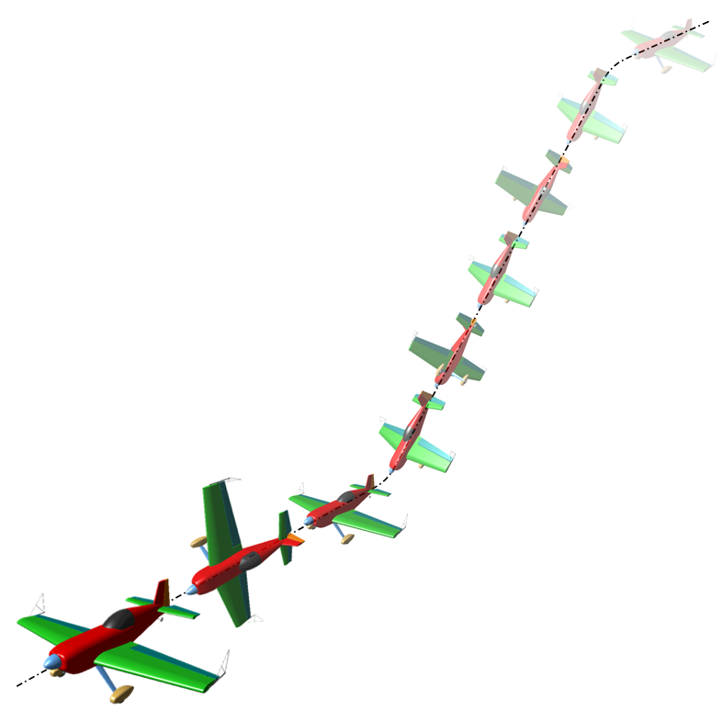
Wing Rocks
For Power only ...
BEFORE the sequence starts:
● There should be THREE consecutive Wing Rocks
● They can start and/or finish inside or outside the box
● Each one should reach at least 45° of roll
● They must be done along the initial sequence axis
● Climbing or diving at up to 90° is allowed
● From a 90° climb an erect or inverted exit is OK
● If not climbing at 90° then for an inverted start
all wing rocks must be completed while inverted
To signify an Interruption or Break:
We need to see THREE Wing Rocks
To restart after a Break:
It’s the SAME process as the very start
If there was no prior direction error then
the pre-break direction MUST be resumed
If there was a direction error immediately before
the break then the restart direction can be
different to that before the break

Slide 8
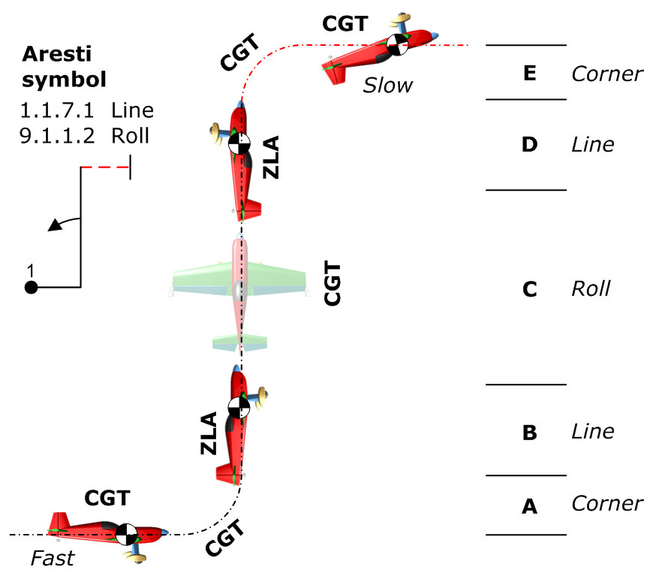
The Basic Rules of Judging
Every figure starts with a potential 'perfect' mark or grade of 10 points
The basic judging rule is : an error of 5° equals a 1 point downgrade
Deduct whole or half points to get your personal final mark for each figure
Radii 'A' and 'E' need not be the same,
but 'E' is flown much more slowly.
Lines 'B' and 'D' must be the same length.
For a 2/1 ratio : deduct 2 marks
For a 3/1 ratio : deduct 3 marks
No line at all : deduct 4 marks
For example:
If the aircraft starts the figure climbing at 5°, no yaw and between 5° and 10° of bank
During the figure is pitched OK but yawed 5° and rolled 10° off axis at a key point
The figure ends with 5° of yaw, between 0° and 5° nose-down and no bank angle
The result is: 10 points - 1 - 0 - 1.5 ... - 0 - 1 - 2 ... - 1 - 0.5 - 0 = 3.0 marks for the figure
This is a FAULT driven process - you are not marking "Goodness" !

Slide 9
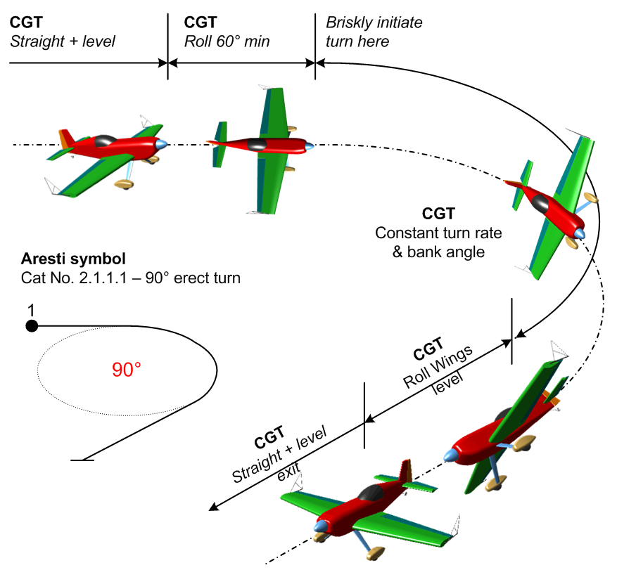
Turns
This is NOT a ‘PPL’ turn – think more of a “jerky marionette”
Types:
Turns can be either erect or inverted
Amounts are 90°, 180°, 270° and 360°
Actions:
Roll to at least 60° of bank (gliders exactly 60°)
Turn at a constant rate through the required angle
Maintain turn rate and altitude
Stop exactly on heading, then
Roll back to wings-level
Not judged:
The shape of the turn (no wind correction)
The size of the turn

Slide 10
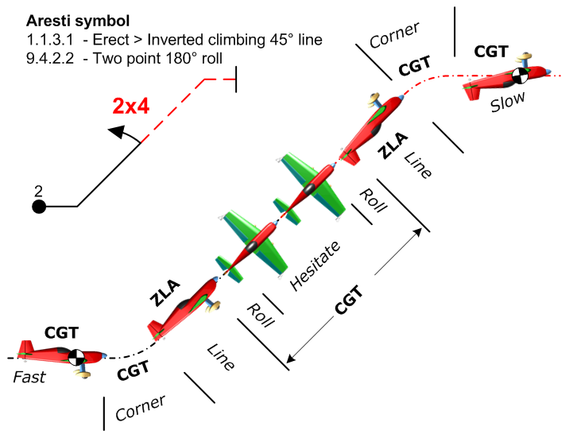
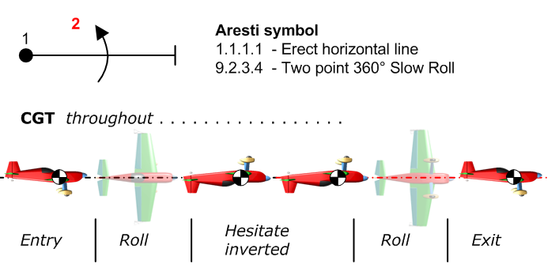
Slow Rolls
Slow rolls, many of which include hesitations, are sometimes called aileron rolls to distinguish them from flick or snap rolls.
In a slow roll the rotation is primarily driven by aileron action, whereas a flick roll combines yaw and pitch inputs to cause rapid 'auto-rotation'.
Many variations of slow rolls are used in a great variety of figures, often preceded and followed by lines which must be judged for CGT (where horizontal) or ZLA (where at 45° or in the vertical) and also for comparative length.

Slide 11
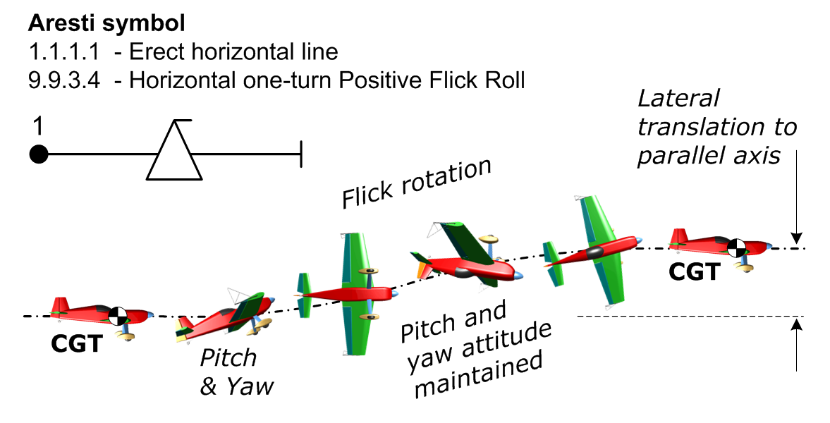
Flick or Snap Rolls
Flick rolls are initiated by rapid pitch and yaw control inputs, which cause one wing to stall while the other one continues to fly. This leads immediately to very high acceleration in roll.
This abrupt high energy translation makes the manoeuvre hard to study and hence difficult to judge accurately. Flicks are over very quickly – it helps to watch how the tail moves throughout.
Flick-rolls happen so quickly it is your subjective 'perception' as to whether the pitch and yaw have –
caused auto-rotation
stayed there during the roll
been removed to stop it
If you are not convinced that the aeroplane “flicked” or “snapped”, i.e. there was no auto-rotation, then you must apply a 4-point downgrade and carry on marking the rest of the figure in the normal way.

Slide 12
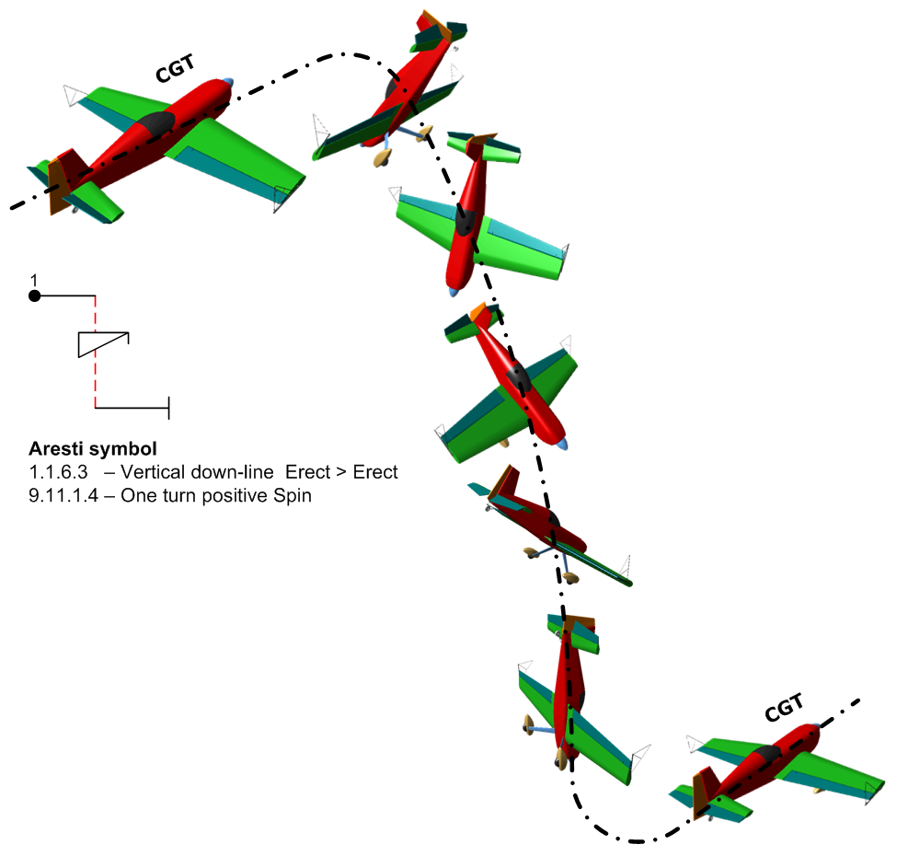
Spins
The ‘competition’ spin must display these characteristics –
A clean initial stall on-heading in level CGT flight, leading to
An immediate combination of nose drop + wing drop + and yaw into true auto-rotation
The auto-rotation must stop on the correct heading
We must then see rapid translation to a vertical ZLA line, and after a SHORT pause there may be a following roll
Finally a smooth radius pull or push to … (level flight exit, remainder of figure etc.)
If you are not convinced that there was a genuine stall leading to the combined wing-drop and auto-rotation then you must apply a 4-point downgrade and carry on marking the rest of the figure.

Slide 13
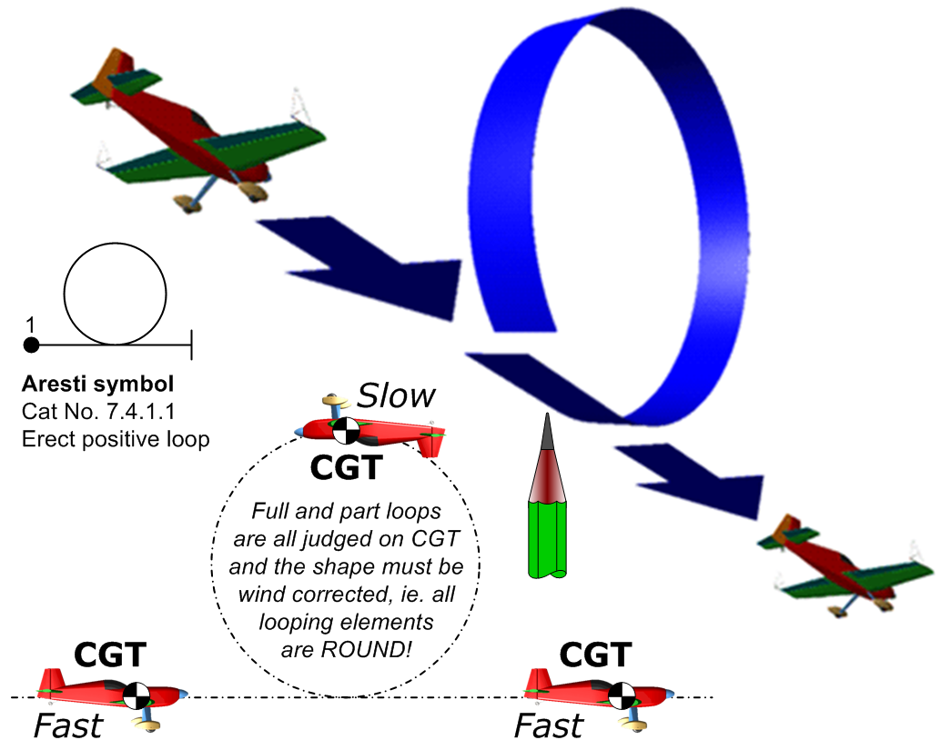
Loops and Eights
A partial or complete loop takes place when the aeroplane pitches through at least 45° without roll or yaw, either in positive (pull) or negative (push) flight.
Looping segments are always judged on CGT or flight path - never on ZLA.
The shape of loops, eights and vertical S's are always wind corrected, their elements must be accurate and 'round'.
In a simple loop (see right) the end point should be exactly where the loop started, both horizontally and vertically.
Hold up your finger, a pencil or pen to keep track of this important position.
Unless you have an easy-to-apply method they can be quite difficult to judge

Slide 14
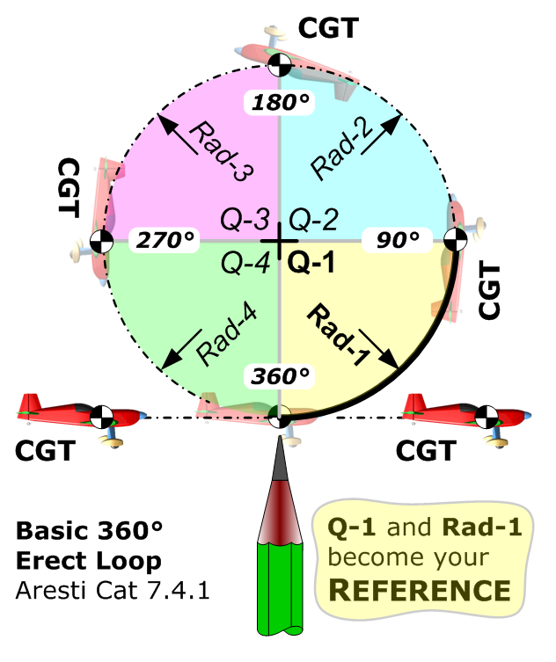
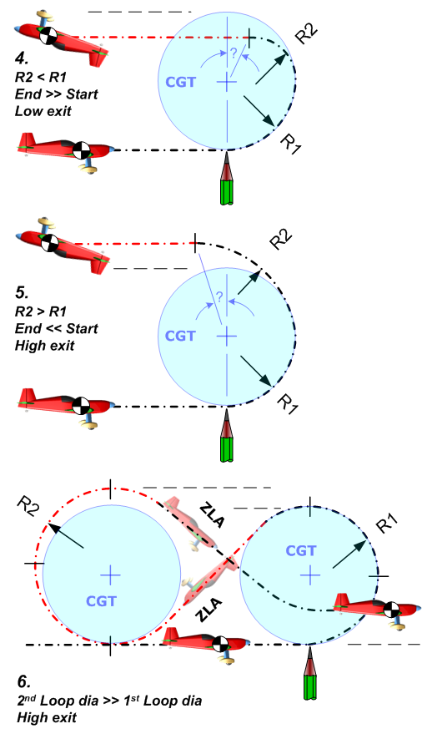
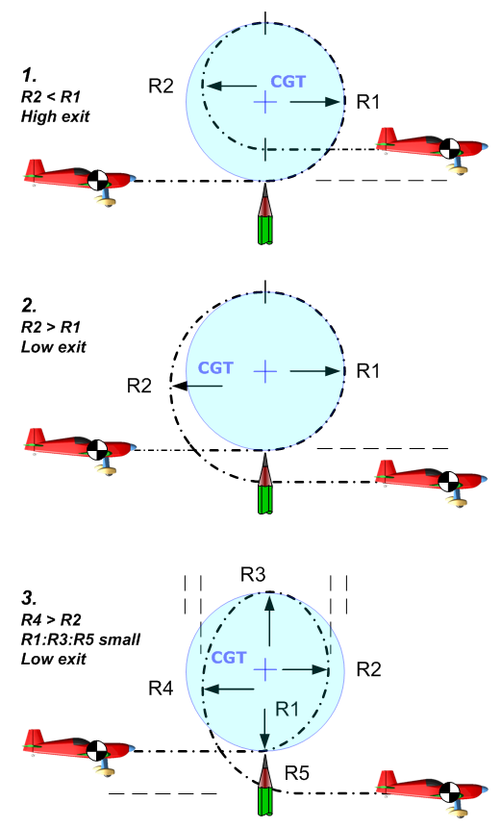
Judging loop shapes
The exit point should be at exactly the same level as the entry point.
The four quadrant radii and centre points are all exactly the same.
The centre-top point is exactly above the start point.
Wherever you see these 3 'truths' you can be sure that the loop is round.

Slide 15
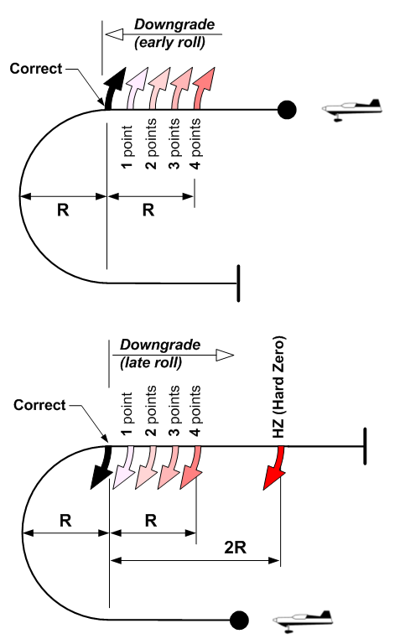
Half-loops with Rolls
When a half-loop upwards or downwards has some rolling at the start or end of the looping segment, there must be NO horizontal line between the rolls and the looping arc.
Fix in your memory the RADIUS of the looping arc while it is being flown:
Where no line is drawn between the arc and the roll there is no downgrade to apply.
If you see any line AT ALL then at least a one point downgrade must be applied.
As the length of this unwanted line increases but remains less than the radius of the half-loop, two to three points should be deducted.
If the length of the line is as long or is longer than the half-loop radius you must award a four point downgrade to the figure.
If the roll is at the END of the figure and the length of the line flown between the half-loop and the roll reaches two times the radius then you must apply a HZ (Hard Zero) to the whole figure and state “Wrong Figure” on the sheet.

Slide 16
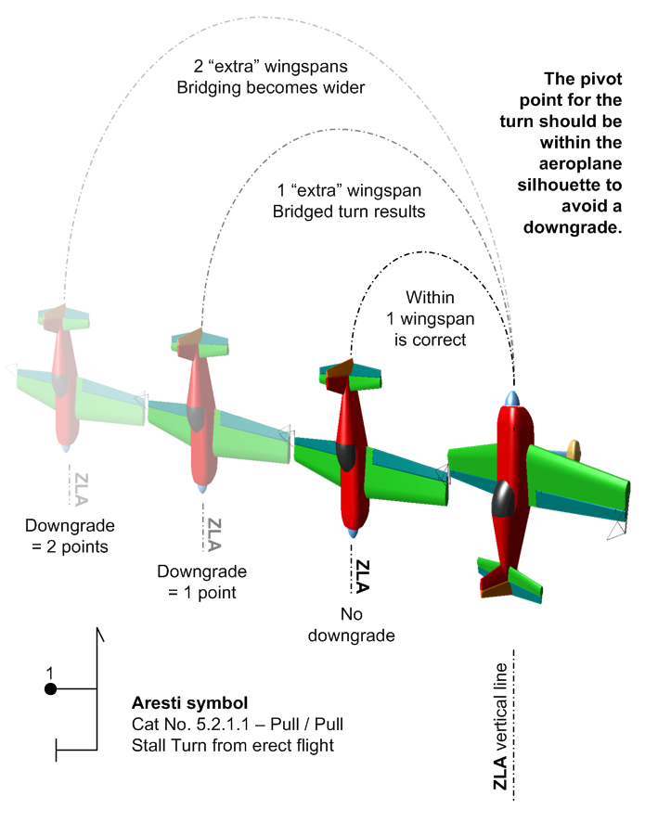
Stall Turns or Hammerheads
The Stall Turn is one of the most graceful aerobatic figures.
The figure can be divided into a series of sections for judging:
Smooth radius CGT entry and pull / push to the vertical.
The ZLA vertical up-line, and assessment of any rolls super-imposed.
The turn itself, which must be purely yaw with no rolling or pitching.
The ZLA down-line, and assessment of any rolls super-imposed.
The smooth radius pull / push and exit to level CGT flight.
Stall Turns with 45° entry and/or exit segments may also have rolls superimposed there.

Slide 17
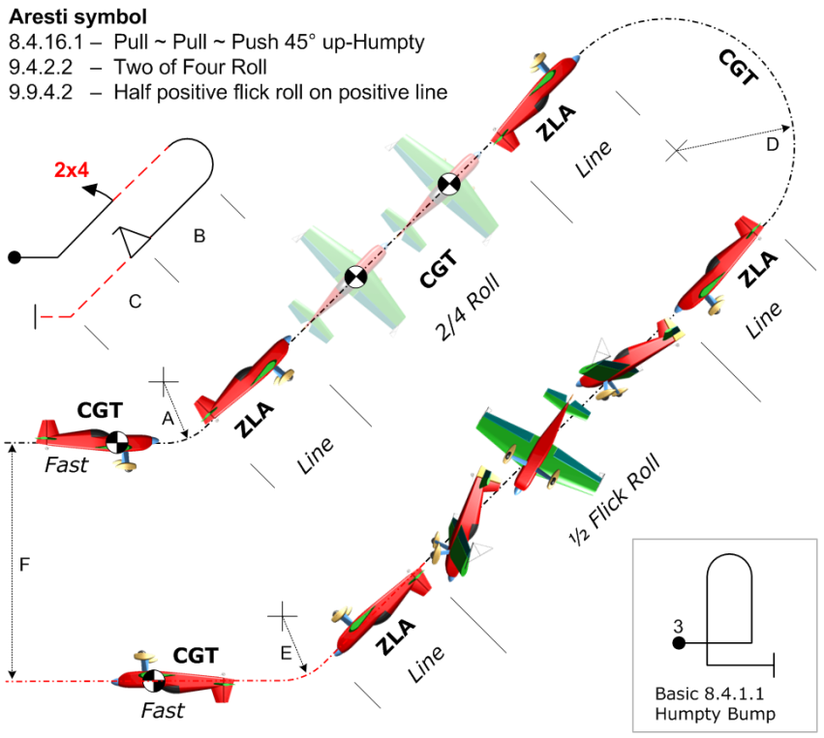
Humpty Bumps
The ‘Humpty’ can be vertical or at 45°, it can start by going up or going down, and there is even a ‘double’ version with one vertical up and one vertical down.
All types are basically similar – they comprise looping segments that connect lines upon which a great variety of rolls can be placed.
Smooth CGT radius entry and pull / push to reach the first line.
The first ZLA line, and assessment of any rolls super-imposed.
A smooth radius half-loop.
The second ZLA line, and assessment of any rolls super-imposed.
The smooth radius pull / push and exit to level CGT flight.
All partial loop segments may have different radii, and in a double humpty the two half-loops may also be of completely different sizes.

Slide 18
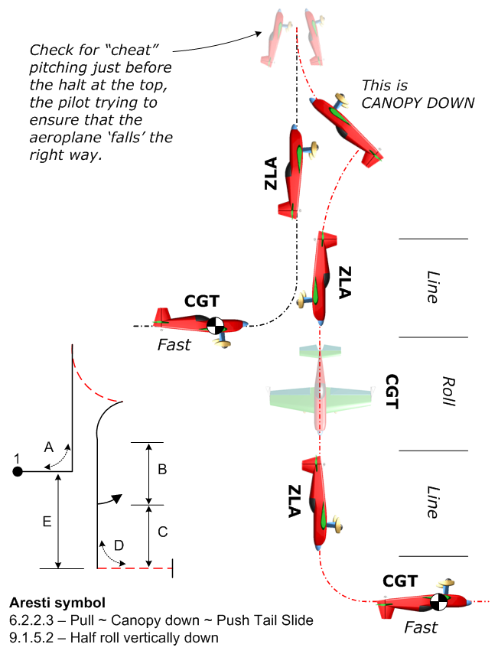
Tail Slides
Tail Slides have very similar judging criteria to Stall Turns, but there are no 45° entry and exit options – they are all vertical, and upwards!
Break the figure into the following parts for judging:
A smooth CGT radius entry and pull / push to reach the vertical up-line.
The first ZLA line, and assessment of any rolls super-imposed.
The slide must be either canopy-up or canopy-down, or you can think of it as wheels-down or wheels-up.
If the slide is less than a half fuselage length the downgrade is four points
The vertical ZLA attitude must be maintained to the top and in the slide.
After the pendulum is finished, assess the second ZLA line, and any rolls that are super-imposed.
A smooth radius pull / push and exit to level CGT flight.

Slide 19
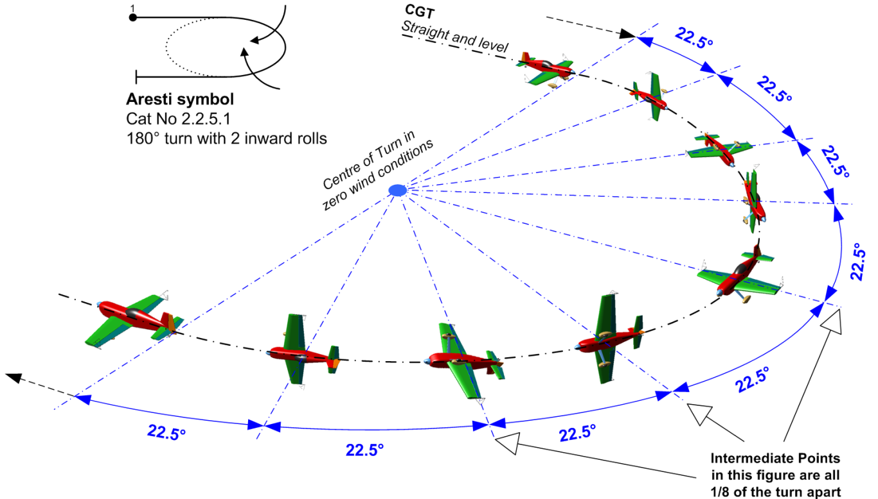
Rolling Turns – page 1
All versions of “Rollers” combine turns with continuous rolling, and they all follow the same set of rules and judging criteria.
Break the figure into the following parts for judging:
Start in level CGT flight precisely on-heading.
There must be a constant –
  rate of turn round the circle
  rate of roll at all times
  with no climbing or diving
At every Intermediate Point (with
the wings level or vertical) the turn
angle must be correct
The exit point must be
reached on-axis with all
rolling exactly completed
Rolling Turns can include whole or half rolls, or a combinations of both.
The rolls can be inwards (inner wing going down) or outwards (inner wing going up)
or both types alternated for the In / Out versions with a short pause between the roll elements.

Slide 20
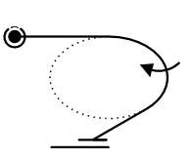
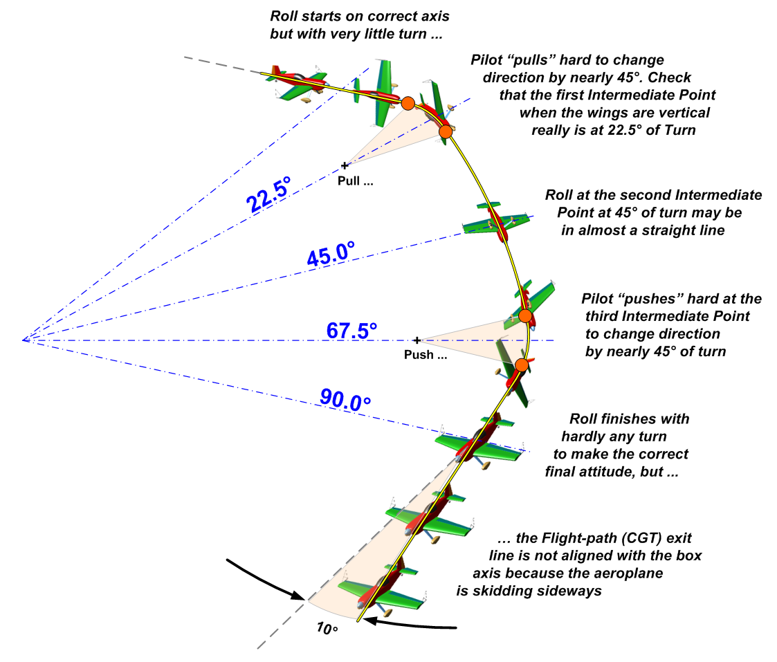
Rolling Turns – page 2
In reality many Rolling Turns are flown as a series of “pull” and “push” arcs with straighter segments between them, giving a jerky appearance with ‘corners’.
Here is a 90° TURN with 360° of inwards ROLL – Aresti 2.1.3.1
Watch the START very carefully:
You must see Rolling and Turning begin together
At the 1st wings vertical Intermediate Point the
turn angle reached must be 22.5° (1/4 of 90°)
At the inverted Intermediate Point the Turn is
45° and the figure is exactly HALF completed
If you see a flick-roll at any stage you
must give the figure a Hard Zero (HZ).
The Roll and Turn must both finish
exactly when the exit axis is reached
If the exit CGT is more than 45° before or after the
correct direction the figure must be given a Zero (0.0) mark.
This figure CAN be flown very convincingly if the rudder and stick inputs are well co-ordinated. Just watch every part carefully and make a running total of the errors.

Slide 21
Flight in the “wrong place”
If a figure is started in front of the judges but part of it is then flown behind the judging line, you should turn around and continue to mark it in the usual way. Your Positioning Mark will naturally be affected by this (NN).
This sometimes happens with rolling turns, or when the pilot fails to pay enough attention to where the figures are being flown. Just keep marking the flight and try not to fall over!
If a figure starts behind the judging line you should continue to mark it regardless, and put a note “Behind” on the judging form. Your Positioning Mark should also reflect this poorly located flying.
After the flight the Chief Judge will review all the judging sheets to check whether there is a majority of “Behind” comments. If so the figure will be declared a Confirmed Hard Zero (CHZ) and judges will be directed to ensure their mark is revised to HZ if it is anything else.
If all or part of a figure is flown so it is not possible to judge it properly -
- for example a cross-box looping element exactly in front of you, or
- the plane is so far away that you really can’t see what it is doing
then you should apply a downgrade of two (2) points to every element that you are unable to judge.
It is the pilot’s job to to fly the figures so that you can judge every part and reach a mark for each completed figure as required. If any parts of the flight are presented in such a way that elements are impossible to judge properly then the performance must be downgraded, and 2-point deductions are your way to make this happen. Your comments should also bring this to the pilots attention!

Slide 22
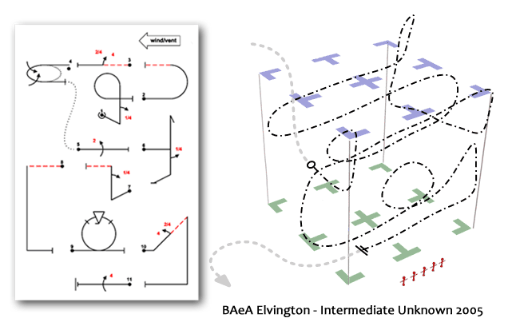
The Positioning Mark
Use the CIVA system to identify figures that are not placed in an optimum position to be judged, within the context of the sequence.
Where they are –
Too far to the left = “L”
Much too far left = “LL”
Too far to the right = “R”
Much too far right = “RR”
Too near = “N”
Much too near = “NN”
Too far = “F”
Much too far = “FF”
so a figure could be “L” or “NLL”
or “FFR” or even “NNRR” etc.
After the flight –
Total the number of letters
Count each one as a half mark (e.g. “N” and “FR” and “LL” and “NL” gives 3.5 downgrades)
Deduct this total from ten (e.g. 10.0 – 3.5 = 6.5 as the Position Mark)
This is your “starter” Positioning Mark, which you can ‘adjust’ up / down by 1 mark if necessary.

Slide 23
Handling the Major Errors
A figure that receives ten or more downgrades must be awarded a Numeric Zero = 0.0
When cumulative errors in roll / pitch / yaw total more than 45° but less than 90° you should award a
Numeric Zero = 0.0
Subjective
personal
Judgement
No Video
Where a Major Error is seen: an element is flown in the wrong direction, part of the figure is different to the Aresti symbols on the Judging Form, the wrong hesitations in a Roll are seen, or there is more than 90° of cumulative error detected …. the figure must be awarded a
Hard Zero = HZ
Clear
matters of
Fact
Video

Slide 24
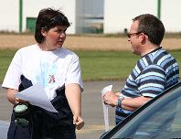

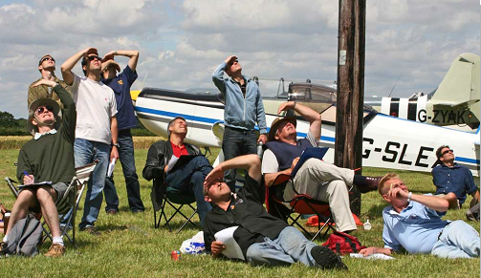
Your questions please … !

