Slide 1
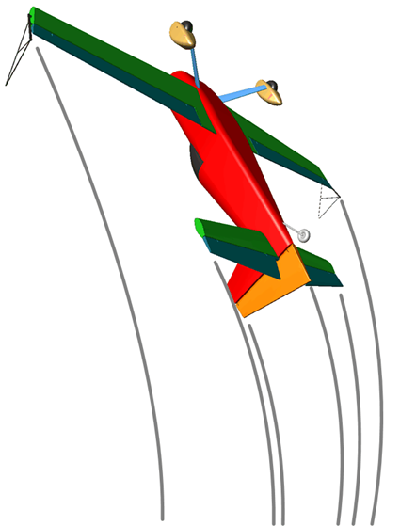
A Quick Zoom through the Rules
● Centre of Gravity Track
● Zero Lift Axis
● When to use each one ?
● The “Box”
● Wing Rocks
● Steep / Shallow, Neg & Pos
● Basics Rules of Judging
● Turns
● Slow Rolls
● Flick Rolls
● Spins
● Loops and Eights
● Stall Turns
● Humpty Bumps
● Tail Slides
● Rolling Circles
● Positioning mark
● Handling the major errors

Slide 2
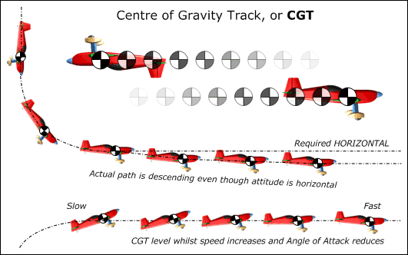
Centre of Gravity Track (CGT)
The Centre of Gravity Track is the imaginary line that the aircraft centre of gravity draws as it flies along.
Imagine the aeroplane condensed into a dot, and watch the path that the dot takes through the sky. This is the Flight Path, or Track of the aeroplanes' Centre of Gravity.
To judge the flight path, compare the CGT against the horizon or the box 'A' or 'B' axes.
Example 1
The aeroplane is required to transit from a vertical down-line to horizontal flight. Although the ZLA remains horizontal after the 90° corner has been completed, the CGT will in reality continue to descend a little below the required horizontal line.
Example 2
Here the transit is from a vertical up-line to normal horizontal flight. The CGT must remain in a level horizontal line, whilst the aircraft speed will increase from very slow and the angle of attack reduces accordingly.
CGT and Angle of Attack
Judges must always look at the CGT and not be "fooled" by a high angle of attack at low speed – this can be particularly noticeable when the aeroplane is inverted, as with most aircraft the nose will appear un-naturally high.

Slide 3
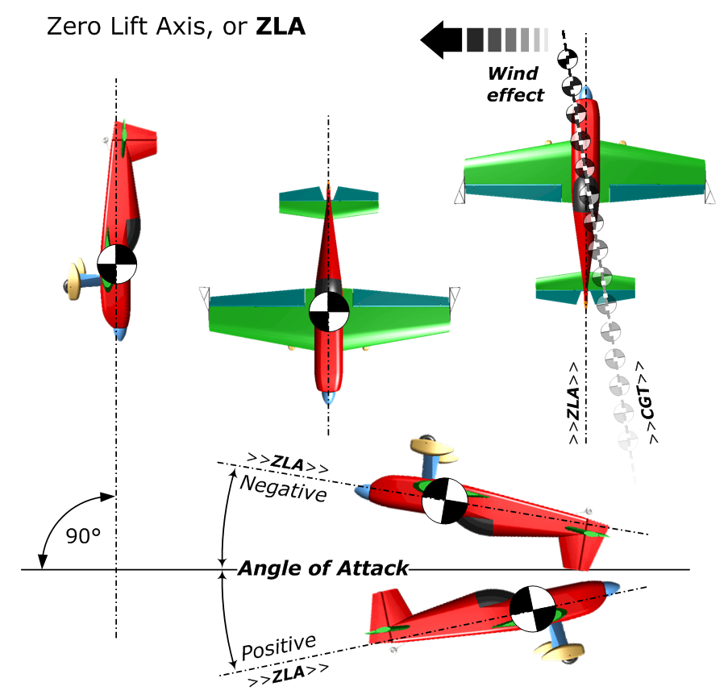
Zero Lift Axis (ZLA)
The "Zero Lift Axis" of an aircraft is purely a function of its shape and aerodynamic qualities.
When flying a true vertical line in still air, the ZLA will be exactly perpendicular to the ground.
In the left and centre sketches the aeroplane is flying vertically downwards with its ZLA through the main axis.
The sketch on the far right shows that the CGT can be different to the ZLA because of the wind.
On all 45° and vertical lines we use the ZLA to tell us how accurately the aircraft is flying the figure.
Note again that in level CGT flight the wing must have a positive or negative Angle of Attack relative to the airflow, to keep the aircraft flying.

Slide 4
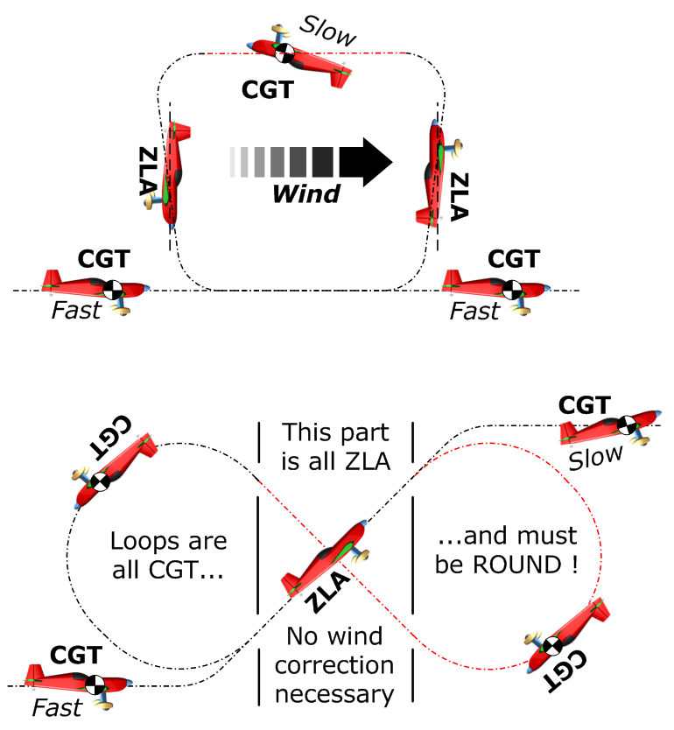
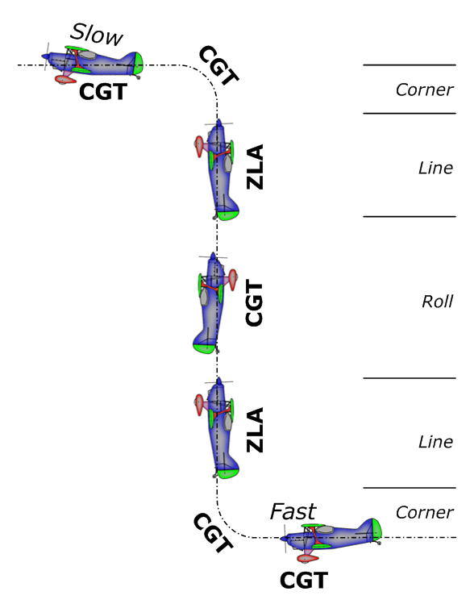
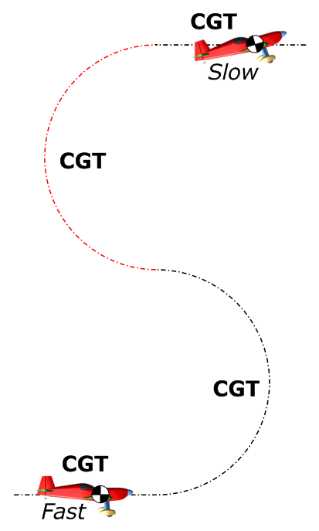
When should we use CGT
and when should we use ZLA?
In horizontal lines or curving, rotating or rolling manoeuvres – use CENTRE OF GRAVITY TRACK (CGT)
When we are judging vertical or 45° lines up or down – use the ZERO LIFT AXIS (ZLA)

Slide 5
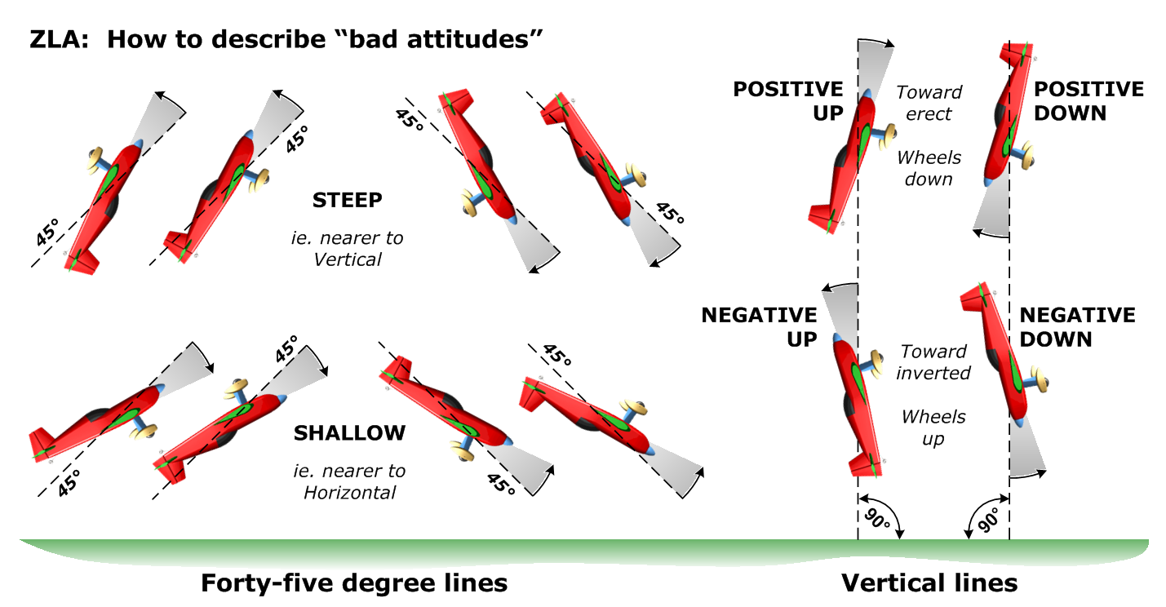
Steep or Shallow …. Negative or Positive

Slide 6
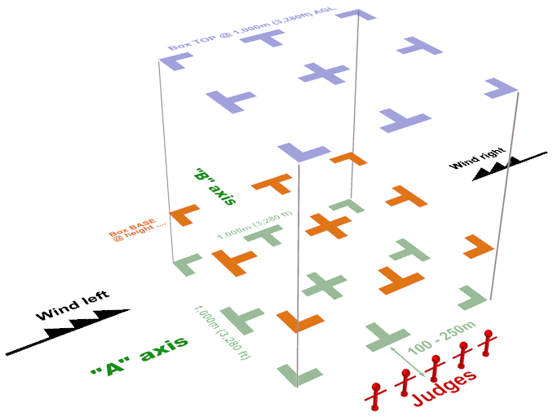
The Aerobatic Performance Zone
The “box” is the 1,000m cube of airspace within which all competition aerobatic flights are executed.
The ‘Official Wind’ defines the main box axis
The ‘main’ box centre-line is called the “A” axis
The box ‘cross’ centre-line is called the “B” axis
Judges sit between 100 and 250m from the box edge
The ‘official’ or ‘contest wind’ will be either from the left or the right, on the “A” axis
Figures must be flown in the correct direction on the “A” axis
Figures can be flown either toward or away from the judges on the “B” axis
The minimum operating height
depends on the category:
100m - power Unlimited
200m - power Advanced - glider Unlimited and Advanced
300m - power Sports and Intermediate - glider Sports and Intermediate
450m - power and glider Club

Slide 7
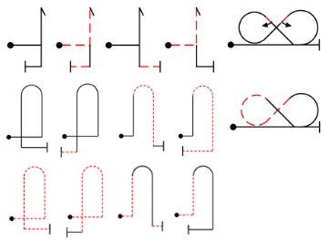
Warm-Up figures
In Power programmes only: Pilots are encouraged to fly a limited range of ‘Warm-Up’ figures to get used to +/- G-forces, check there are no loose items in the aeroplane and ensure all systems are operating correctly. ONLY these figures are allowed -
Half rolls
Any number of these two half-rolls -
Additional figures
Up to three of the following fourteen figures without rotations may be flown once each, i.e. they may not be repeated -
Stick Pull-Push
Any number of pull/push stick movements in erect or inverted flight -
Turns
Any number of 90°, 180°, 270° and 360° Turns without rotations in erect or inverted flight -
Also - in power Programme-1 / Free Known sequences only
Up to the first five figures of the pilots own sequence. These must be flown inside the box and in the correct order, i.e. just figure 1, or figures 1 and 2, or figures 1-2-3 and so on up to 1-2-3-4-5. If they are flown incorrectly or in any other order or any other figures are flown then a penalty must be applied.

Slide 8
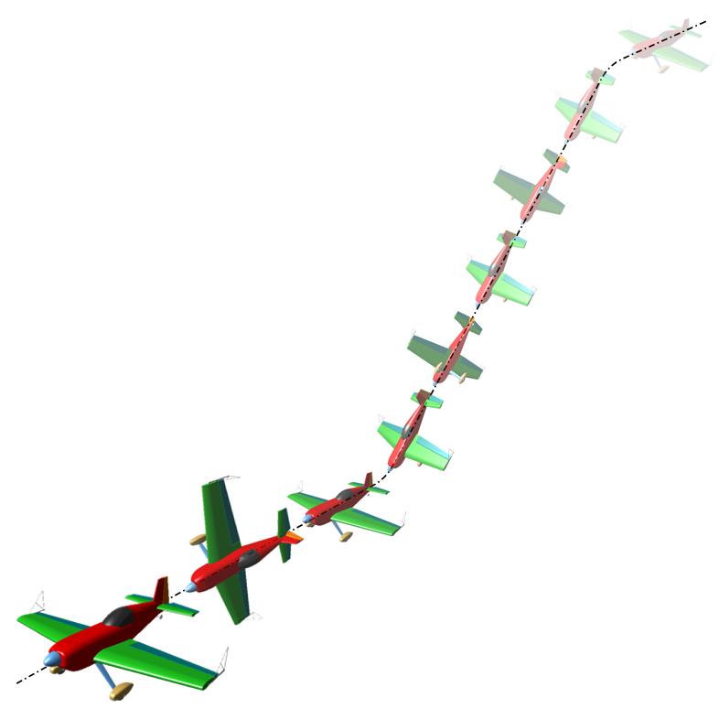
Wing Rocks
For Power
BEFORE the sequence starts:
● There should be THREE consecutive Wing Rocks
● They can start and/or finish inside or outside the box
● Each one should reach at least 45° of roll
● They must be done along the initial sequence axis
● Climbing or diving at up to 90° is allowed
● From a 90° climb an erect or inverted exit is OK
● If not climbing at 90° then for an inverted start all wing rocks must be completed while inverted
To signify an Interruption or Break:
We need to see THREE Wing Rocks
To restart after a Break:
It’s the SAME process as the very start
If there was no prior direction error then the pre-break direction MUST be resumed
If there was a direction error immediately before the break then the restart direction can be different to that before the break

Slide 9
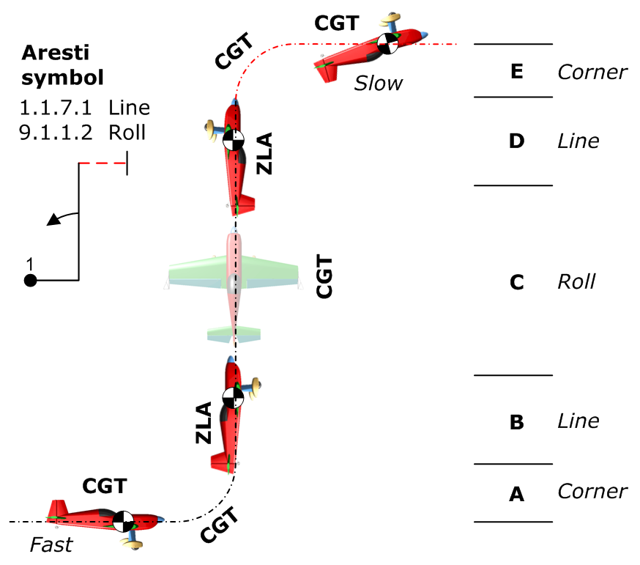
The Basic Rules of Judging
Every figure starts with a potential 'perfect' mark or grade of 10 points
The basic judging rule is : an error of 5° equals a 1 point downgrade
Deduct points to arrive at your personal final mark for each figure
Radii 'A' and 'E' need not be the same, but 'E' is flown much more slowly.
Lines 'B' and 'D' must be the same length.
For a 2/1 ratio : deduct 2 marks
For a 3/1 ratio : deduct 3 marks
No line at all : deduct 4 marks
For example:
If the aircraft starts the figure climbing at 5°, no yaw and between 5° and 10° of bank
During the figure is pitched OK but yawed 5° and rolled 10° off axis at a key point
The figure ends with 5° of yaw, between 0° and 5° nose-down and no bank angle
The result is: 10 points - 1 - 0 - 1.5 ... - 0 - 1 - 2 ... - 1 - 0.5 - 0 = 3 marks for the figure
This is a fault driven process - you are not marking "goodness".

Slide 10
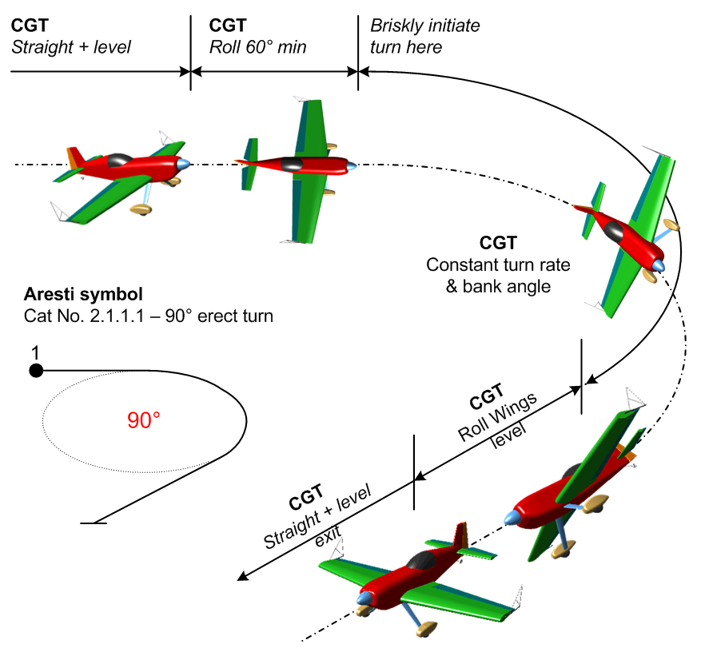
Turns
This is NOT a ‘PPL’ turn – think more of a “jerky marionette”
Types:
Turns can be either erect or inverted
Amounts are 90°, 180°, 270° and 360°
Actions:
Roll to at least 60° of bank (gliders exactly 60°)
Turn at a constant rate through the required angle
Maintain turn rate and altitude
Stop exactly on heading, then
Roll back to wings-level
Not judged:
The shape of the turn (no wind correction)
The size of the turn

Slide 11
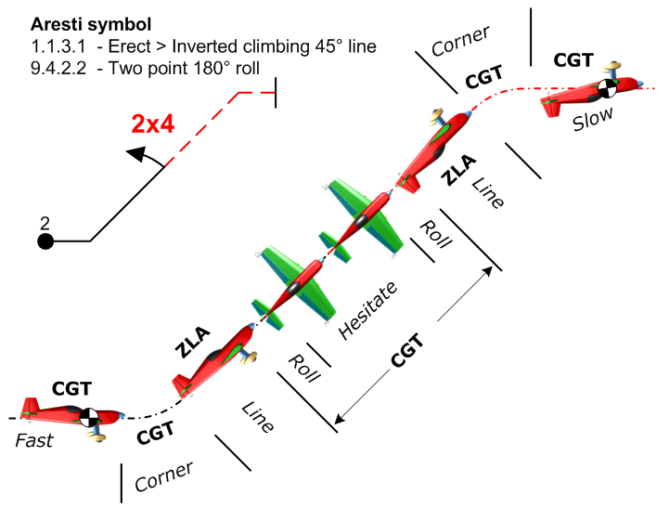
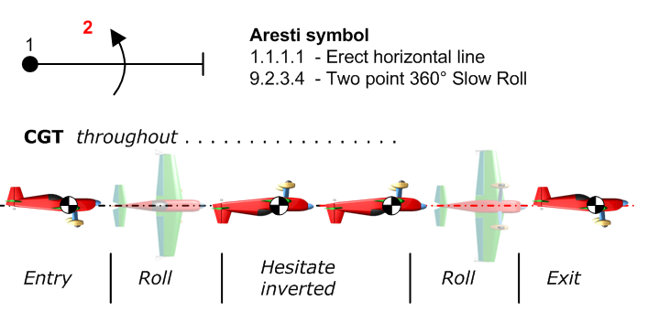
Slow Rolls
Slow rolls, many of which include hesitations, are sometimes called aileron rolls to distinguish them from flick or snap rolls.
In a slow roll the rotation is primarily driven by aileron action, whereas a flick roll combines yaw and pitch inputs to cause 'auto-rotation'.
Many variations of slow rolls are used in a great variety of figures, often preceded and followed by lines which must be judged for CGT (where horizontal) or ZLA (where at 45° or in the vertical) and also for comparative length.

Slide 12
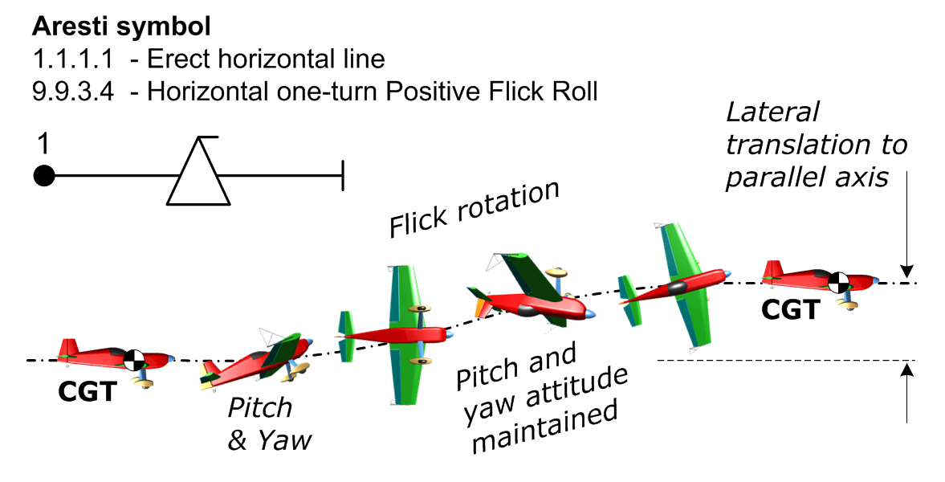
Flick or Snap Rolls
Flick rolls are initiated by rapid pitch and yaw control inputs, causing one wing to stall whilst the other continues to fly - leading to very high acceleration in roll. This abrupt high energy translation makes the manoeuvre hard to study and hence difficult to judge accurately.
Flick-rolls happen so quickly it is your subjective 'perception' as to whether the pitch and yaw have –
caused auto-rotation
stayed there during the roll
been removed to stop it
If you are not convinced that the aeroplane “flicked” or “snapped”, i.e. there was no auto-rotation, then you should give the figure a Hard Zero (HZ) and not a normal mark.

Slide 13
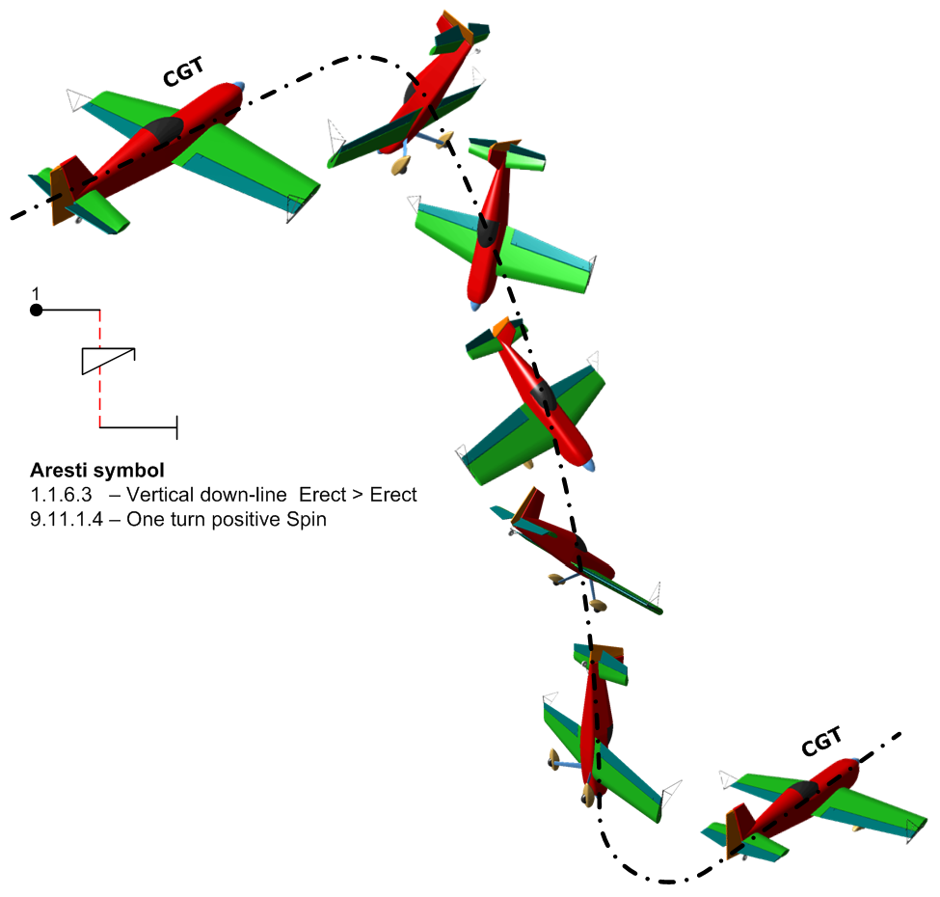
Spins
The ‘competition’ spin must display these characteristics –
A clean initial stall on-heading in level CGT flight, leading to
Immediate nose drop + wing drop + and yaw into auto-rotation
The rotation must stop on the correct heading
We must see rapid translation to a vertical ZLA line
A smooth radius pull or push, to … (level flight exit, remainder of figure etc.)
If you are not convinced that there was a genuine stall leading to the wing-drop and auto-rotation then you should award the figure a Hard Zero (HZ) instead of a normal mark.

Slide 14
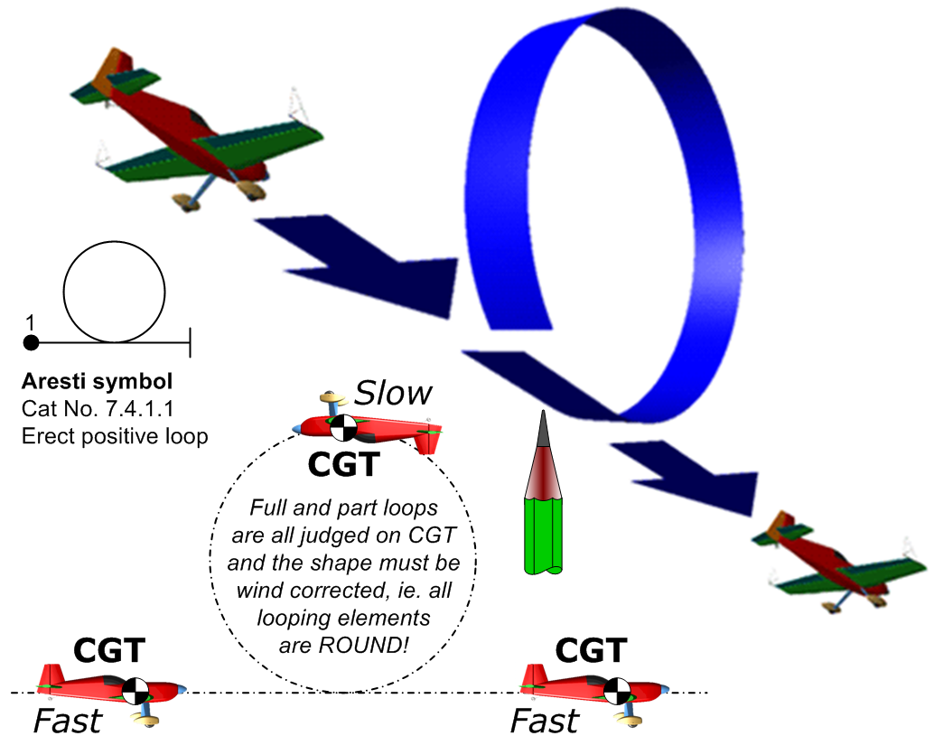
Loops and Eights
A partial or complete loop takes place when the aeroplane pitches through at least 45° without roll or yaw, either in positive (pull) or negative (push) flight.
Looping segments are always judged on flight path or CGT - never ZLA.
Loops, eights and vertical 'S's are always wind corrected, their elements must be accurate and 'round'.
In a simple loop (see right) the end point should be exactly where the loop started, both horizontally and vertically.
Hold up your finger, a pencil or pen to keep track of this important position.
Unless you have an easy-to-apply method they can be quite difficult to judge

Slide 15
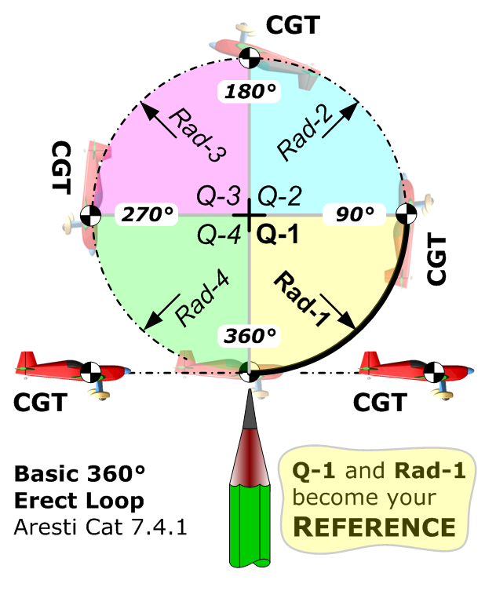
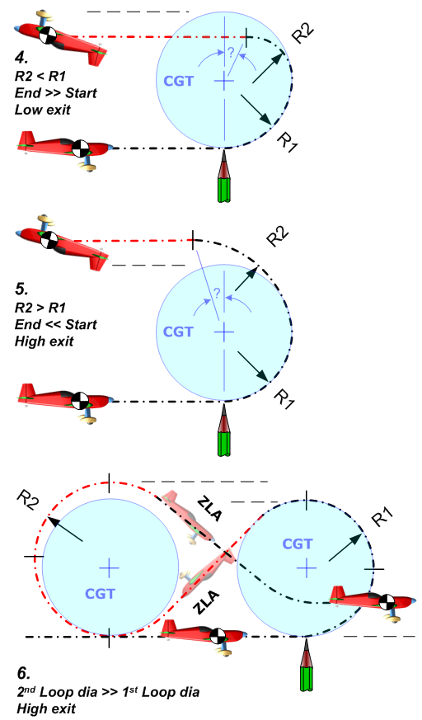
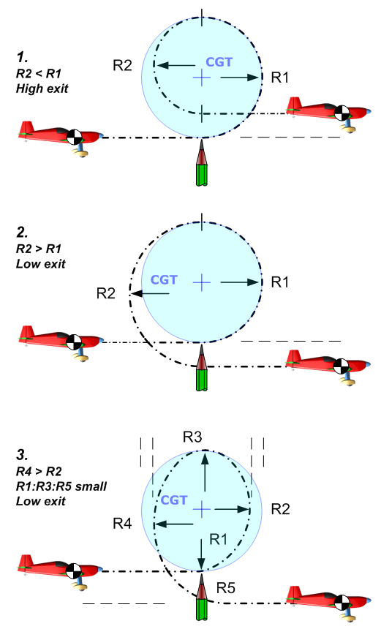
Judging loop shapes
The exit point should be at exactly the same level as the entry point.
The four quadrant radii and centre points are all exactly the same.
The centre-top point is exactly above the start point.
Wherever you see these 3 'truths' you can be sure that the loop is round.

Slide 16
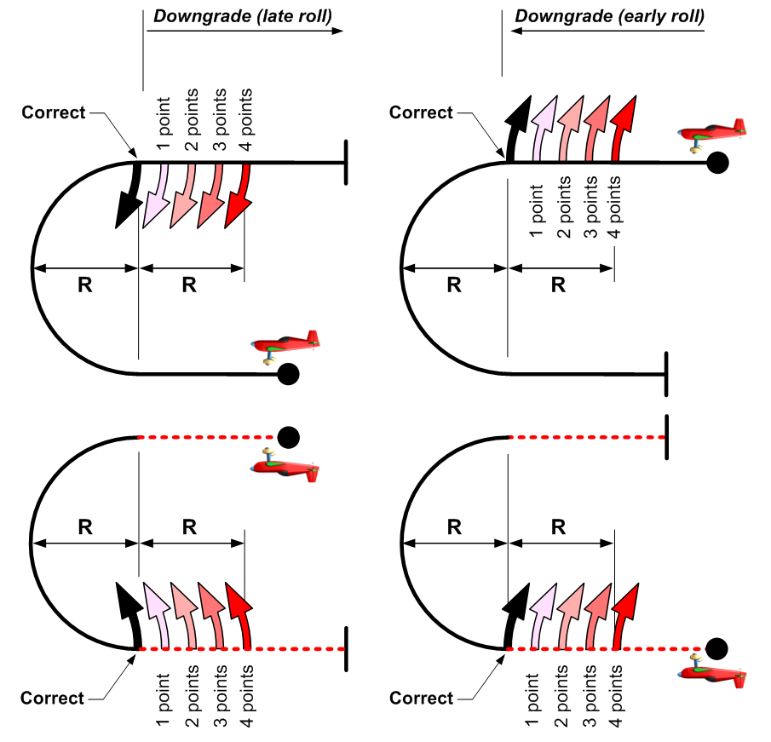
Half-loop with Rolls
When a half-loop upwards or downwards has some rolling at the start or end of the looping segment, there must be NO horizontal line between the rolls and the looping arc.
Memorise the size of looping arcs as they are being flown:
Where no line is drawn there is no downgrade to apply.
If you see any line at all then at least a one point downgrade must be applied.
As the length of this unwanted line increases but remains less than the half-loop radius, two to three points should be deducted.
If the length of the line exceeds the half-loop radius you must award a four point downgrade to the figure.

Slide 17
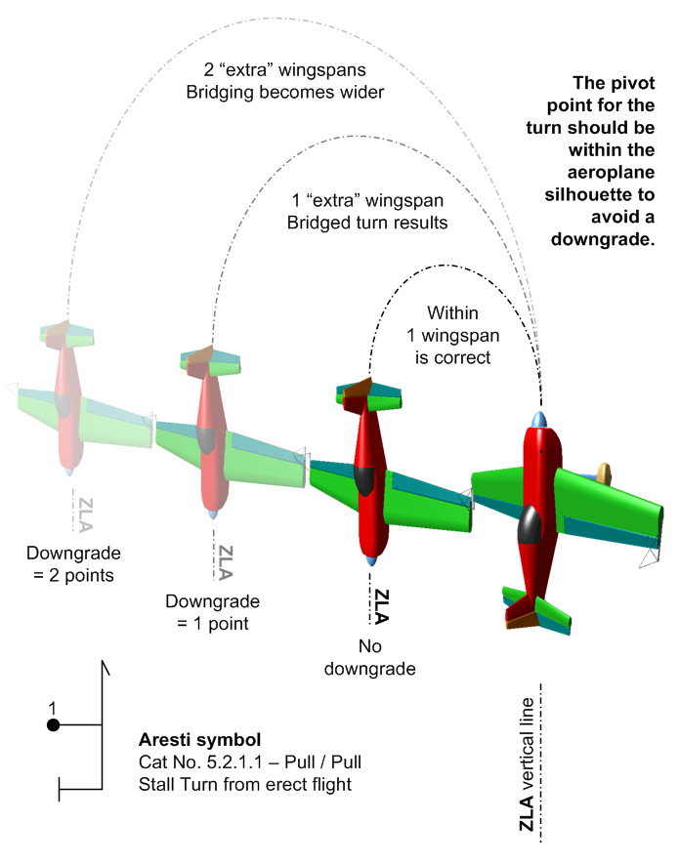
Stall Turns or Hammerheads
The Stall Turn is one of the most graceful aerobatic figures.
The figure can be divided into a series of sections for judging:
Smooth radius CGT entry and pull / push to the vertical.
The ZLA vertical up-line, and assessment of any rolls super-imposed.
The turn itself, which must be purely yaw with no rolling or pitching.
The ZLA down-line, and assessment of any rolls super-imposed.
The smooth radius pull / push and exit to level CGT flight.
Stall Turns with 45° entry and/or exit segments may also have rolls super-imposed there.

Slide 18
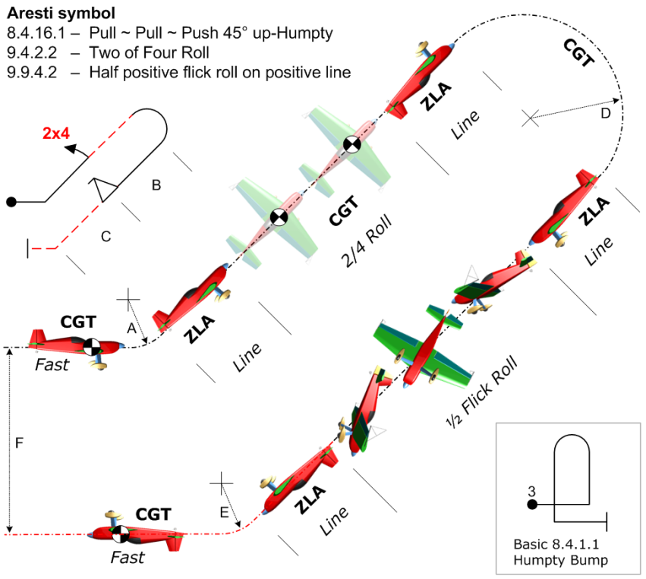
Humpty Bumps
The ‘Humpty’ can be vertical or at 45°, it can start by going up or going down, and there is even a ‘double’ version with one vertical up and one vertical down.
All types are basically similar – they comprise looping segments that connect lines upon which a great variety of rolls can be placed.
Smooth CGT radius entry and pull / push to reach the first line.
The first ZLA line, and assessment of any rolls super-imposed.
A smooth radius half-loop.
The second ZLA line, and assessment of any rolls super-imposed.
The smooth radius pull / push and exit to level CGT flight.
All partial loop segments may have different radii, and in a double-humpty the two half-loops may also be of different sizes.

Slide 19
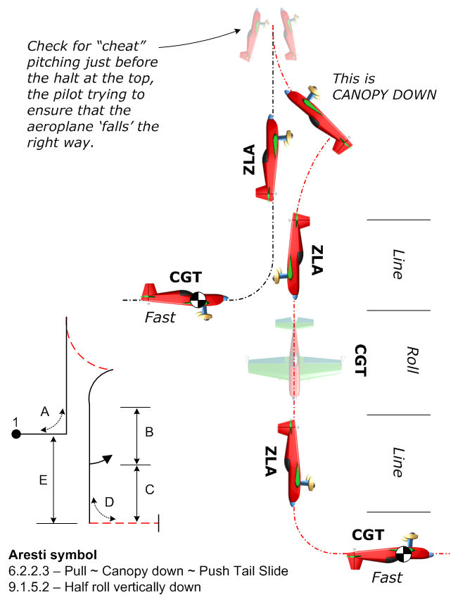
Tail Slides
Tail Slides have very similar judging criteria to Stall Turns, but there are no 45° entry and exit options – they are all vertical, and upwards!
Break the figure into the following parts for judging:
A smooth CGT radius entry and pull / push to reach the vertical up-line.
The first ZLA line, and assessment of any rolls super-imposed.
The slide must be either canopy-up or canopy-down, or you can think of it as wheels-down or wheels-up.
If the slide is less than a half fuselage length the downgrade is four points
The vertical ZLA attitude must be maintained to the top and in the slide.
After the pendulum is finished, assess the second ZLA line, and any rolls that are super-imposed.
A smooth radius pull / push and exit to level CGT flight.

Slide 20
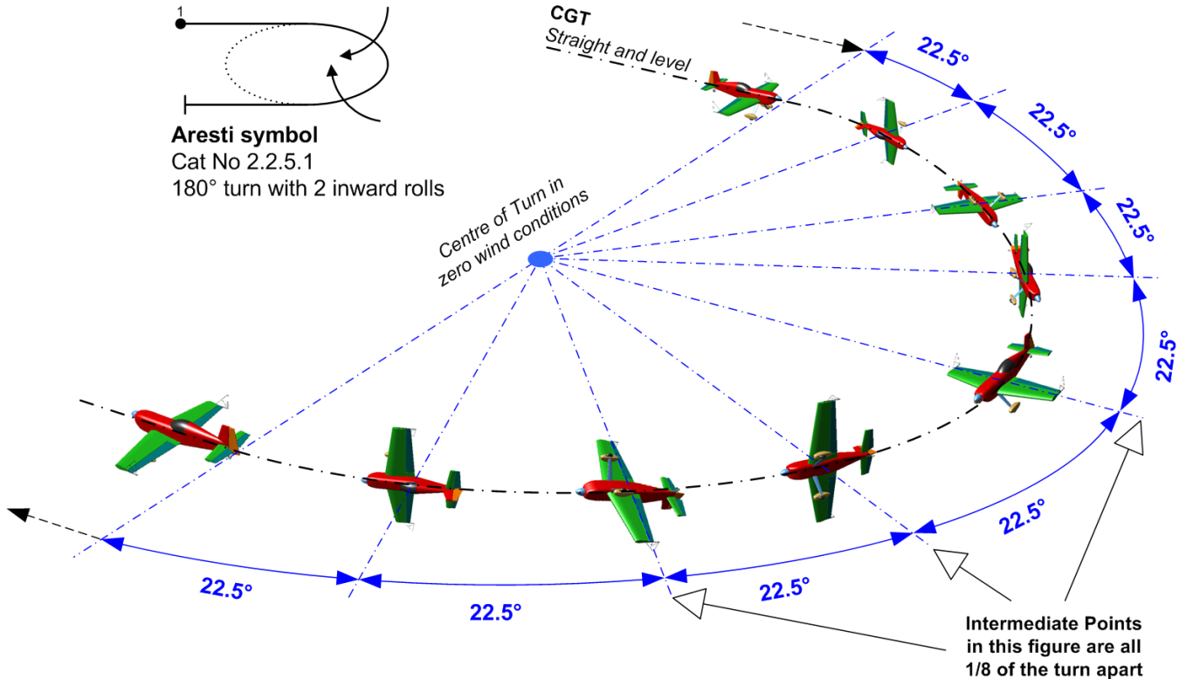
Rolling Turns – page 1
All versions of “Rollers” combine turns with continuous rolling, and they all follow the same set of rules and judging criteria.
Break the figure into the following parts for judging:
Start in level CGT flight precisely on-heading.
There must be a constant –
rate of turn round the circle
rate of roll at all times
with no climbing or diving
At every Intermediate Point (with the wings level or vertical) the turn angle must be correct
The exit point must be reached on-axis with all rolling exactly completed
Rolling Turns can include whole or half rolls, or a combinations of both. The rolls can be inwards (inner wing going down) or outwards (inner wing going up) or both types alternated for the In / Out versions with a short pause between.

Slide 21
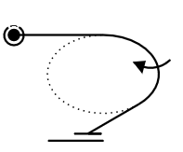
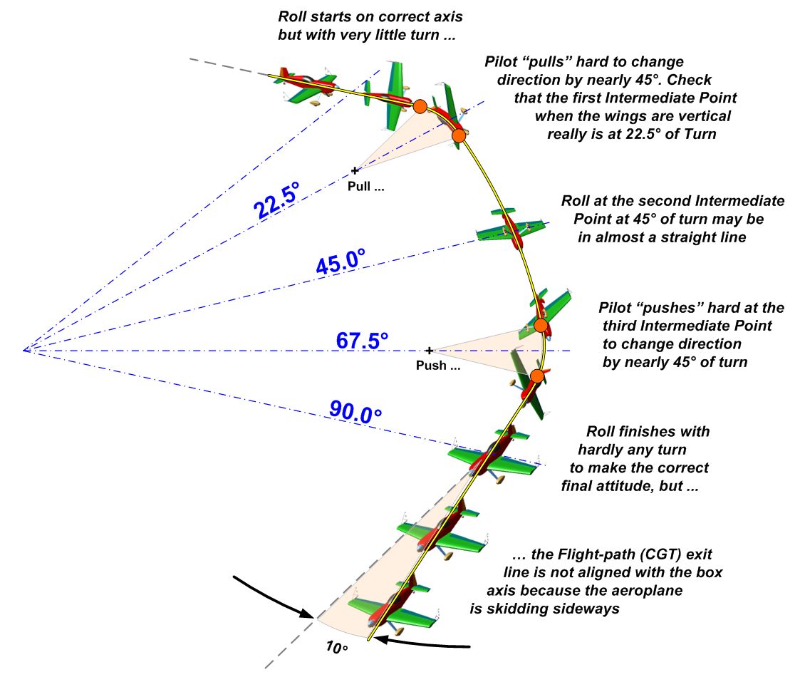
Rolling Circles – page 2
In reality many Rolling Turns are flown as a series of “pull” and “push” arcs with straighter segments between them, giving a jerky appearance with ‘corners’.
Here is a 90° TURN with 360° of inwards ROLL – Aresti 2.1.3.1
Watch the START very carefully:
You must see Rolling and Turning begin together
At the 1st wings vertical Intermediate Point the turn angle reached must be 22.5° (1/4 of 90°)
At the inverted Intermediate Point the Turn is 45° and the figure is exactly HALF completed
If you see a flick-roll at any stage you must give the figure a Hard Zero (HZ).
The Roll and Turn must both finish exactly when the exit axis is reached
If the exit CGT is more than 45° before or after the correct direction the figure must be given a Hard Zero (HZ).
This figure CAN be flown very convincingly if the rudder and stick inputs are well co-ordinated. Just watch every part carefully and make a running total of the errors.

Slide 22
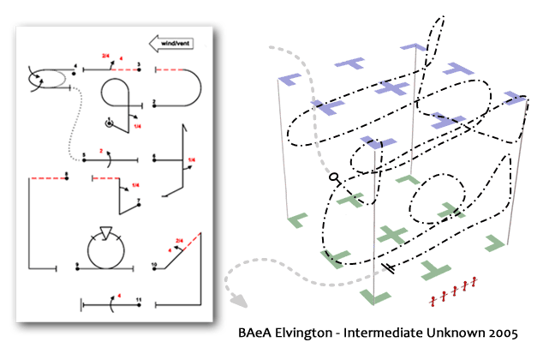
The Positioning Mark
Use the CIVA system to identify figures that are not placed in an optimum position to be judged, within the context of the sequence.
Where they are –
Too far to the left = “L”
Much too far left = “LL”
Too far to the right = “R”
Much too far right = “RR”
Too near = “N”
Much too near = “NN”
Too far = “F”
Much too far = “FF”
so a figure could be “L” or “NLL” or “FFR” or even “NNRR” etc.
After the flight –
Total the number of letters
Count each one as a half mark (e.g. “N” and “FR” and “LL” and “NL” gives 3.5 downgrades)
Deduct this total from ten (e.g. 10.0 – 3.5 = 6.5 as the Position Mark)
This is your “starter” Positioning Mark, which you can ‘adjust’ up / down by 1 mark if necessary.

Slide 23
Handling the Major Errors
A figure that receives ten or more downgrades must be awarded a Numeric Zero = 0.0
When cumulative errors in roll / pitch / yaw total more than 45° but less than 90° you should award a Numeric Zero = 0.0
Subjective
personal
Judgement: No Video
Where a Major Error is seen: an element is flown in the wrong direction, part of the figure is different to the Aresti symbols on the Judging Form, the wrong hesitations in a Roll are seen, or there is more than 90° of cumulative error seen …. the figure must be awarded a Hard Zero = HZ
Clear
matters of
Fact: Video

Slide 24
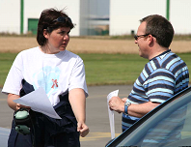
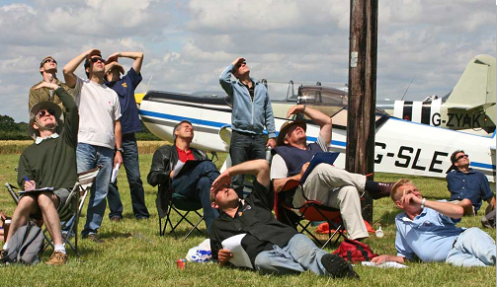
Your questions please … !

