Slide 1
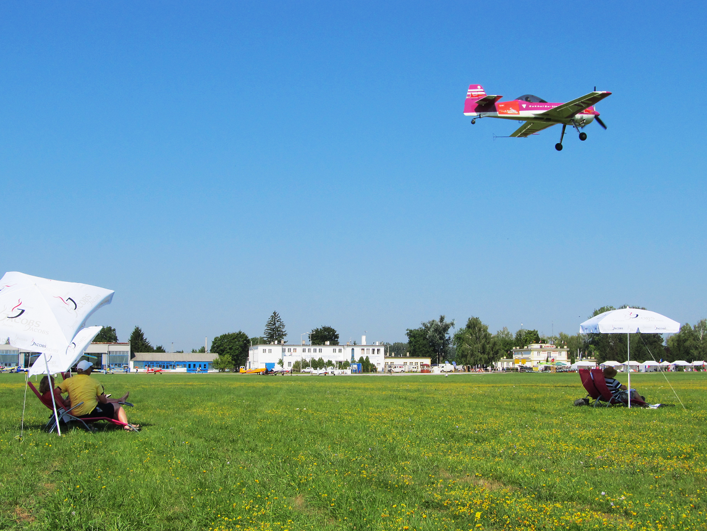


Aerobatic Judging Seminar
CIVA / FAI International
CIVA / FAI
Seminar
Before we start …
How do you think you think?

Slide 2
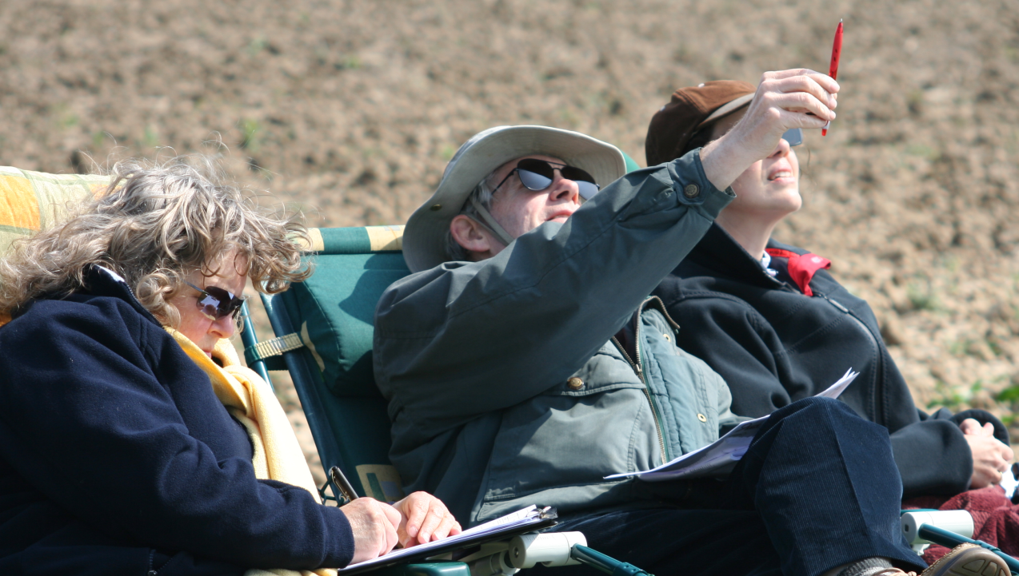
Thinking: Fast and Slow
CIVA / FAI
Seminar
Source: “Thinking, Fast and Slow” by Daniel Kahneman

Slide 3
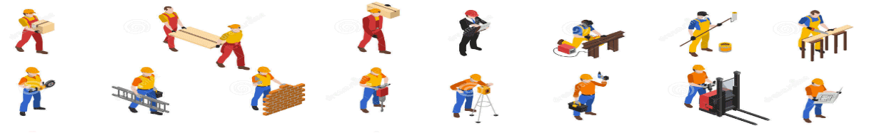
You probably think that you spend most of your day making decisions …
Not True!
85% of the time you are simply REACTING and doing stuff that is drawn from your own memory
15%

Slide 4
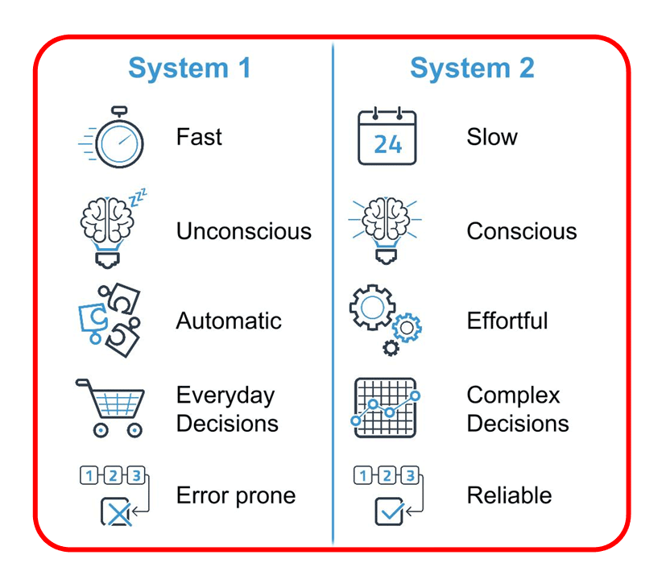



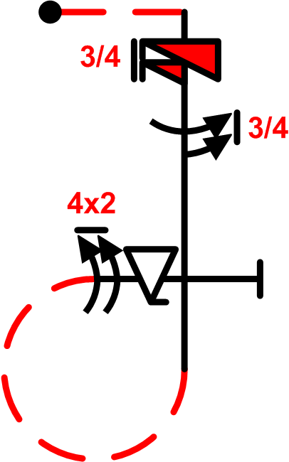
THINKING
CIVA / FAI
Seminar
Fast
Slow

Slide 5
CIVA / FAI
Seminar
a) Learning to React vs. b) Learning to T h i n k
a) . . . . . . . . . . . . . . . . . . . . . . . . . . . . . . . . . . . b)
Baby > youngster > teenager > adult > Real World
Reactions are “System-1” – fight or flight, instant conclusions
Thinking is a “System-2” process and requires logical deductions

Slide 6
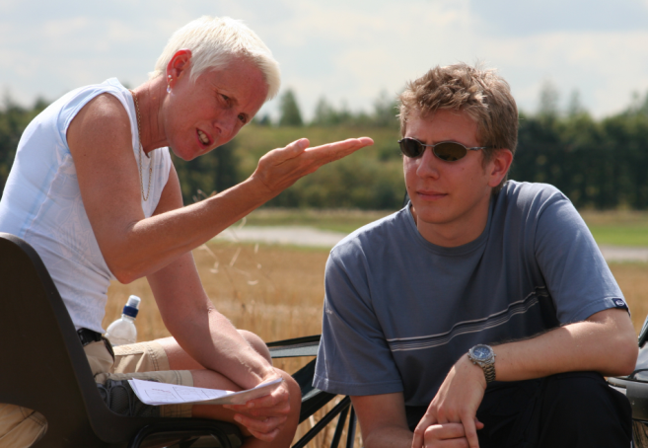
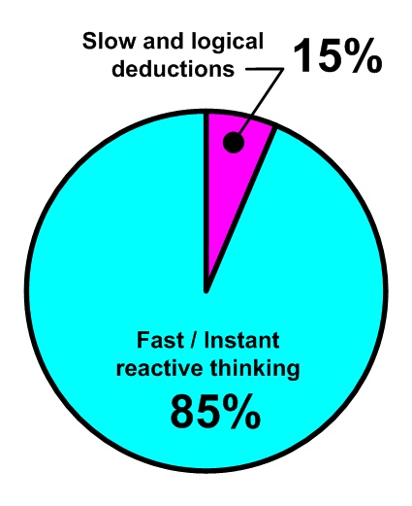
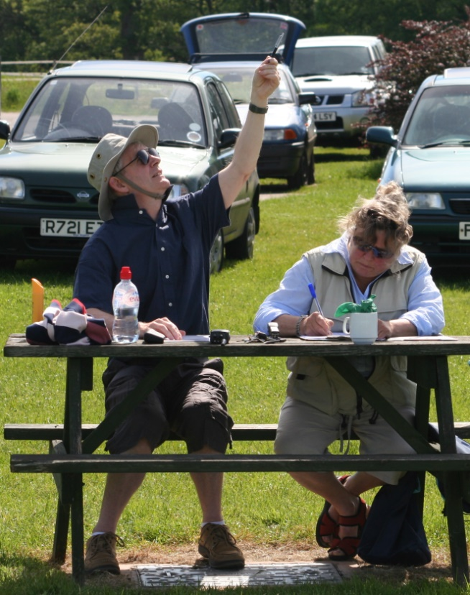
Your day is normally spent …
CIVA / FAI
Seminar

Slide 7
CIVA / FAI
Seminar
Fast thinking always comes direct from known things in your MEMORY
-------------
S l o w thinking comes only through ANALYSIS
-------------
These two things don’t easily work together !

Slide 8
Most of the time aerobatic Judging requires immediate assessment of part or whole figures This is Fast thinking
CIVA / FAI
Seminar

Slide 9
CIVA / FAI
Seminar
Sometimes the Judge has to Pause, Reflect and Reassess what he or she believes has just been seen … --------------
This is a complete change of approach to S L O W thinking

Slide 10
CIVA / FAI
Seminar
Be very careful!
Fast and S l o w thinking do not mix well. They require you to change thinking styles and mentally switch from one to the other

Slide 11
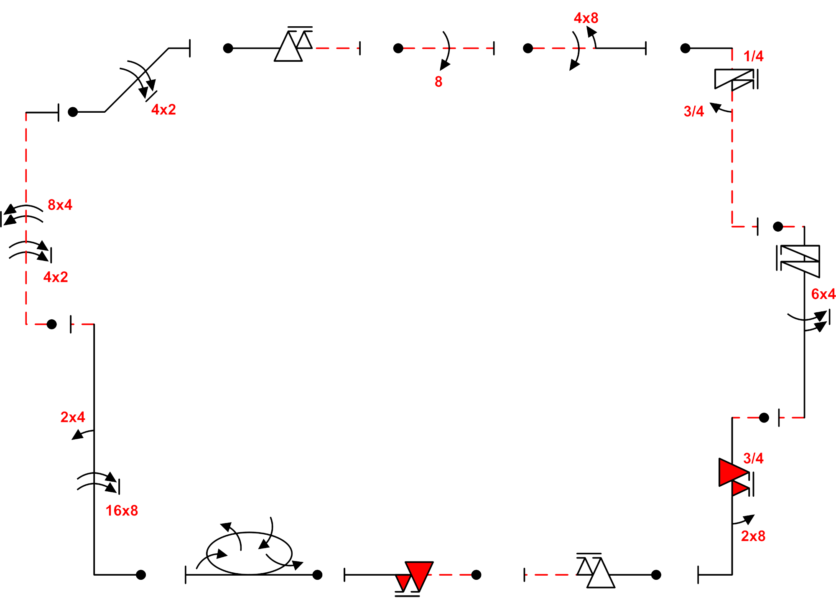
Did it hesitate … ? Were they opposite …?
How many … ?
Fast … S l o w

Slide 12
Believe what you see
Trust your confidence
Keep moving forwards
Review after each flight
CIVA / FAI
Seminar
You WILL make mistakes!

Slide 13
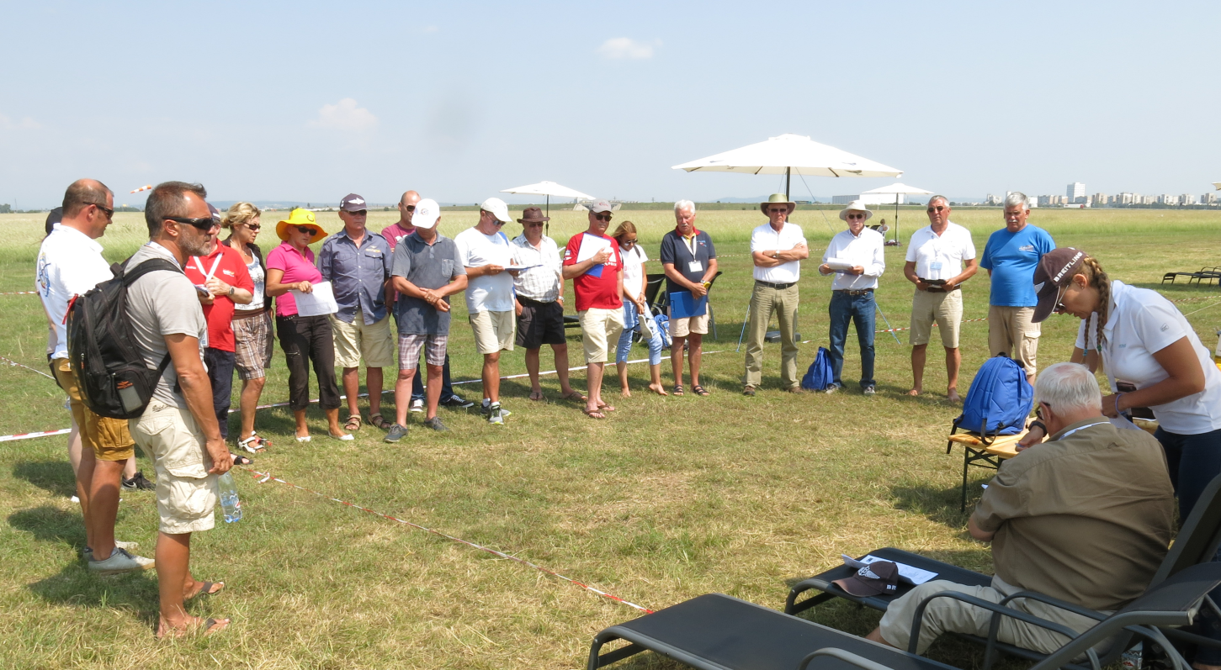
CIVA / FAI
Seminar
This is why we have these …

Slide 14
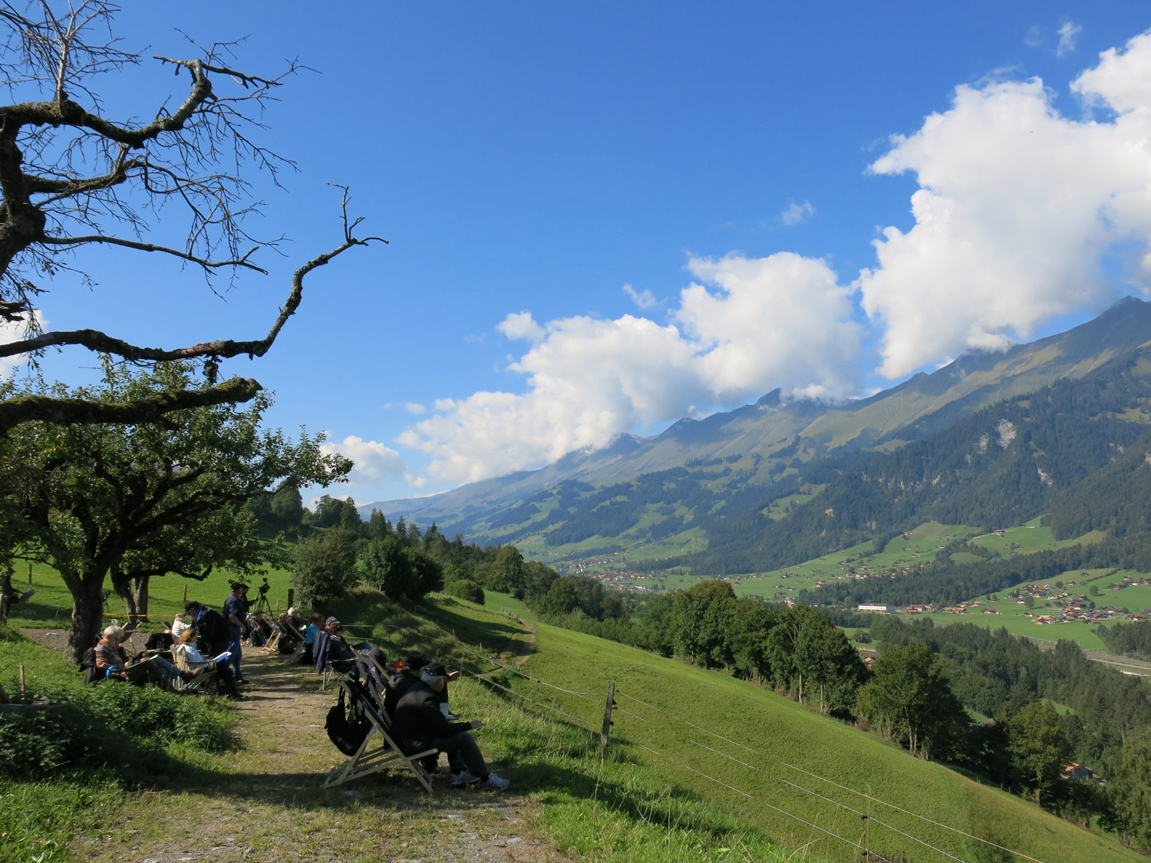
Judges (very short) Break #1
CIVA / FAI
Seminar

