Slide 1
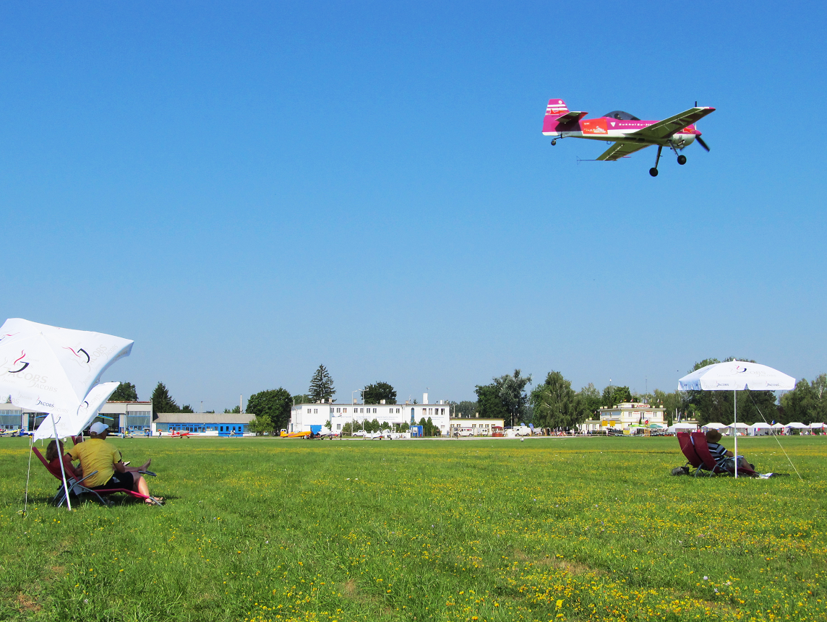

Aerobatic
Judging
Seminar
CIVA / FAI International
CIVA / FAI
Seminar
Part 4 – FPS and the Judging Analyses

Slide 2
Remember! a Judge is …
Detective
Examiner
Analyst
Interpreter
Reviewer
Theatre critic
Commentator
Pilot …
A competition aerobatic sequence is a demonstration of aircraft control requiring extreme levels of technical ability and discipline from the Pilot.
The Pilot attempts to convince the Judges that the figures are flown exactly according to the rules.
The Judges view the performance to discover where the rules are not fully met. They award downgrades for imperfections and errors seen.
An aerobatic Judge uses ALL of these skills to mark the performance properly.

Slide 3
Judge Performance
Calculating
and
Measuring
Contest Results
Let’s look at:
1.
Why and how CIVA calculates the Pilots scores so that they are FAIR
2.
How we review the performance of each Judge, comparing their marks with the statistical “average” of the output from whole judging panel

Slide 4
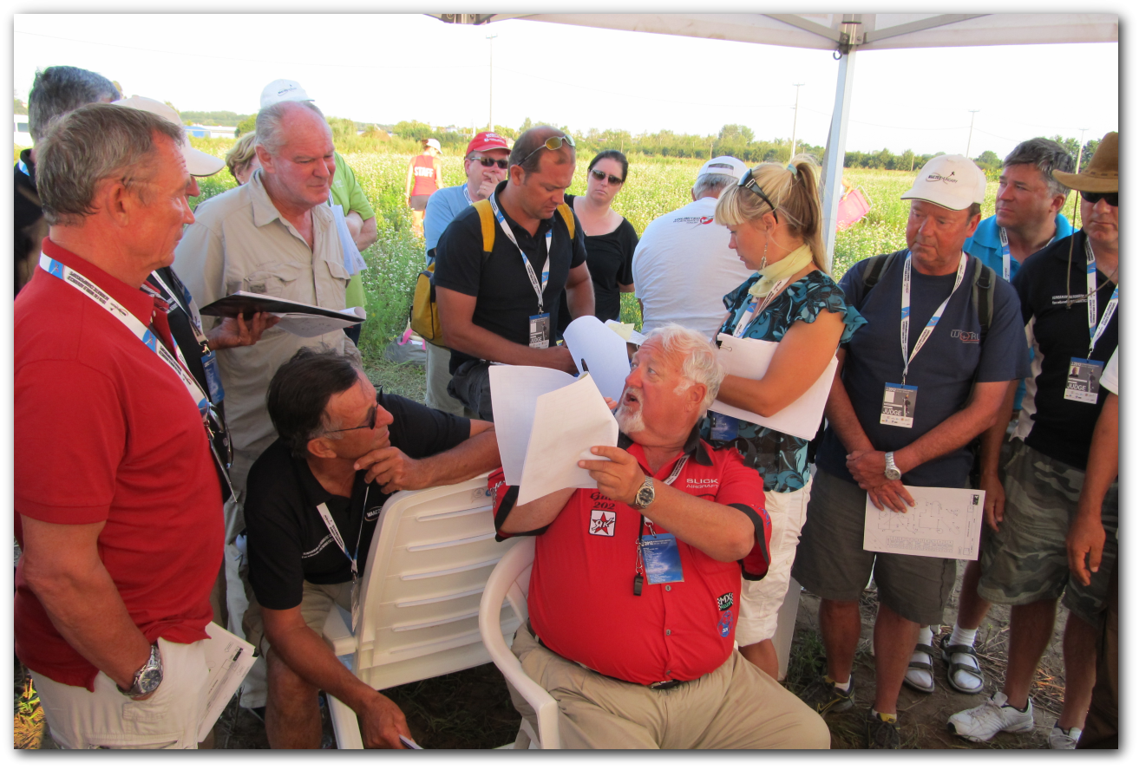
Why ‘FairPlay’ and ACRO?

Slide 5
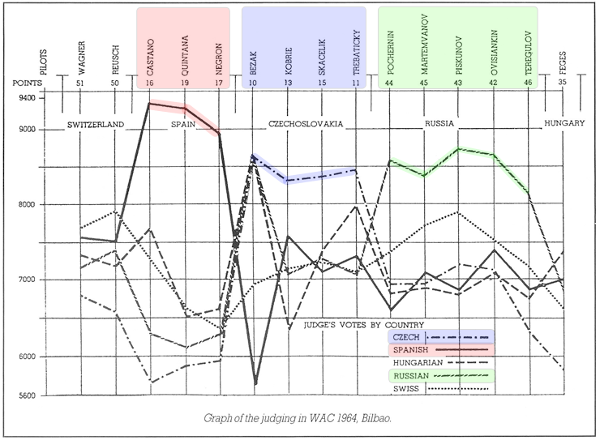
Is this what you’d call “Fair play” ?

Slide 6
The FairPlay Statistical System
Why do we need it ?
How does FPS work ?
Judges don’t all see the same things all the time
We must eliminate style and unconscious bias
Small differences are OK
Major differences are problems to be resolved in a sensitive and appropriate manner
Causes:
Poor team work
Poor understanding
Poor application of the rules
Divides the figures into suitable groups by K-factor & figure type
Normalises the groups of marks to eliminate individual judging style
Sets ‘wrong’ HZ’s and marks and also any ‘AV’s to “Missing”
Tests every mark, and if any are not acceptable or “Missing” it replaces them with a calculated Fitted Value
Makes a table of scores, normalises them and tests again for BIAS
Subtracts the penalties to give the sequence Final Results

Slide 7


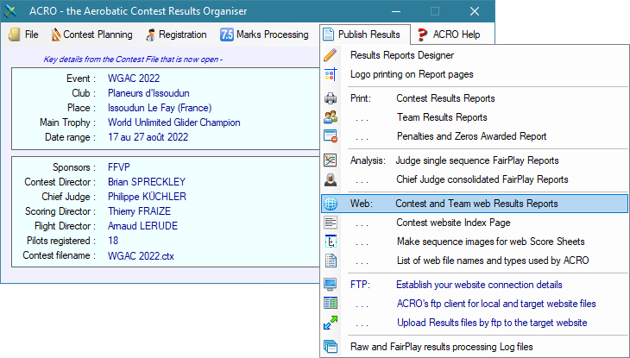
The ACRO scoring software includes both Raw Grade scoring and the CIVA FairPlay System
For ACRO – look at:
https://www.acro-online.net/
Includes a very detailed explanation of the complete FairPlay system

Slide 8


In ACRO -
Two useful analyses:
The Judges
Individual Analysis
The Judges
Overall Analysis

Slide 9
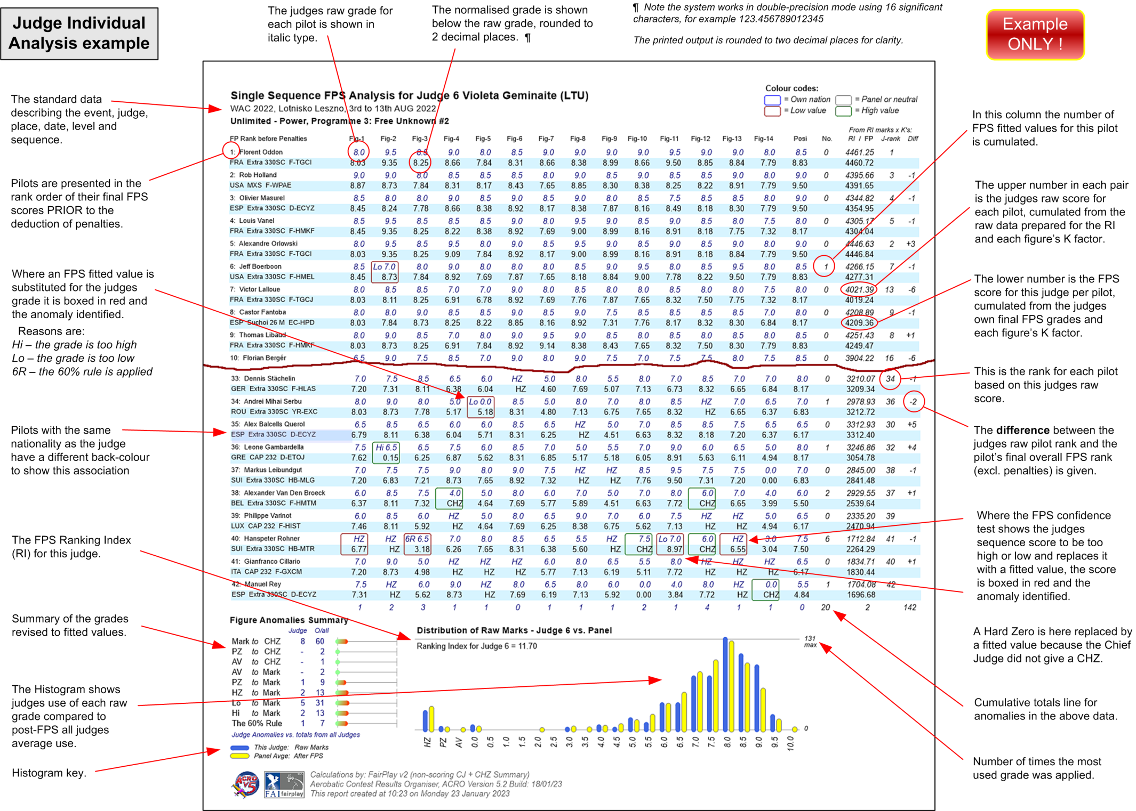
CIVA / FAI
Seminar

Slide 10

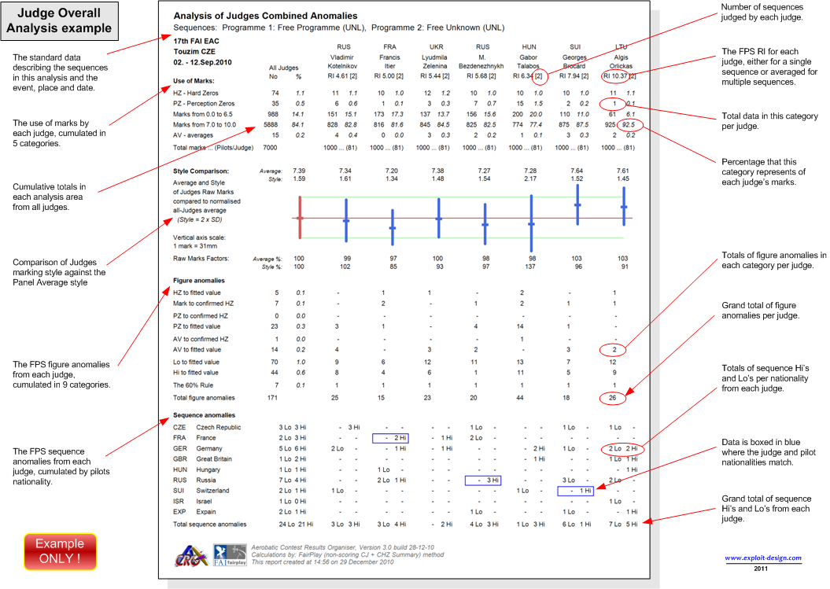
CIVA / FAI
Seminar

Slide 11
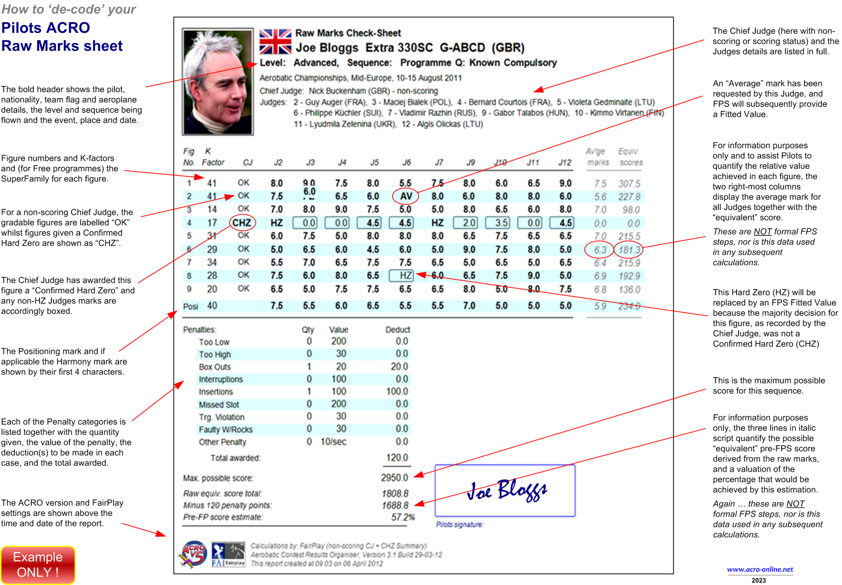
CIVA / FAI
Seminar

Slide 12

PILOTS . . .
AVOID LOWS: DON’T FLY
ANYWHERE NEAR THE LOW LINE !
Don’t get clever with the rules
Do not show off
Before you part with your Euros/$/Roubles . . . .
Read the Rules & Ask for Advice!
Get the opinion of your Team Manager
Check with the Chief Judge if the problem that you have is a technical issue
Be factual . . . . NOT emotive !

Slide 13



JUDGES and
PILOTS
Treat judges fairly EVEN IF YOU THINK THEY ARE rubbish !! They do actually work very hard
Do not expect them to favour the “Home Team”
Remember that during a competition a judge may have looked at as many as 4,500 figures, and He/She will make mistakes. That
is why we have at least 7 judges.

Slide 14
Open Forum
Go on – ASK A QUESTION !!
What do you think ?
What can you add ?
What else would you like explained ?
Feedback ?

