Slide 1
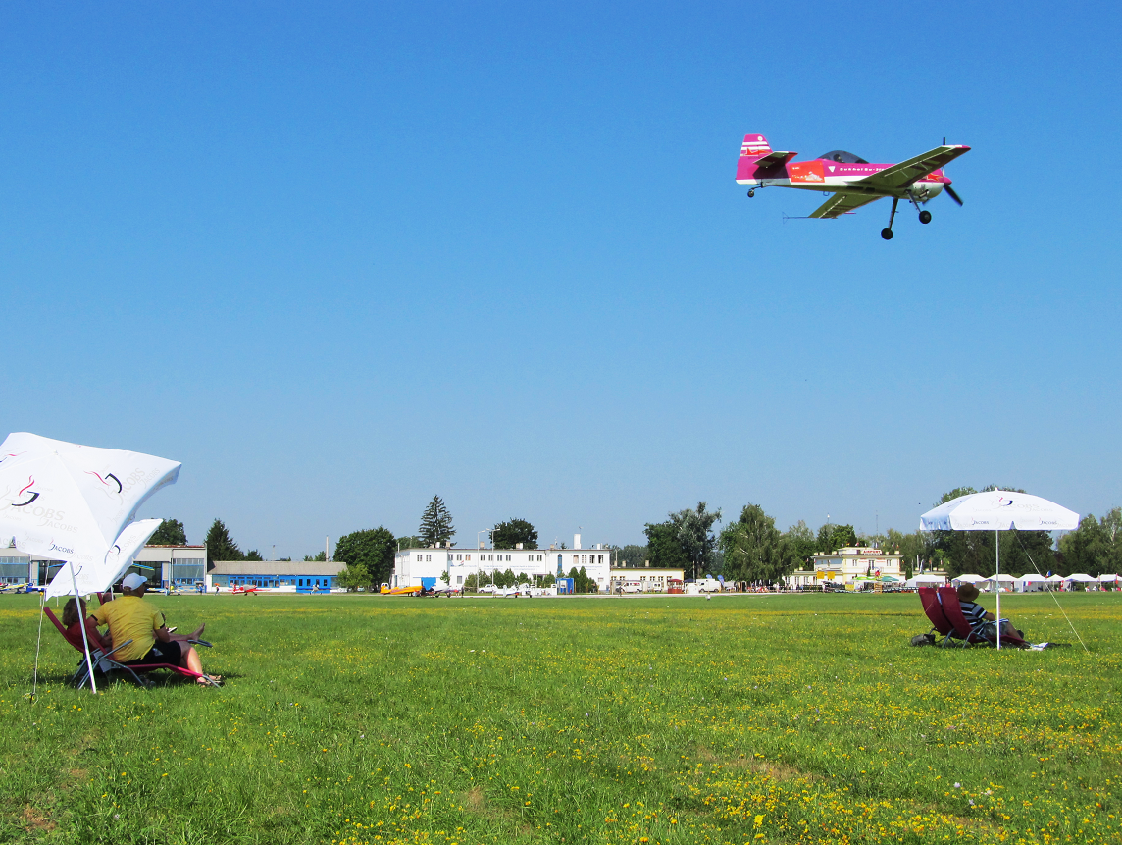
CIVA / FAI International
CIVA / FAI
Seminar
Aerobatic Judging Seminar
Part 3 – Problems, Positioning & Freestyle

Slide 2
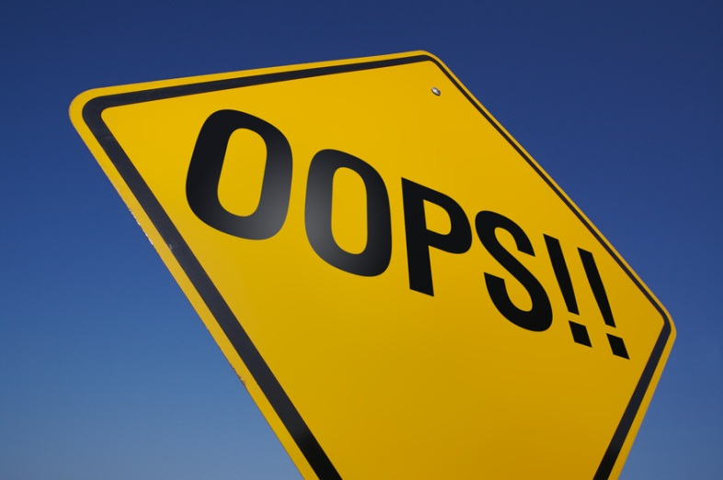
HANDLING MISTAKES
Keep calm. The judge should be able to sort it out immediately after the flight.
NEVER JUST “GIVE” A MARK. YOUR MARK MUST BE THE NUMBER OF ERRORS DEDUCTED FROM TEN
If in doubt give an “AV”. However … Judges must prepare for every flight in a professional manner. Give an “AV” only if you have been distracted from seeing the figure.
If there is a “mix up”, avoid trying to solve the problem immediately. Ask the caller to give you the number of the next figure so the scribe knows that the next mark given will apply to that
figure.

Slide 3
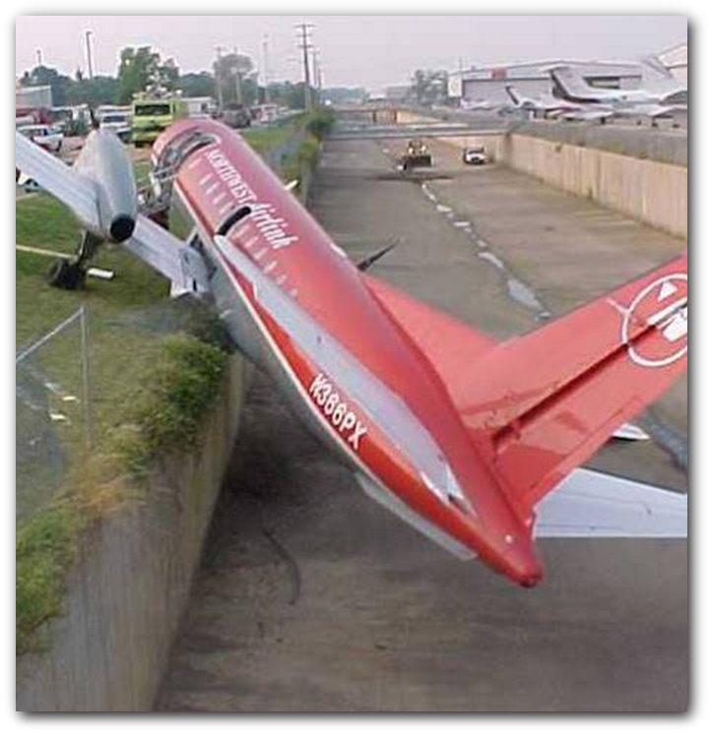
Pilot Mistakes
Be Prepared!
A pilot starts a figure which seems to bear no relation to the next form B/C …
Or a figure is not flown …
Or a sequence row is missed …
_______________
Try to match what you see to valid figures later in the sequence
BUT if the pilot realises his mistake he may revert back to the original sequence, and the figure may become classified as an Insertion. Be sure you know the correct rules for what to mark as 0.0, what to mark as HZ, and what to mark as normal …

Slide 4
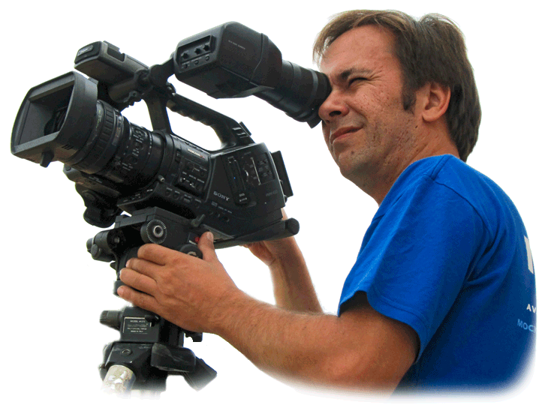
Video
Is used for matters of FACT
Any judge may call for the video even if he is the only judge who believes that there is an error of fact
It may be used to confirm gross under or over rotation, yaw / pitch of 90° or more; tail slide canopy up or down.
The judge must give his mark before calling to see the video, but is ALWAYS entitled to review the video afterwards

Slide 5
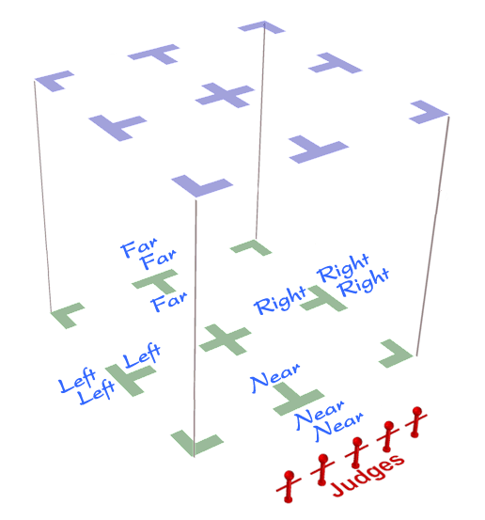
POSITIONING
The positioning mark is very important, and is often not given enough attention
The rules give good guidance on how to reach the correct mark
The position mark can often have the highest “K” factor on Form A
Using the Near Near - Far Far System is mandatory at CIVA events

Slide 6
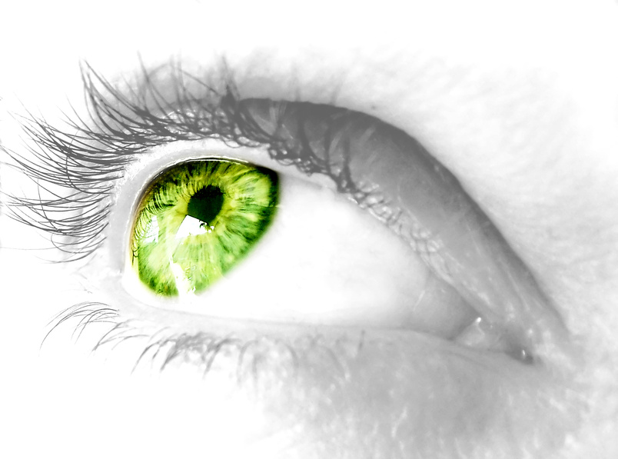
CIVA / FAI
Seminar
Now …
Just how
observant
do you
think you really are?
Run the ‘Monkey Business’ video

Slide 7
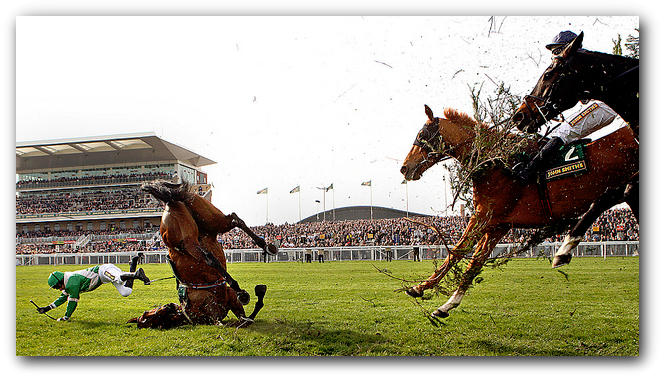
SOME HOT TIPS
Listen – watch – then judge honestly
A correctly held pencil will help correct for parallax with 45° attitude flight
Against a clear sky it is almost impossible to judge accurately the height of two loops without some reference point: Finger … pencil … pen !
Have the confidence to give the mark you know is right
Your job is to "nit pick" – pilots respect strict but fair judging
Do not be influenced by comments overheard from other judges
Manage your judging station firmly – you are the person in charge
Have a few large elastic bands to stop paper flapping on your clipboards

Slide 8
See … Check! … Grade
Remember ….
Humans react effortlessly when the eye-brain combination thinks it sees a recognisable event, and the brain immediately fetches and delivers a fixed answer. You have a huge store of these reactions.
Psychologists call this process Fast Thinking. It involves no logical reflection or assessment, and is normally very convincing
It can also blind you to REALITY – the reaction may be WRONG!
A careful judge will constantly check to ensure that the brains’ automatic reaction really does match what has actually happened.
This process is called Slow Thinking and it requires a positive effort to reassess things before the figure Grade can be settled.
Slow Thinking – truly re-examining what you saw – only happens when YOU make the effort to do it. Check, check, check!

Slide 9
Remember ….
THE KEY SKILLS ARE:
THE ABILITY TO DEDUCT MARKS ACCURATELY AND QUICKLY WHILE WATCHING A SEQUENCE
FULL KNOWLEDGE OF THE RULES
GOOD EYESIGHT (+ GLASSES!)
TEAMWORK

Slide 10
Remember ….
1
LEARN THE RULES: Print a full copy of the CIVA Section-6 Regulations, read the Judging Rules and understand how to apply them
2
PRACTICE “CALLING” for other Judges: Being able to Call is the best preparation
3
Get used to being a TEAM MEMBER: Judging is always a co-operative venture
4
Go and Scribe, then Call … then Judge

Slide 11
So: what is a Judge?
Detective
Examiner
Analyst
Interpreter
Reviewer
Theatre critic
Commentator
Pilot …
A competition aerobatic sequence is a demonstration of aeroplane control requiring extreme levels of technical ability and discipline from the Pilot.
The Pilot attempts to convince the Judges that the figures are flown exactly according to the rules.
The Judges view the performance to discover where the rules are not fully met. They award downgrades for imperfections and errors seen.
An aerobatic Judge uses ALL of these skills to mark the performance properly.

Slide 12
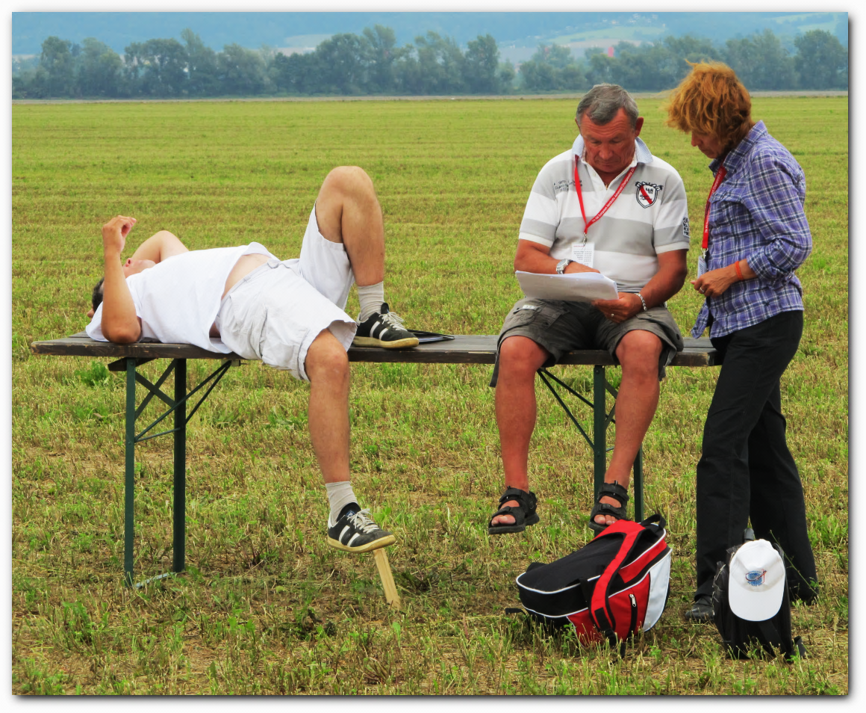
Judges Break #3

