Slide 1
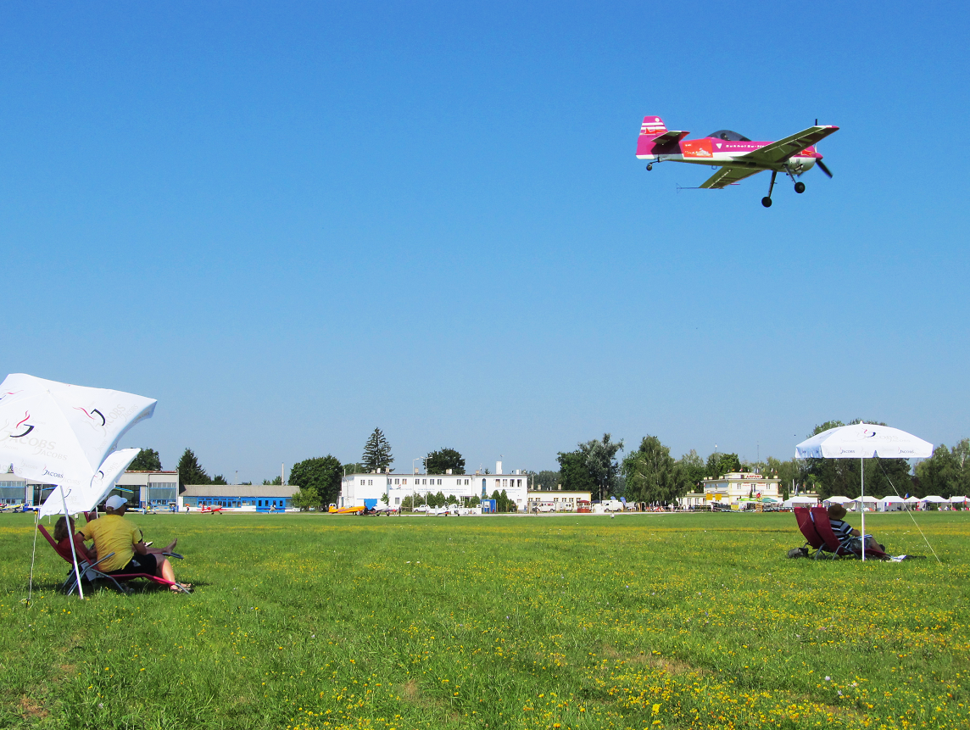

Aerobatic
Judging
Seminar
CIVA / FAI International
CIVA / FAI
Seminar
Part 2 – The Judging Process

Slide 2

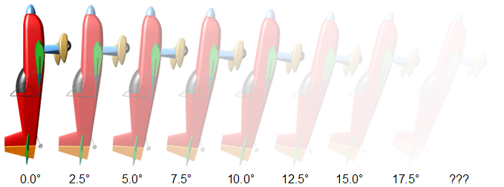
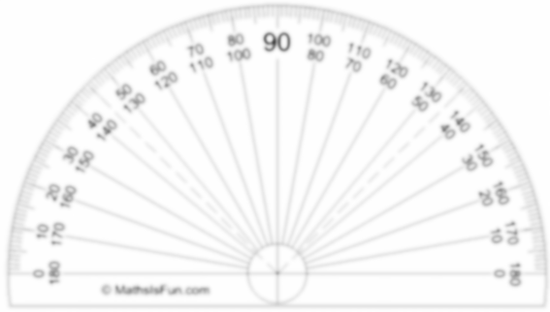

IS IT 45°? LET’S SEE!
How is your attitude?
How is your attitude?
How is your attitude?
Show the ‘Judging Attitudes x8’ PDF

Slide 3
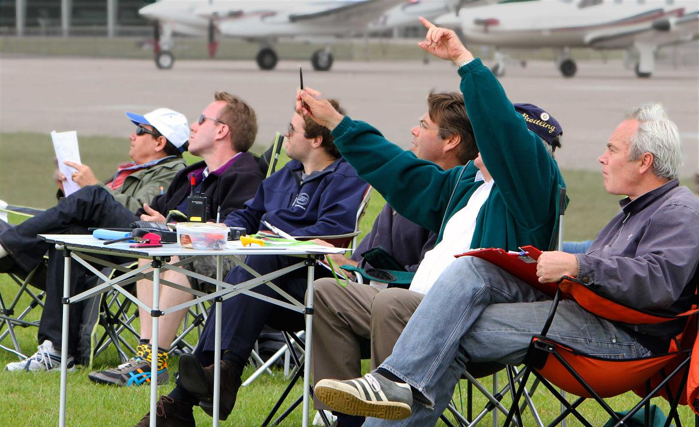
The process of judging
The Judging Team
Caller ~ Judge ~ Scribe
Get familiar with the sequence
Mark “opposites” & equal radii
The Judge has no paperwork:
The Caller and Scribe handle this
Never take your eyes off the aeroplane from box entry to exit
The Judge uses a pencil as a guide to lines and angles
The Caller describes each element “Just-In-Time”
The Judge observes, checks! judges, grades and comments
The Scribe notes the marks and the comments

Slide 4

Mark ONLY WHAT YOU SEE
1. The Judge
Judging must be objective. Check carefully, then assess and judge only what you see
If an aeroplane does not demonstrate the required criteria then a zero or the right downgrade must be given
If the required criteria for a flick are not seen you must not GIVE a mark because “I know that aeroplane and how it flies!”
If it didn’t flick / slide / spin then it must be given an HZ

Slide 5
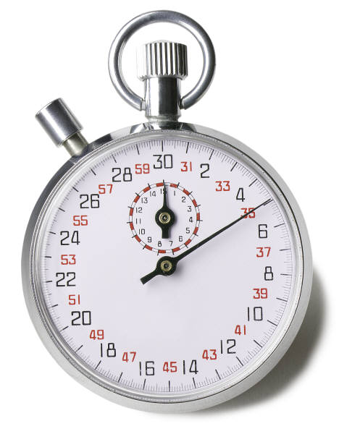
Creating Time
2. The Caller
Remain calm!
Call clearly and at the right speed to create time for the judge to concentrate on the small errors
The Caller is also responsible for helping the judge to spot gross errors: the Hard Zeros
The principle is:
Give a running commentary on the detail within the figure just before each item begins, including radii that should be the same, left / right / cross-box exit etc.
Saying the general outline of the figure FIRST can sometimes be useful, but more often leads to confusion with complicated figures. Don’t overcomplicate!
Always use the minimum of words to convey the maximum of information

Slide 6
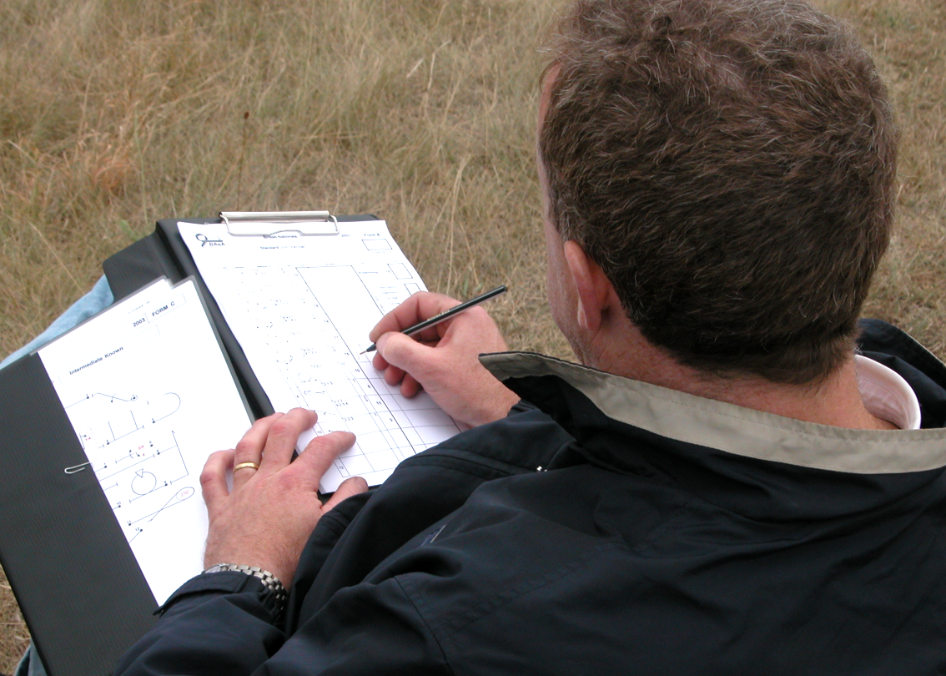
3. The Scribe
An experienced scribe
can assist in looking for
gross errors
He/she should repeat the
mark called by the judge
after each figure
The scribe listens for the
caller to say “End” and if the judge does not give a mark then he simply calls “Mark?”
The main job of the scribe is to write down the mark, and he must note the reasons for ZERO’s (HZ or 0.0)
If he has time to write other comments given by the Judge so much the better - pilots do appreciate it

Slide 7
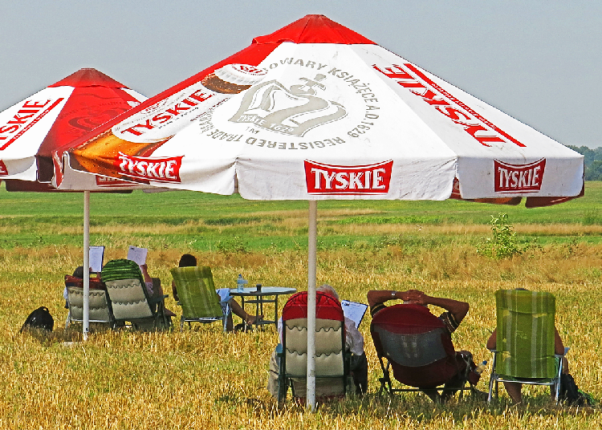
Remember : “Mark only what you see”
Compare these judges …
In the team on the LEFT the judge is dividing his attention between looking down at his Form-B and looking up to mark the figures.
Focus near, focus far … !
In the team on the RIGHT the judge is giving full attention to marking the figures
Judging requires unbroken attention.
A good CALLER and TEAMWORK are vital!

Slide 8
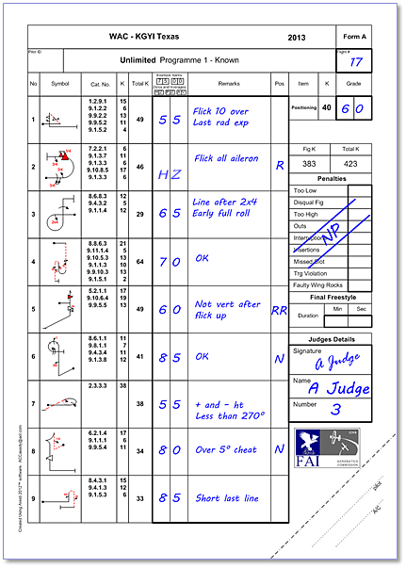
Marking the Forms
Flight number
Judge number and name
Make sure it is signed
Ensure the correct use of AV, HZ and 0.0
Position mark recorded
NP if no penalties

Slide 9
Calling Angles and Loops
Calling 1
Vertical
Horizontal
Loop
Push half loop
Pull half loop
45° up, positive
45° down, negative
3/4 loop
Push 3/4 loop
5/8 loop

Slide 10
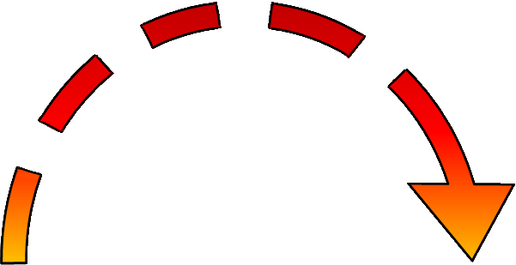
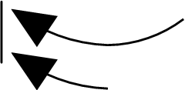

Pulling and Pushing
Calling 2
Stick forward
Push!
Stick forward
Push!
Stick forward
Push!
Stick back
Pull!
Stick back
Pull!

Slide 11
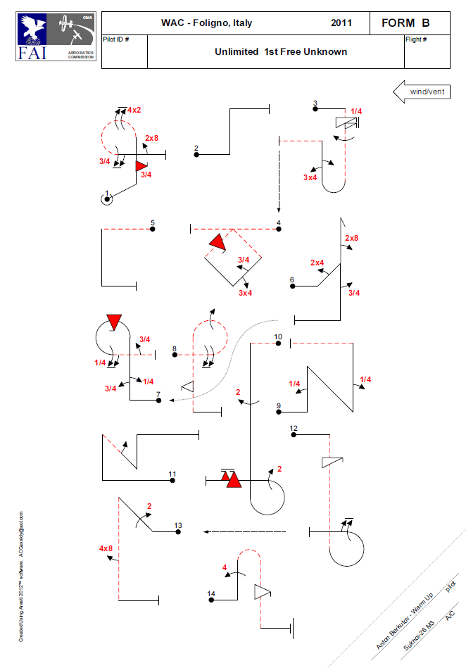
A demonstration:
Calling an Unlimited Sequence
Mark your Sequence Diagram
Radii that should be matched
Rolls that should be in the ‘same’ or ‘opposite’ directions
Tricky or key figure aspects
Call the Sequence
Watch the video through
The calling is “Just in Time”
Match the figure elements to the descriptions called
Listen to the judging … do you agree with the marks?
Run the two videos:
WAC-11 and US Nats 14 Free Unknowns

Slide 12
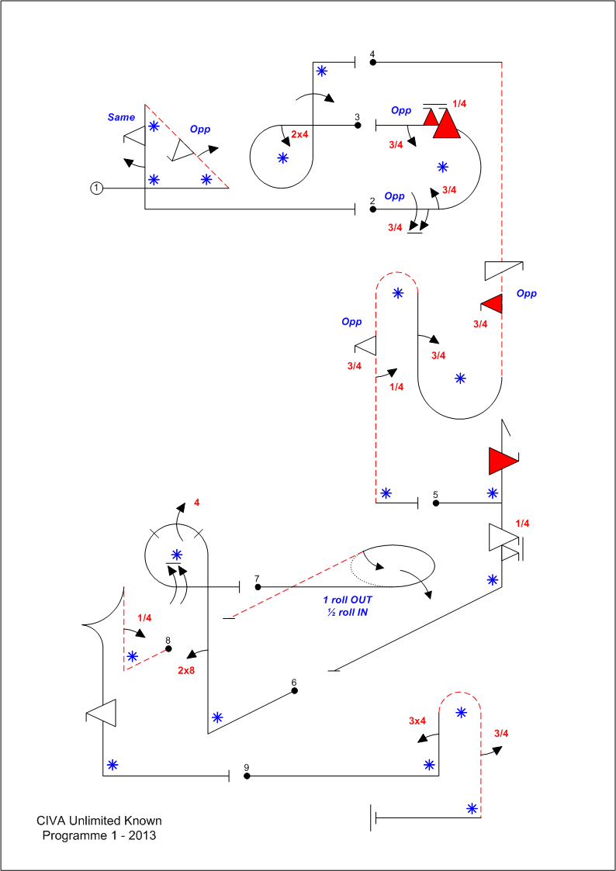
The Caller
Calling 3
CALLER
Figure one. Pull to 45° inverted, opposite half roll then half positive flick, (looks up and says “opposite was OK"), pull down to vertical, same direction half positive flick then half roll, pull erect, exit right. End.
JUDGE
45° OK … roll good … flick 10° over and corrected … vertical OK … snap and roll good … short line after … last radius bigger at end … position OK. Five point five.
SCRIBE
Five point five
CALLER
Figure two. Opposite one and three quarters roll then three quarters roll back, pull half loop up (waits till near the top of loop), opposite one and a quarter negative flick then three quarters roll, exit left erect. End.
JUDGE
5° over 1st roll … snatched into loop … flicked early but hardly any yaw … it’s all aileron so HZ … three quarters good. Position right, Hard Zero.
SCRIBE
PZ because not snapped ... Right
CALLER
Figure three. Two by four roll to inverted, three quarters loop down (waits until nearly vertical), full roll, push off right erect. End
JUDGE
Line after two by four roll … second roll was early … Position left. Six point five.
SCRIBE
Six point five … Left

Slide 13
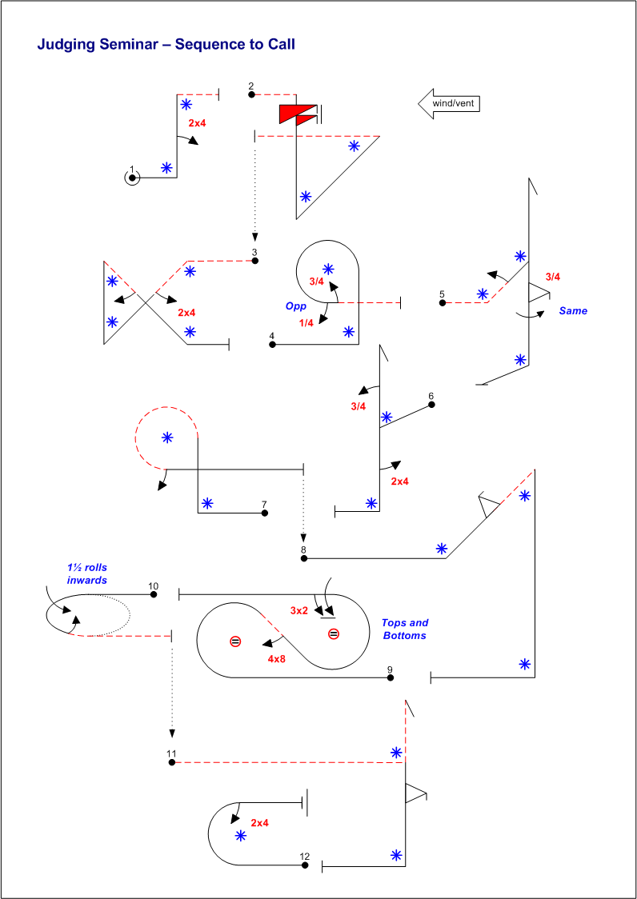
Practice Calling
Don’t be shy now …. !
1. Mark the Sequence Diagram
Radii that should be matched
Rolls that should be in the ‘same’ or ‘opposite’ directions
Tricky or key figure aspects
2. Call the Sequence
Be clear and concise
Use minimum words for
maximum information
Watch for major errors
Exit direction is important
Remember to say “End” when each figure is finished

Slide 14
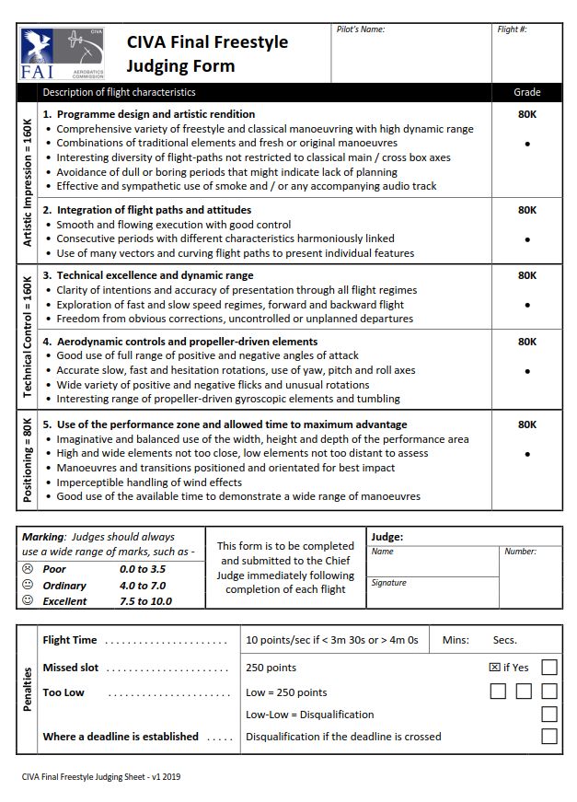
The 4 minute Final Freestyle
A change from OBJECTIVE to SUBJECTIVE Judging!
Remember: it is the relative marks that matter, NOT the marks themselves
You must hand in your marks sheet after EVERY FLIGHT
Use the REFERENCE sheet to keep track of how you grade each competitor

Slide 15
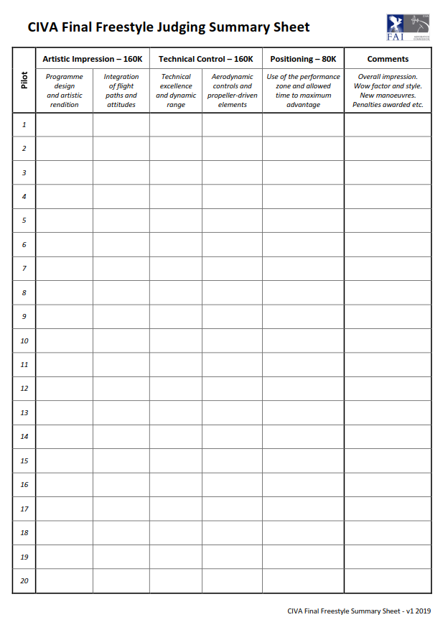
Use this reference sheet to record how you grade every competitor, so you can ensure that they all get a balanced and fair set of marks.

Slide 16
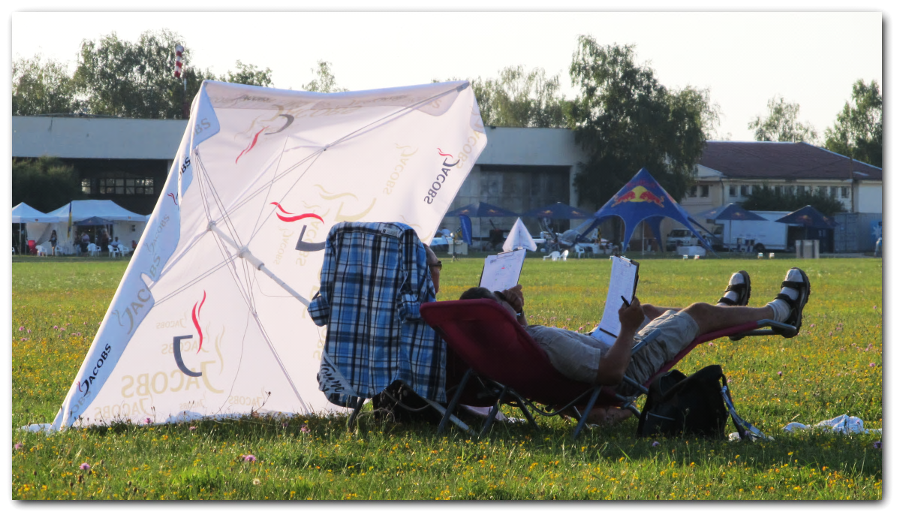
Judges Break #2

