Slide 1
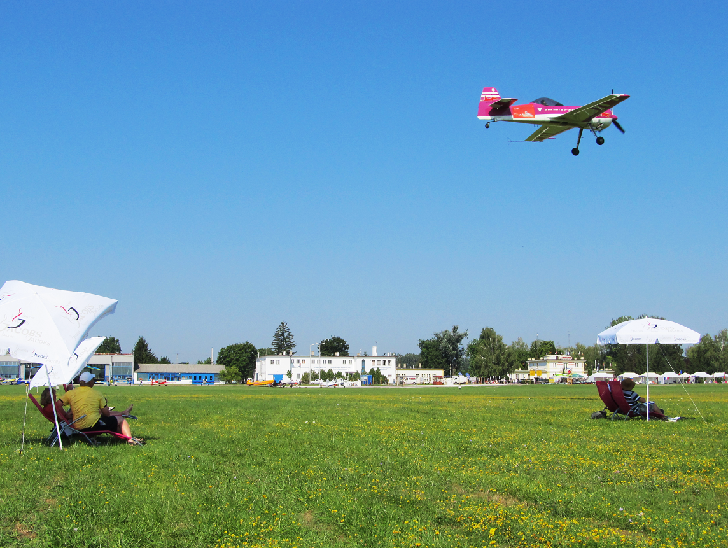
Aerobatic Judging Seminar
CIVA / FAI International
CIVA / FAI
Seminar
Part 1 – Introduction and Rules

Slide 2
What IS a Judge?
Detective
Examiner
Analyst
Interpreter
Reviewer
Theatre critic
Commentator
Pilot …
A competition aerobatic sequence is a demonstration of aeroplane control requiring extreme levels of technical ability and discipline from the Pilot.
The Pilot attempts to convince the Judges that the figures are flown exactly according to the rules.
The Judges view the performance to discover where the rules are not fully met. They award downgrades for imperfections and errors seen.
An aerobatic Judge must use ALL of these skills to mark the performance properly.

Slide 3
See … Check! … Grade
Humans react effortlessly when the eye-brain combination thinks it sees a recognisable event, and the brain immediately fetches and delivers a fixed answer. You have a huge store of these reactions.
Psychologists call this process Fast Thinking. It involves no logical reflection or assessment, and is normally very convincing
It can also blind you to REALITY – the reaction may be WRONG!
A careful judge will constantly check to ensure that the brains’ automatic reaction really does match what has actually happened.
This process is called Slow Thinking and it requires a positive effort to reassess things before the figure Grade can be settled.
Slow Thinking – truly re-examining what you saw – only happens when YOU make the effort to do it. Check, check, check!

Slide 4
The KEY SKILLS are:
Aerobatic Judging …
THE ABILITY TO DEDUCT MARKS ACCURATELY AND QUICKLY WHILE WATCHING A SEQUENCE
FULL KNOWLEDGE OF THE RULES
GOOD EYESIGHT (+ GLASSES!)
TEAMWORK

Slide 5
Training to BE a Judge
1
LEARN THE RULES: Download and print a full copy of the P or G CIVA Section-6 Regulations, read the Judging Rules and understand how to apply them
2
PRACTICE “CALLING” for other Judges: Being able to Call is by far the best preparation!
3
Get used to being a TEAM MEMBER: Judging is always a co-operative venture
4
Go and Scribe, then Call … then Judge

Slide 6
Seminar Topics
The Basics
Understand the Judging Rules
Recognise aircraft ‘Attitudes’
The Zeros
Sequence Calling in the lecture room:
Explain every figure to the Judge
The Process of judging:
Teamwork
Handling mistakes and using the Video
Positioning
Practical Scribing, Calling and Judging on the airfield
An explanation of FPS and the Judging Analysis
What does it do?
Reading the Analysis

Slide 7
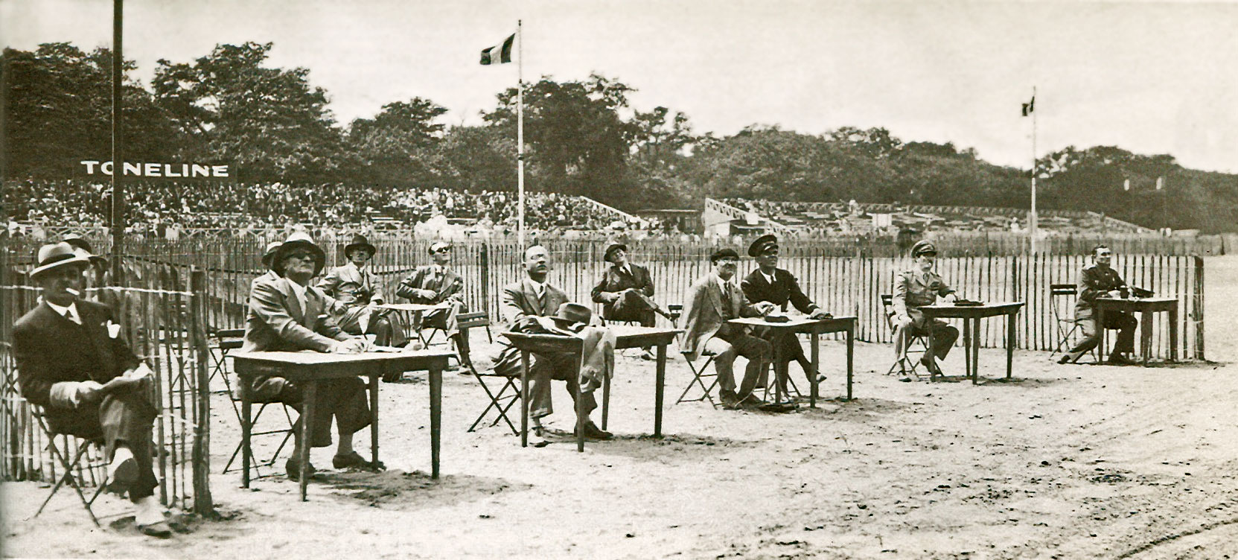
This is JUDGING 1934 Style!

Slide 8
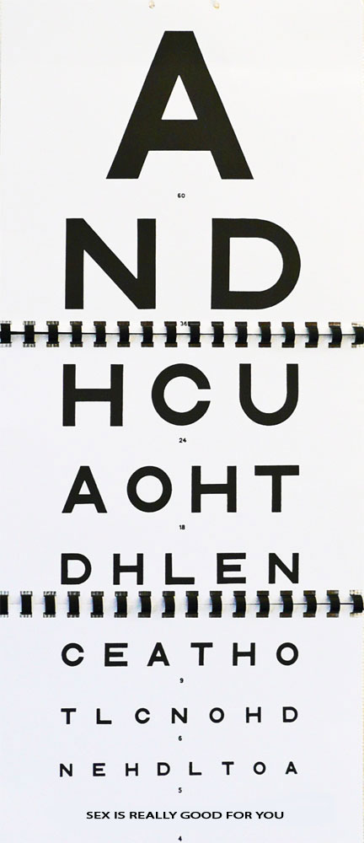
Eye test anyone ??

Slide 9
OK - THE BASICS
Have a spare pair of glasses, sun glasses too
Take a comfortable chair, an umbrella etc.
Take some sun screen – don’t be the sun-burned Judge!
Have some spare pens and pencils
Have a good sun hat
Drink plenty of water
Get up and walk around regularly between sequences
Take a copy of the appropriate rules
Have a spare clipboard and some elastic bands
Take some peppermints or sweets – you’ll talk a lot ….

Slide 10
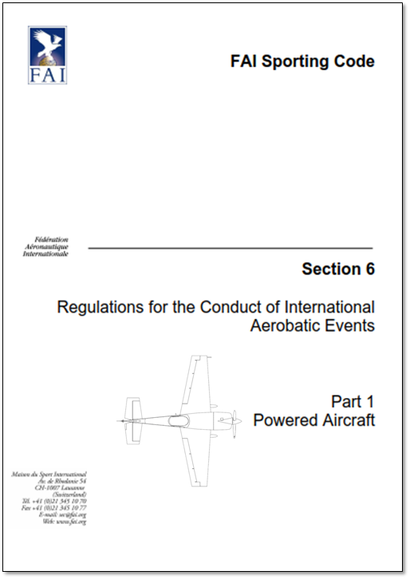
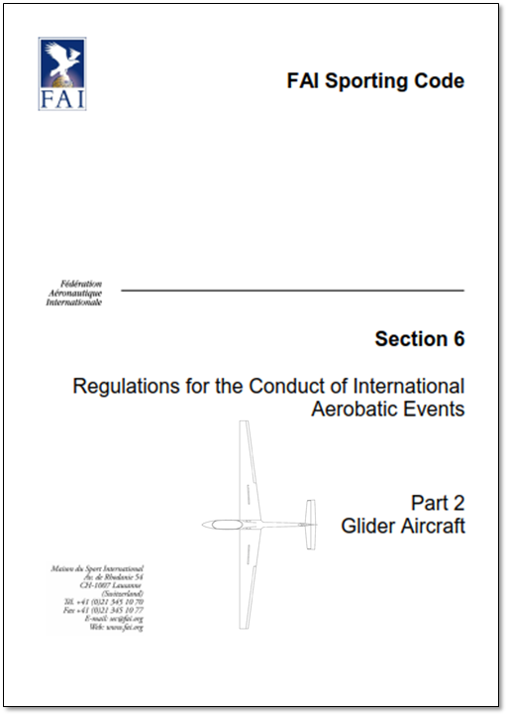
We need to KNOW the RULES
Make sure that you have the most up to date rules!
The CIVA Section-6 Regulations are updated and published every year:
On the CIVA News website at: https://www.civanews.com/the-civa-document-store/
On the FAI / CIVA website at: https://www.fai.org/civa-documents

Slide 11
CIVA / FAI
Seminar
Common RULES are Essential
For EVERY aspect of what we do –
Judges preparing …
Pilots in training …
Designing sequences …
Chief Judge / panel discussions …
The application of a fixed or standard set of RULES is the fundamental ‘glue’ that makes sure we can all be confident of predictable marks, scores and results.
Never "adapt" or "invent" your own downgrades if you think the rule book is wrong - always follow the rules!

Slide 12
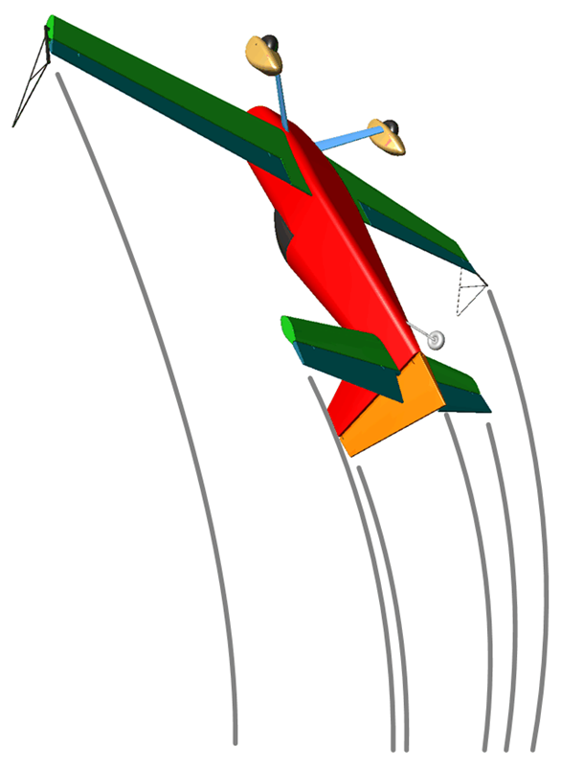
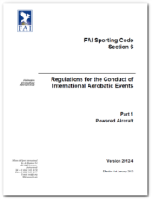
2023 CIVA Rules
RULES RULES RULES RULES
Zoom around
the CIVA Rules!
Run ‘Zoom Round the Rules’ PowerPoint

Slide 13
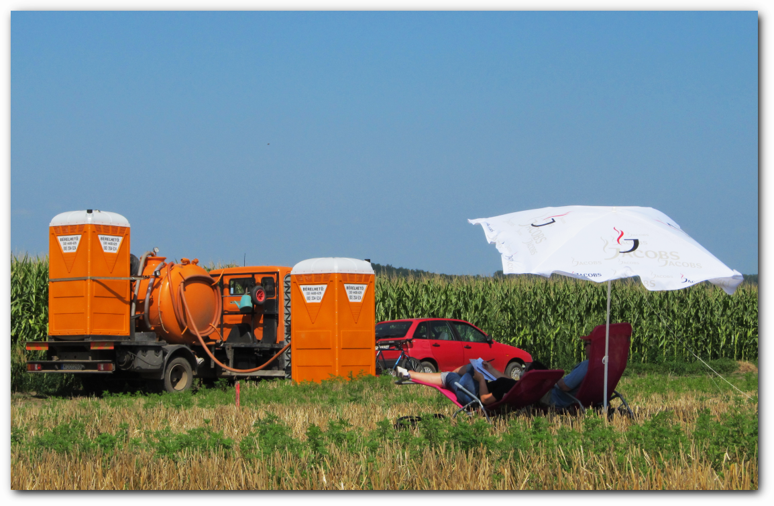
Judges Break #1

