Slide 1
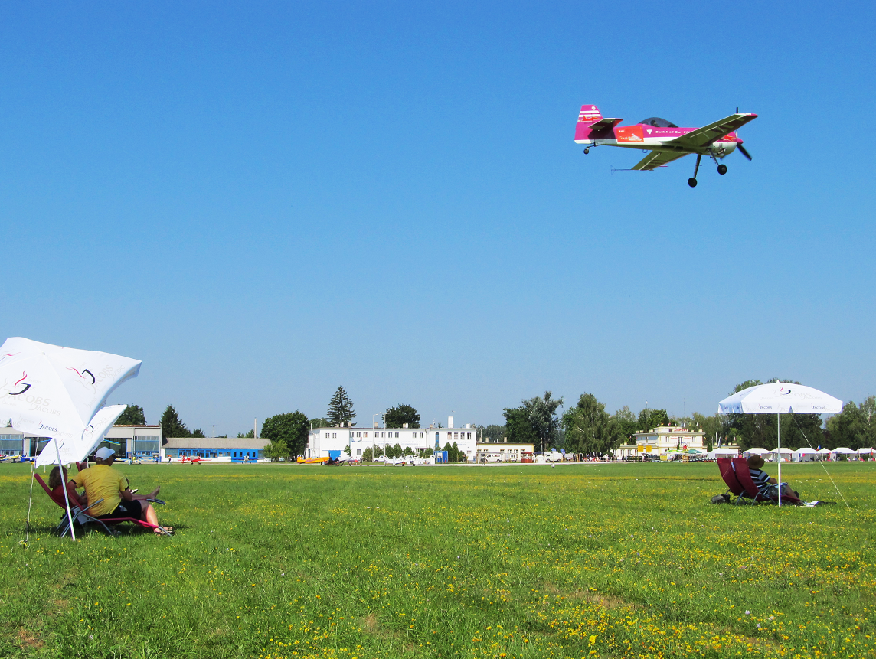
Aerobatic Judging Seminar
CIVA / FAI International
CIVA / FAI
Seminar
Before we start …
How do YOU think you think?

Slide 2
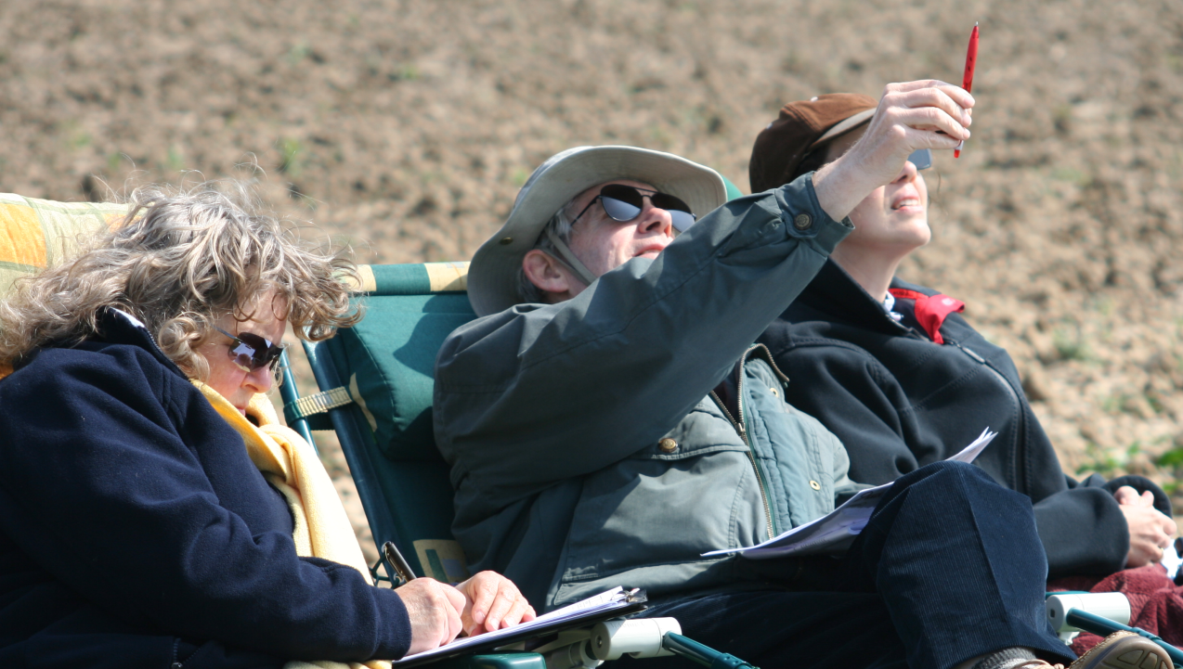
Thinking: Fast and S-l-o-w
CIVA / FAI
Seminar

Slide 3
You probably think you spend most of your day making decisions …
WRONG!
85% of the time you are simply REACTING and doing stuff from memory
15%

Slide 4
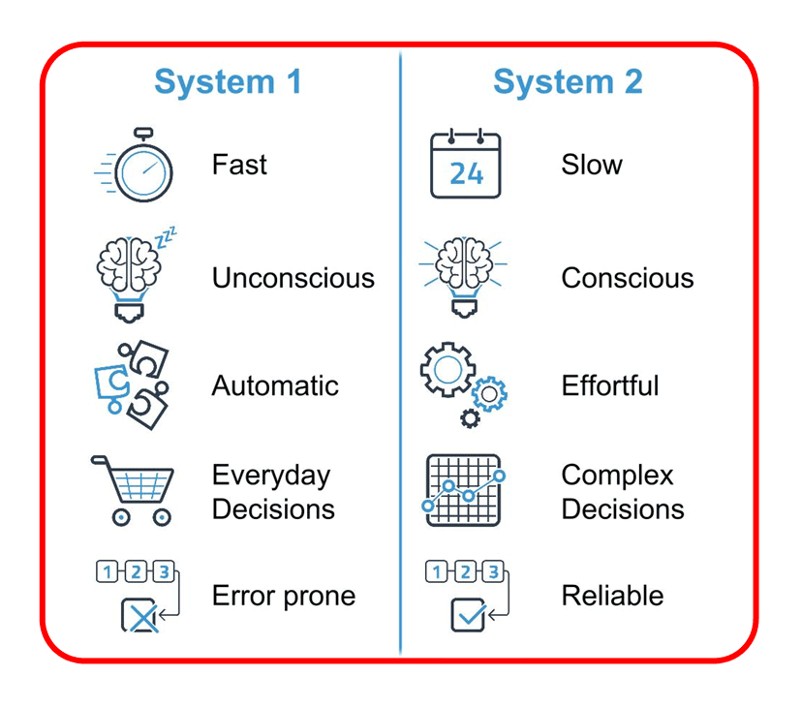
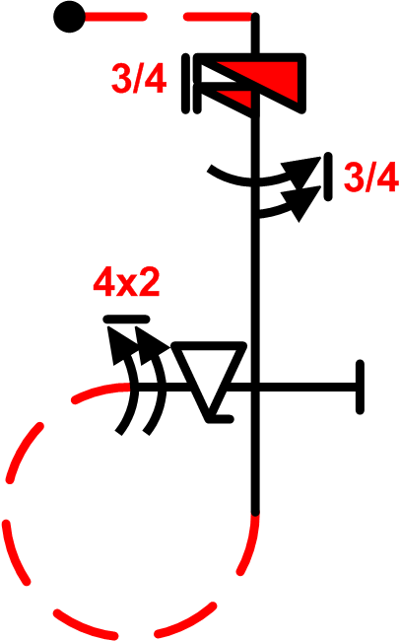
THINKING
CIVA / FAI
Seminar
Fast
S-l-o-w
3 quick thoughts …
20 careful
decisions?

Slide 5
CIVA / FAI
Seminar
a) . . . . . . . . . . . . . . . . . . . . . . . . . . . . . . . . . . . b)
Baby > youngster > teenager > adult > Real World
a) Learning to React vs. b) Learning to T-h-i-n-k
Reactions are “System-1” – fight or flight, instant conclusions
Thinking is a “System-2” process – needs logical deductions

Slide 6
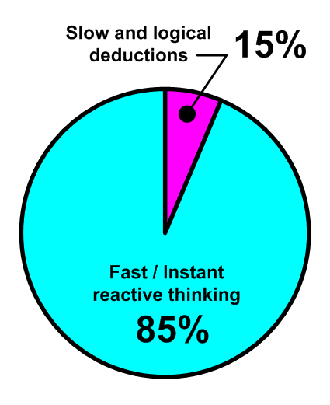
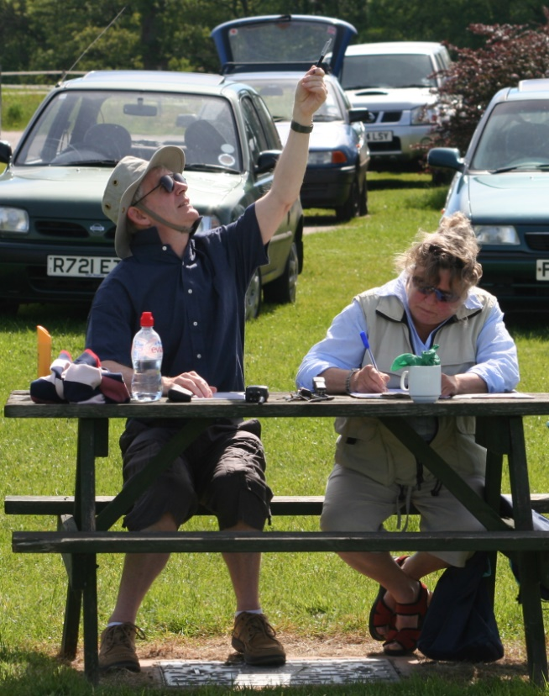
Your day is normally spent …
CIVA / FAI
Seminar

Slide 7
CIVA / FAI
Seminar
Fast thinking always comes from MEMORY
-------------
S-l-o-w thinking comes from ANALYSIS
-------------
These two things don’t work together !

Slide 8
Most of the time aerobatic Judging requires immediate assessment of part or whole figures = Fast thinking
CIVA / FAI
Seminar

Slide 9
Sometimes the Judge has to pause and reassess what he or she believes has been seen …
This is a major change to S-L-O-W thinking
CIVA / FAI
Seminar

Slide 10
Be very careful!
Fast and S-l-o-w thinking do not mix well or complement each other
CIVA / FAI
Seminar

Slide 11
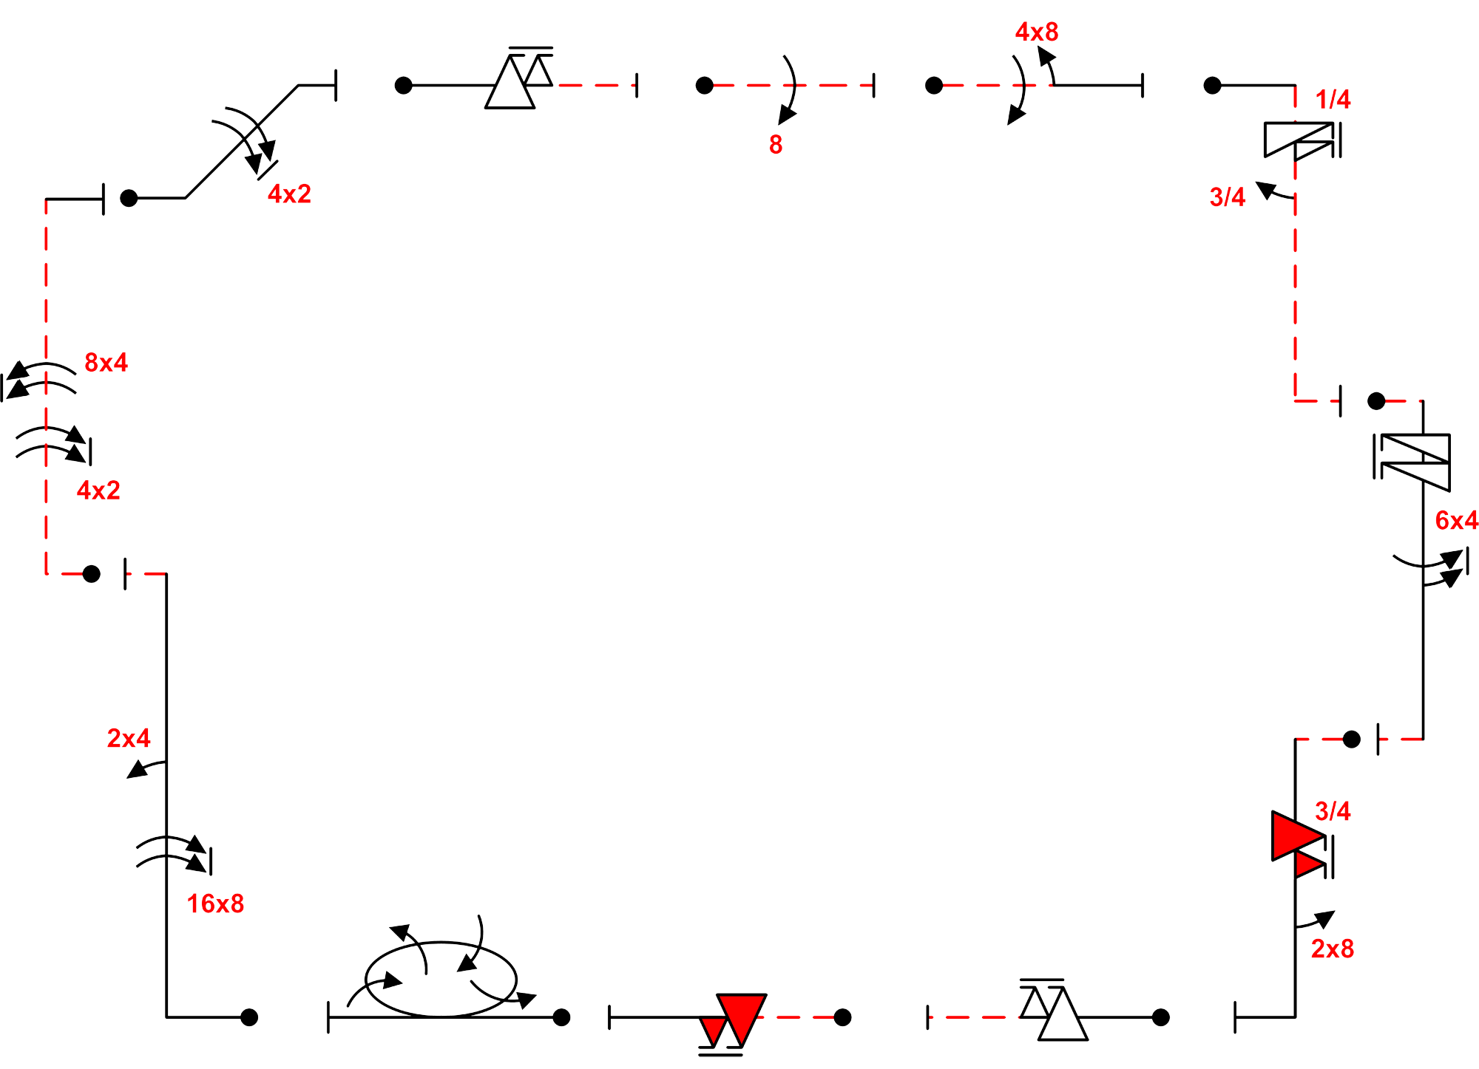
Did it hesitate … ? Were they opposite …?
How many … ?
Fast … S l o w

Slide 12
Believe what you see
Trust your confidence
Keep moving forwards
Review after each flight
CIVA / FAI
Seminar
You WILL make mistakes!!

Slide 13
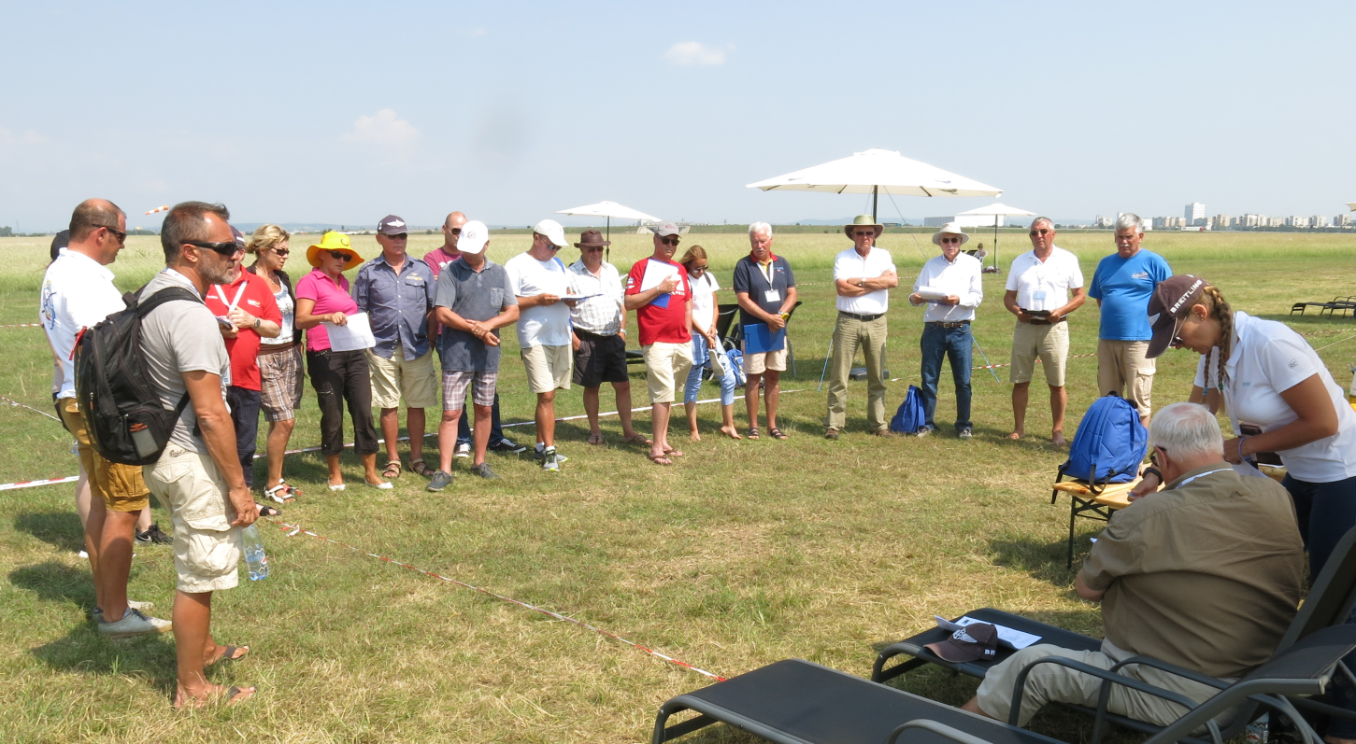
CIVA / FAI
Seminar
This is why we have these …

Slide 14
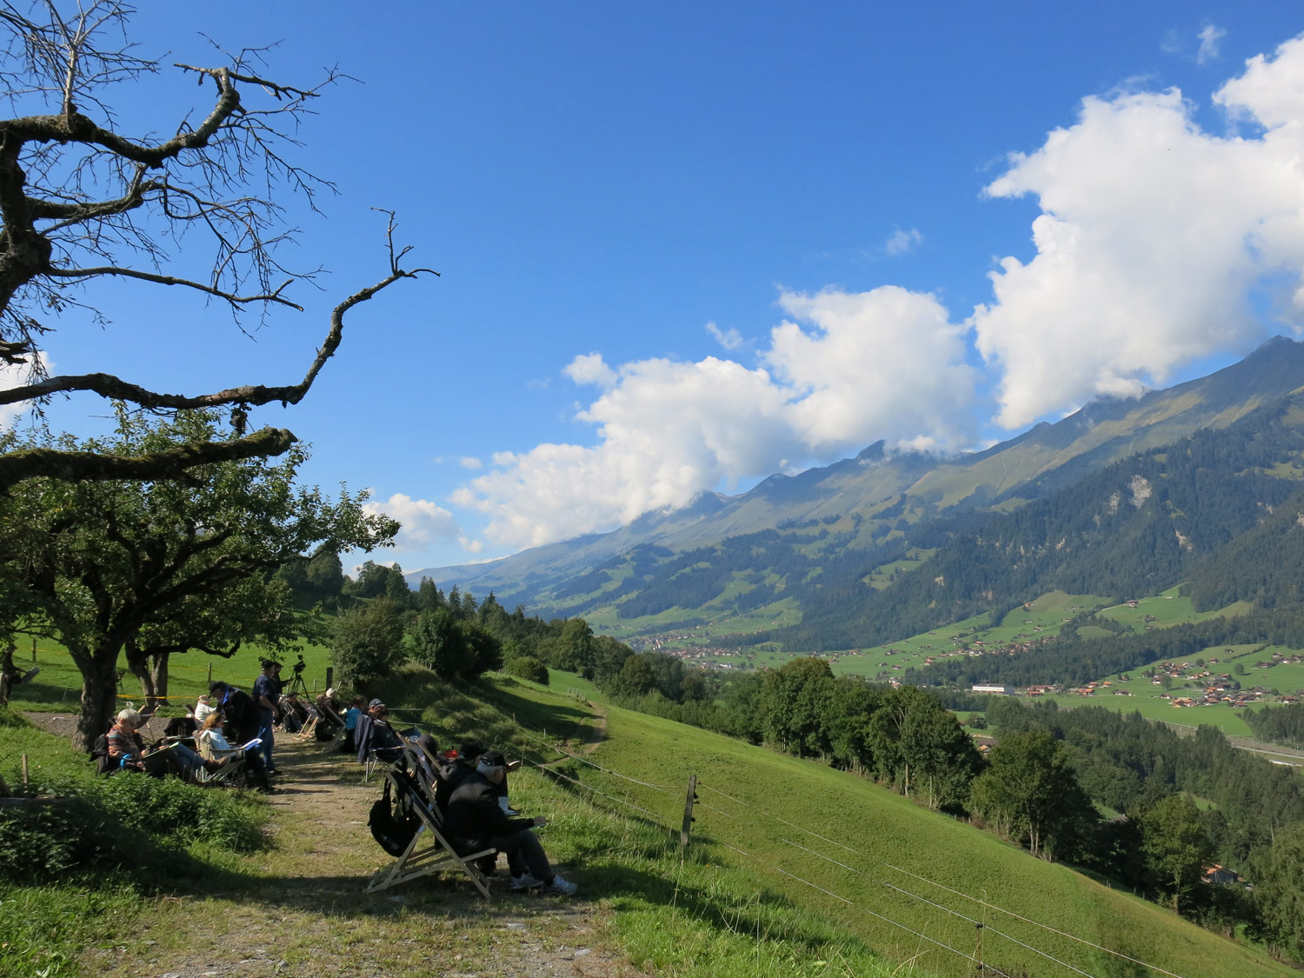
Judges (very short) Break #1
CIVA / FAI
Seminar

